Slide 1

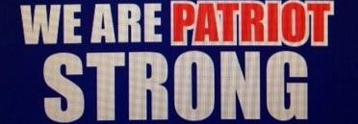
Week 10
Diction: Connotations, Irony, and Symbols

Slide 2

Monday October 26, 2020
Connotations, Symbols, and Irony check up Wednesday November 4
Learning Target(s)
Students will learn label sentence parts
Students participate in a survey about the previous 9 weeks
Get a computer and login to Teams through Classlink.
Activities:
Book Log 16p.5
Signpost reference page correction
1st 9 weeks survey
Notebook Organizing
First day of book projects is tomorrow. Get signed up if you have not.
Connotations, Symbols, and Irony check up Wednesday November 4

Slide 3
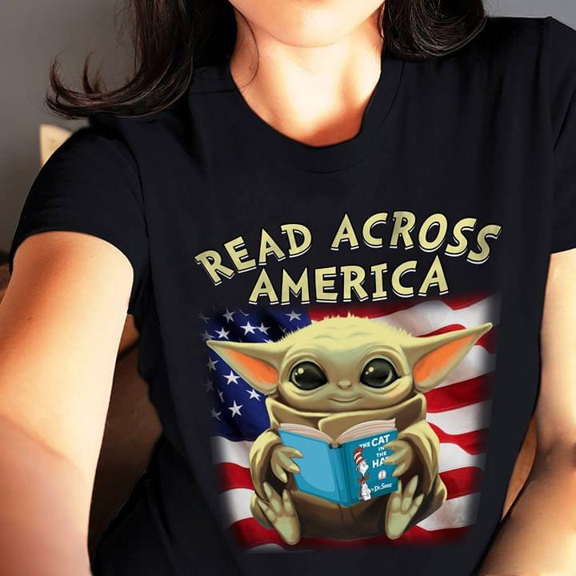
Reading Time
Don’t forget to log your progress in your book log section.
You may go to the library if you need to check out a book or return a book at this time.

Slide 4
1st 9 weeks survey
WE ARE….
In Teams under the post is a survey that I want you to take. Once you have taken it, log out of your computer and place it back in the COW container in its proper spot.
After you have put your computer back, take out your notebook so that we can make sure it is organized
Turn to page 20 of your notes where you have the signpost answer frames. We are going to add a missing piece to the words of the wiser answer frame. Add the following at the end below the answer frame: This may affect the character by ______________.
Once you have added that, continue organizing your folder.
When you finish organizing your folder go back to reading your book.
Patriot Strong!

Slide 5
Tuesday October 27, 2020
Connotations, Symbols, and Irony check up Wednesday November 4
Learning Target(s)
Students will be introduces to sentence structure element identification and labeling.
Students will analyze choices made concerning signposts, comprehension answers, and story elements in “Spotlight.”
Activities:
Book project presentations
Bell Ringer 25 p.7
Book Log 17p.5
Review of “Spotlight” work over the elements of short stories and signposts
Connotations, Symbols, and Irony check up Wednesday November 4

Slide 6
Bell Ringer: Parts of a Sentence
Connotations, Symbols, and Irony check up Wednesday November 4
WE ARE….
Nouns: Persons, places, things, ideas
Verbs: actions!
Find these and you’ve found 3 parts of your sentence
Patriot Strong!
Connotations, Symbols, and Irony check up Wednesday November 4

Slide 7
Subject
Subject- Who or What the sentence is talking about; the main noun in the sentence
Types of subjects: Simple, Full, and Compound
Examples
Simple subject: Kate is a thin girl.
Full subject: Jeffrey's poem about his mother made the class cry.
Compound subject: Paul and Tommy joined the soccer team at the same time.
S
s
S
S

Slide 8
Predicate (Verb or Verbal phrase)
Predicate: Tells what is being done in the sentence. It is the verb in the sentence.
There are 3 types of predicates: Simple, full, and Compound
Examples
Simple predicate: Harry ate his apple.
Full predicate: The mouse slowly ran towards the food.
Compound predicate: She both laughed and cried at the film
p
p
p
p

Slide 9
Objects
Nouns that do not take predicates (verbs).
Examples
He kicked the can.
She threw the paper ball at Eric.
Charity is important to humanity.
o
o
O
o

Slide 10
Bell Ringer: Parts of a Sentence
Connotations, Symbols, and Irony check up Wednesday November 4
WE ARE….
Directions: Parts of speech: Directions: Label the parts of speech in the following sentences. Use the following symbols to identify the Parts of speech: Common noun= n, proper noun = N, verbs = v, Pronouns= Pro, Adjectives= Adj, Adverbs= Adv, Prepositions= prep, Coordinating Conjunctions= cc, Subordinate conjunctions=sc, Articles= art
Vampires Dairies is my favorite television show, but I also love True Blood.
Directions: Label each part of the sentence using the following abbreviations: Subject= S for proper nouns and s for regular nouns, Predicate=p, and Object= O for proper nouns and o for regular nouns.
2. Vampires Dairies is my favorite television show, but I also love True Blood.
Patriot Strong!
Connotations, Symbols, and Irony check up Wednesday November 4

Slide 11
Bell Ringer answers
Connotations, Symbols, and Irony check up Wednesday November 4
WE ARE….
Vampires Diaries is my favorite television show, but I also love True Blood.
Vampires Diaries is my favorite television show, but I also love True Blood.
N
v
Pro
adj
adj
cc
n
v
N
n
adv
S
p
o
S
p
O
Patriot Strong!
Connotations, Symbols, and Irony check up Wednesday November 4

Slide 12
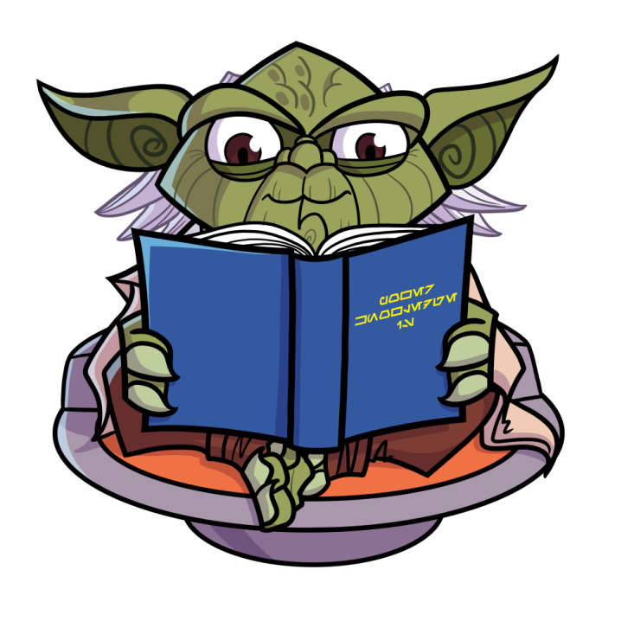
Reading Time
Don’t forget to log your progress in your book log section.
You may go to the library if you need to check out a book or return a book at this time.

Slide 13
Elements of short stories and Signpost review: “Spotlight”
Connotations, Symbols, and Irony check up Wednesday November 4
WE ARE….
Areas Review:
Setting- not being specific enough
Protagonist and Antagonist- Protagonists are not always heroes. Antagonists depend on the main conflict.
Theme: It is a full statement about the subject. Good: Being stressed about the first day of high school does not make the day go smoother, or It’s better not to speak when what you may say may cause more issues. Bad: Be more confident; Express yourself more; It’s better not to speak.
Patriot Strong!
Connotations, Symbols, and Irony check up Wednesday November 4

Slide 14
Elements of short stories and Signpost review: “Spotlight” continued
Connotations, Symbols, and Irony check up Wednesday November 4
WE ARE….
Point of view- choose between the 3 listed on the left
Type of Conflict- Man vs ? The type of main conflict should match the antagonist in the story. Man vs man should have a person as listed, man vs society should have the society as a whole or as many of the parts of society needed, man vs nature should have some sort of natural issue listed, and man vs self should have the internal conflict named as the antagonist.
Internal Conflict- Most did well here
External conflict- The only real external conflict is with the teacher. The mash potatoes hitting her was not implied to be a conflict with her and the people who threw them. She is not having a conflict with the potatoes themselves.
Patriot Strong!
Connotations, Symbols, and Irony check up Wednesday November 4

Slide 15
Elements of short stories and Signpost review: “Spotlight”
Connotations, Symbols, and Irony check up Wednesday November 4
WE ARE….
Plot Diagram:
Exposition: 3 things needed here. Characters in the beginning part of the story, place it is happening, and what the conflict is.
Rising action ¾ of the story will be this.
Climax- always closer to the end than any other part of the story. Look for an important event or decision that leads to the protagonists major problem being solved in some way.
Falling action- important events after the climax
Resolution the final result of the story.
Patriot Strong!
Connotations, Symbols, and Irony check up Wednesday November 4

Slide 16
Elements of short stories and Signpost review: “Spotlight” continued
Connotations, Symbols, and Irony check up Wednesday November 4
WE ARE….
Signposts
C&C: Most everyone is doing fine finding a contrast and contradiction. The problem is not everyone is explaining what makes it a contrast and contradiction in a way that makes sense.
Bad Example: In paragraph 4 it states, “I could sit across from her. Or I could crawl behind a trash can. Or I could dump my lunch straight into the trash and keep moving right on out the door.” This is an example of contrast and contradiction because why would you buy lunch and not eat it? She is probably doing that because she really isn’t hungry.
Why is this a bad example?
Patriot Strong!
Connotations, Symbols, and Irony check up Wednesday November 4

Slide 17
Elements of short stories and Signpost review: “Spotlight”
Connotations, Symbols, and Irony check up Wednesday November 4
WE ARE….
Signpost:
C&C:
Good example: In paragraph 4 it states, “I could sit across from her. Or I could crawl behind a trash can. Or I could dump my lunch straight into the trash and keep moving right on out the door.” This is an example of contrast and contradiction because she wants to eat lunch but she is self-conscious and afraid of what others will think of her. She is probably doing this because she feels uncomfortable around people who know who she is since she made note that she could sit by the new girl.
Why is this a good example?
Patriot Strong!
Connotations, Symbols, and Irony check up Wednesday November 4

Slide 18
Elements of short stories and Signpost review: “Spotlight” continued
Connotations, Symbols, and Irony check up Wednesday November 4
WE ARE….
Signposts
Aha moment: Make sure that you know who is having a moment of realization about something. Make sure it is not you but one of the characters.
Bad Example: In paragraph 6 it states, “Thwap! A lump of mash potatoes hit me…” This is an aha moment because who would expect her to spill mash potatoes on herself. This might change things because she will have to change her shirt.
Why is this a bad example?
Patriot Strong!
Connotations, Symbols, and Irony check up Wednesday November 4

Slide 19
Elements of short stories and Signpost review: “Spotlight”
Connotations, Symbols, and Irony check up Wednesday November 4
WE ARE….
Signpost:
Aha moment:
Good example: In paragraph 6 it states, “Thwap! A lump of mash potatoes hit me…” This is an aha moment because she understands that many people will remember this moment happening to her for a long time and it will be come a part of her reputation. This might change things by causing the girl to stop going to school or becoming depressed.
Why is this a good example?
Patriot Strong!
Connotations, Symbols, and Irony check up Wednesday November 4

Slide 20
Elements of short stories and Signpost review: “Spotlight” continued
Connotations, Symbols, and Irony check up Wednesday November 4
WE ARE….
Signposts
Tough Question: Make sure this question is not one you have but one that the character has. You are looking for a tough decision that someone has to make. Make sure the character is struggling with the decision and that you are not choosing it because you think it should be a touch decision based on your feelings and experiences.
Bad Example: In paragraph 10 the narrator says, “Would he listen to ‘I need to go home and change.’” This is a tough question because she needs to go home and change. This made me wonder if she will get to go home and change.
Why is this a bad example?
Patriot Strong!
Connotations, Symbols, and Irony check up Wednesday November 4

Slide 21
Elements of short stories and Signpost review: “Spotlight”
Connotations, Symbols, and Irony check up Wednesday November 4
WE ARE….
Signpost:
Tough Question:
Good example: In paragraph 10 the narrator says, “Would he listen to ‘I need to go home and change.’” This is a tough question because teachers don’t always want to hear excuses from students and will just shut them off some times. This makes me wonder if Mr. Neck will give her a chance to explain things later.
Why is this a good example?
Patriot Strong!
Connotations, Symbols, and Irony check up Wednesday November 4

Slide 22
Elements of short stories and Signpost review: “Spotlight” continued
Connotations, Symbols, and Irony check up Wednesday November 4
WE ARE….
Signposts
Words of the Wiser:
Bad Example: “No one really wants to hear what you have to say.” This is words of the wiser because she knows he doesn’t care. You could learn that people don’t care what’s wrong with you. This might affect her desire to talk to people.
Why is this a bad example?
Patriot Strong!
Connotations, Symbols, and Irony check up Wednesday November 4

Slide 23
Elements of short stories and Signpost review: “Spotlight”
Connotations, Symbols, and Irony check up Wednesday November 4
WE ARE….
Signpost:
Words of the Wiser:
Good example: In paragraph 13 the narrator says, “No one really wants to hear what you have to say.” This is an example of words of the wiser because often adults do not allow kids to explain things, so it makes sense to believe that no one wants to hear what she has to say. One could learn that sometimes it is better to not speak than it is to speak. This may affect the character by causing her to become even more of a recluse.
Why is this a good example?
Patriot Strong!
Connotations, Symbols, and Irony check up Wednesday November 4

Slide 24
Elements of short stories and Signpost review: “Spotlight” continued
Connotations, Symbols, and Irony check up Wednesday November 4
WE ARE….
Signposts
Again and Again: Try to look for the deeper meaning behind why the author is choosing to say, do, or present something again and again. What does it say about the person, place, or thing that is being mentioned, done, or presented?
Bad Example: In paragraphs 3, 5, and 6 the narrator refers to the basketball player as the “basketball pole.” This is an example of again and again because he is so tall.
Why is this a bad example?
Patriot Strong!
Connotations, Symbols, and Irony check up Wednesday November 4

Slide 25
Elements of short stories and Signpost review: “Spotlight”
Connotations, Symbols, and Irony check up Wednesday November 4
WE ARE….
Signpost:
Again and Again:
Good example: In paragraphs 3, 5, and 6 the narrator refers to the basketball player as the “basketball pole.” This is an example of again and again because of how often it is mentioned. The author wants us to get a good glimpse of the protagonist’s wit and humor.
Why is this a good example?
Patriot Strong!
Connotations, Symbols, and Irony check up Wednesday November 4

Slide 26
Elements of short stories and Signpost review: “Spotlight” continued
Connotations, Symbols, and Irony check up Wednesday November 4
WE ARE….
Signposts
Memory Moment: When talking about the importance of a memory moment, it always points to one or more of the following: theme, foreshadowing events to come, or character insight.
Bad Example: In paragraphs 4 the narrator says, “I see a few friends– people I used to think were friends…” This is an example of a memory moment because the character is remembering something. This is important because it’s important to her.
Why is this a bad example?
Patriot Strong!
Connotations, Symbols, and Irony check up Wednesday November 4

Slide 27
Elements of short stories and Signpost review: “Spotlight”
Connotations, Symbols, and Irony check up Wednesday November 4
WE ARE….
Signpost:
Memory Moment:
Good example: In paragraphs 4 the narrator says, “I see a few friends– people I used to think were friends…” These words are a part of a memory moment in which the protagonist reflects on friends that have now abandoned her. This memory is important because it allows the reader to understand why she may be so scared about being at school on the first day.
Why is this a good example?
Patriot Strong!
Connotations, Symbols, and Irony check up Wednesday November 4

Slide 28
Wednesday October 27, 2020
Connotations, Symbols, and Irony check up Wednesday November 4
Learning Target(s)
Students will be introduced to the 3 types of irony and connotations.
Students will take notes on and practice identifying the 3 types of irony and connotations
Activities:
Bell Ringer 26 p.7
Book Log 18 p.5
Irony and connotation notes Ref. page 24
Connotations homework worksheet assignment page 9 due Friday when you come to class
Irony homework worksheet assignment page 8 due Friday when you come to class
Connotations, Symbols, and Irony check up Wednesday November 4

Slide 29
Bell Ringer: Parts of a Sentence
Connotations, Symbols, and Irony check up Wednesday November 4
WE ARE….
Directions: Parts of speech: Directions: Label the parts of speech in the following sentences. Use the following symbols to identify the Parts of speech: Common noun= n, proper noun = N, verbs = v, Pronouns= Pro, Adjectives= Adj, Adverbs= Adv, Prepositions= prep, Coordinating Conjunctions= cc, Subordinate conjunctions=sc, Articles= art
The trendy fashion designer released her new line on Wednesday.
Directions: Label each part of the sentence using the following abbreviations: Subject= S for proper nouns and s for regular nouns, Predicate=p, and Object= O for proper nouns and o for regular nouns.
2. The trendy fashion designer released her new line on Wednesday.
Patriot Strong!
Connotations, Symbols, and Irony check up Wednesday November 4

Slide 30
Bell Ringer Answers
WE ARE….
The trendy fashion designer released her new line on Wednesday.
2. The trendy fashion designer released her new line on Wednesday.
art
adj
adj
n
v
Pro
adj
n
prep
N
s
p
o
O
Patriot Strong!

Slide 31
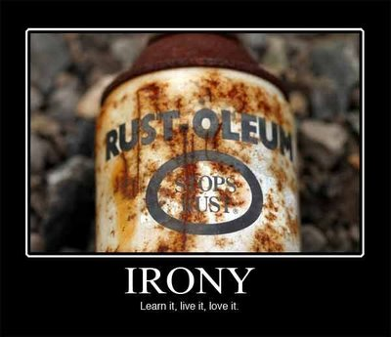

Slide 32
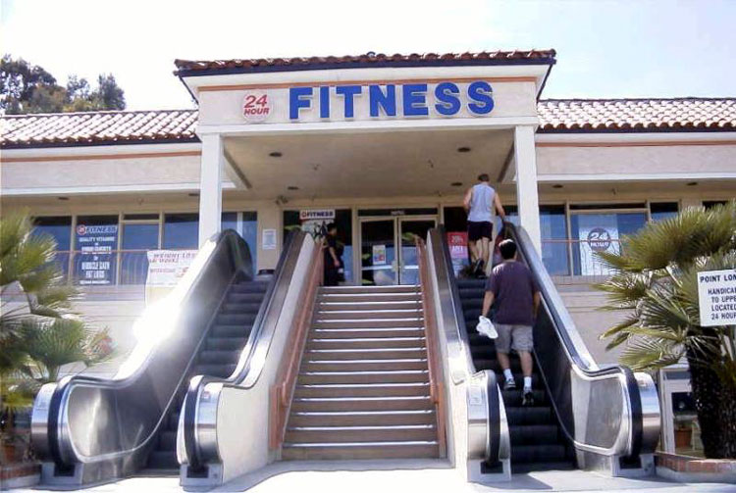
An escalator leading to a fitness center.
Notes:
Situational Irony

Slide 33
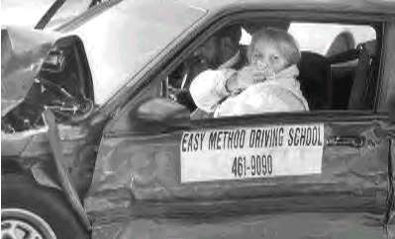
A wrecked car belonging to an "easy" driving school.
Notes:
Situational Irony

Slide 34
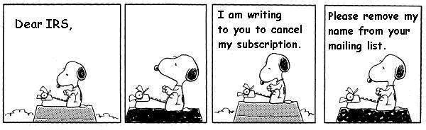
We know that the IRS is not a subscription and will not leave Snoopy alone, but he does not.
Notes:
Dramatic Irony

Slide 35
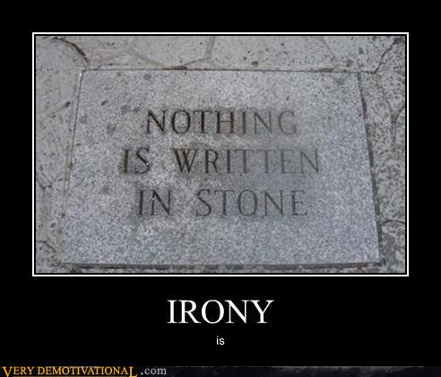
Notes:
Situational Irony or Verbal Irony

Slide 36
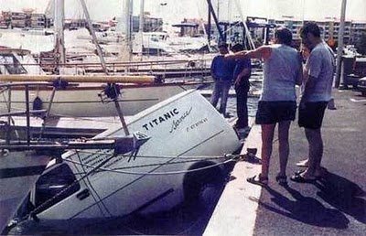
Notes:
Situational Irony

Slide 37
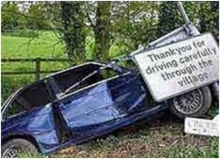
Notes:
Verbal Irony

Slide 38
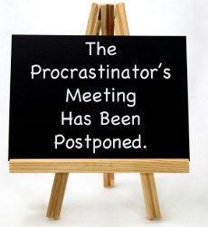
Notes:
Situational Irony

Slide 39
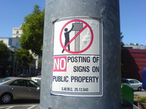
Notes:
Situational Irony

Slide 40
Irony
3 Kinds of Irony

Slide 41
What is Irony?
Irony is about expectations.
Irony: the opposite of what is expected.
3 kinds of irony
Verbal
Dramatic
Situational

Slide 42
Verbal Irony
A character says one thing but means the opposite
Also called sarcasm or being sarcastic.
Examples
The locker room smells really good.
Awesome! Another homework packet!

Slide 43
Dramatic Irony
When the reader understands more about the events of a story than a character.
You know something that a character doesn’t.
Example
Tim’s parents are proud of the “A” he got on the test, but we know he cheated.
Alex writes a love poem to Judy but we know that Judy loves Devin.

Slide 44
Situational Irony
When what actually happens is the opposite of what is expected.
Something about the situation is completely unexpected.
Example
General Sedgwick’s last words were, “They couldn’t hit an elephant at this distance.”
Bill Gates uses an Apple computer.

Slide 45
Review
Something that is ironic is unexpected.
If unexpected by a character, it’s dramatic.
If unexpected by everyone, it’s situational.
If it’s sarcasm, it’s verbal.

Slide 46
Quiz
Read the following examples of irony. Determine which of the three types of irony are being used.

Slide 47
1. When Mr. Goodenwell saw his baby boy Vince for the first time, he swore that he'd do anything to protect the little guy. This was easy at first, when all Vince did was lie in a pillow and drink milk. But as little Vince grew bigger, he started walking. And once he started walking, he got into everything. He was becoming a serious threat to himself when Mr. Goodenwell, making good on his vow to protect his son, went to the store and bought $150 worth of equipment to childproof his home. He put covers on the outlets, bumpers on the table corners, and a sliding lock on the toilet lid. But right as Mr. Goodenwell was adjusting the covers on the door knobs, Vince pulled the cap off an outlet and choked on it. Mr. Goodenwell found him just in time.
Notes:
Which type of irony is used? Situational Irony
Explain your answer:
One would expect that childproofing a home would protect the child, when in fact it endangers Vince.

Slide 48
2. One bright and warm Easter morning, Timmy Holloway woke up to the smell of eggs, but not breakfast eggs, Easter eggs. That's right Timmy had a craving for Easter eggs, and today was the day to get them boy howdy. There was only one thing standing in his way, well two really: the Solomon brothers. The Solomon brothers got more eggs than Timmy every year because there were two of them and they counted their eggs as one. Timmy suspected that this was cheating but he couldn't articulate the notion. When Timmy got to the fair grounds, he clutched his Easter egg sack behind his back and approached the Solomon brothers.

Slide 49
The taller one distracted Timmy while the shorter one snuck behind him, clipping the corner of Timmy's egg sack and making quite a big hole. Unfortunately, Timmy failed to notice this. When the whistle blew, Timmy was off. He was surprised to see the Solomon brothers behind him, since he was much faster than they, but he didn't mind. Timmy beat them to every egg, and raced on to the next, never noticing that his sack wasn't getting heavier. As he approached the end of the course, Timmy was elated that he was the first to finish. The Solomon brothers were right behind him. "Maybe next year, loser twins," Timmy chuckled, right before he noticed that his sack was empty.
Notes:
Which type of irony is used? Dramatic Irony
Explain your answer:
Timmy thinks that he is winning the egg hunt, but the reader knows that the opposite is true.

Slide 50
3. Making friends isn't easy. Ask Juan Guerrero, who moved to New Middle School three months ago but still eats lunch by himself. Nobody picks on him really, but they pretty much ignore him completely, at least since the incident. You see, Juan had his chance. We almost adopted him into our crew, the skaters, after Juan said he could skate. "Oh yeah?" asked my boy Romeo, "well, where's your board?" Juan replied shakily, "Uh, my mom ran over it with her car, but I do flips and grinds and all that stuff."
Notes:
Which type of irony is used? Situational Irony
Explain your answer:
One would expect that childproofing a home would protect the child, when in fact it endangers Vince.

Slide 51
Romeo didn't believe him. "Why don't you use my board? Show me one of those flips," Romeo challenged. Juan gulped and grabbed the board. "Uh… Ok," he replied. When you see a good skater on TV or in a video game, skateboarding may look easy, but just moving properly, let alone doing any tricks, takes a lot of practice. Because of this, I was not the least bit surprised when Juan landed flat on his can before he even made it across a single sidewalk square. "Wow! What an awesome flip, Tony Hawk. You'll have to teach me that," Romeo sneered. Now Juan eats lunch alone.
Notes:
Which type of irony is used? Verbal Irony
Explain your answer:
Romeo expresses admiration for Juan when in fact he means the opposite.

Slide 52
Write down the underlined section
Connotations, Symbols, and Irony check up Wednesday November 4
WE ARE….
Writers choose words both for their literal meanings (their dictionary definitions, or denotations) and for their implied meanings (their emotional associations, or connotations). Writers create their intended effects through particular connotations—the associations or images readers connect with certain words. Some words provoke strong positive or negative associations. These reactions are central to how we, as readers, draw inferences about the tone, the characters, and the meaning of a text.
Patriot Strong!
Connotations, Symbols, and Irony check up Wednesday November 4

Slide 53
Connotations continued- Practice using the list of words on the board. Materials\Connotations 4 practice.docx
Connotations, Symbols, and Irony check up Wednesday November 4
WE ARE….
Positive Connotative Words
Denotive (Neutral) Words
Negative Connotative Words
Patriot Strong!
Connotations, Symbols, and Irony check up Wednesday November 4

Slide 54
Now you practice- The handout is due at the start of class Friday.
Connotations, Symbols, and Irony check up Wednesday November 4
WE ARE….
Patriot Strong!
Connotations, Symbols, and Irony check up Wednesday November 4

Slide 55
Thursday October 29, 2020
Connotations, Symbols, and Irony check up Wednesday November 4
Learning Target(s)
Students will annotating “Marigolds” looking for signposts.
Students will also annotate the passage for imagery and words that show the narrators voice.
Activities:
Book project presentations
Bell Ringer 27 p.7
Book Log 19 p.5
Irony and connotation notes Ref. page 24
Connotations homework worksheet assignment page 9 due Friday when you come to class
Irony homework worksheet assignment page 8 due Friday when you come to class
Connotations, Symbols, and Irony check up Wednesday November 4

Slide 56
Reading Time
Don’t forget to log your progress in your book log section.
You may go to the library if you need to check out a book or return a book at this time.

Slide 57
Bell Ringer: Parts of a Sentence
Connotations, Symbols, and Irony check up Wednesday November 4
WE ARE….
Directions: Parts of speech: Directions: Label the parts of speech in the following sentences. Use the following symbols to identify the Parts of speech: Common noun= n, proper noun = N, verbs = v, Pronouns= Pro, Adjectives= Adj, Adverbs= Adv, Prepositions= prep, Coordinating Conjunctions= cc, Subordinate conjunctions=sc, Articles= art
1. The student wiped the white board that was filthy with last week’s notes.
Directions: Label each part of the sentence using the following abbreviations: Subject= S for proper nouns and s for regular nouns, Predicate=p, and Object= O for proper nouns and o for regular nouns.
1. The student wiped the white board that was filthy with last week’s notes.
Patriot Strong!
Connotations, Symbols, and Irony check up Wednesday November 4

Slide 58
Bell Ringer answers
Connotations, Symbols, and Irony check up Wednesday November 4
WE ARE….
1. The student wiped the white board that was filthy with last week’s
notes.
2. The student wiped the white board that was filthy with last week’s
notes.
art
n
v
art
adj
n
sc
v
adv
prep
adj
adj
n
p
S
p
o
o
Patriot Strong!
Connotations, Symbols, and Irony check up Wednesday November 4

Slide 59
Reading Time
Don’t forget to log your progress in your book log section.
You may go to the library if you need to check out a book or return a book at this time.

Slide 60
Irony and Connotations Work pages
Connotations, Symbols, and Irony check up Wednesday November 4
WE ARE….
Work on Irony and connotations
Patriot Strong!
Connotations, Symbols, and Irony check up Wednesday November 4

Slide 61
Friday September 25, 2020
Connotations, Symbols, and Irony check up Wednesday November 4
Learning Target(s)
Students will complete and discuss the Irony and Connotations work pages
Students will take notes on symbolism
Assignments
Bell ringer 28 p.7
Book Log 20 p.5
Activities:
Symbolism notes
Connotations, Symbols, and Irony check up Wednesday November 4

Slide 62
Reading Time
Don’t forget to log your progress in your book log section.
You may go to the library if you need to check out a book or return a book at this time.

Slide 63
Bell Ringer Answers
Connotations, Symbols, and Irony check up Wednesday November 4
WE ARE….
Directions: Label the parts of speech in the following sentences. Use the following symbols to identify the Parts of speech: Common noun= n, proper noun = N, verbs = v, Pronouns= Pro, Adjectives= Adj, Adverbs= Adv, Prepositions= prep, Coordinating Conjunctions= cc, Subordinate conjunctions=sc, Articles= art
After the teacher chose groups, John and Sarah were selected as partners for a project, yet Sarah did most of the work.
Directions: Label each part of the sentence using the following abbreviations: Subject= S for proper nouns and s for regular nouns, Predicate=p, and Object= O for proper nouns and o for regular nouns.
2. After the teacher chose groups, John and Sarah were selected as partners for a project, yet Sarah did most of the work.
Patriot Strong!
Connotations, Symbols, and Irony check up Wednesday November 4

Slide 64
Bell Ringer: Parts of a sentence
Connotations, Symbols, and Irony check up Wednesday November 4
WE ARE….
After the teacher chose groups, John and Sarah were selected as partners for a project, yet Sarah did most of the work.
2. After the teacher chose groups, John and Sarah were selected as partners for a project, yet Sarah did most of the work.
sc
art
n
v
n
N
cc
N
v
v
prep
n
prep
art
n
cc
N
v
adv
prep
art
n
s
p
o
S
S
p
o
o
S
p
o
Patriot Strong!
Connotations, Symbols, and Irony check up Wednesday November 4

Slide 65
Write down the underlined section
Connotations, Symbols, and Irony check up Wednesday November 4
WE ARE….
Writers choose words both for their literal meanings (their dictionary definitions, or denotations) and for their implied meanings (their emotional associations, or connotations). Writers create their intended effects through particular connotations—the associations or images readers connect with certain words. Some words provoke strong positive or negative associations. These reactions are central to how we, as readers, draw inferences about the tone, the characters, and the meaning of a text.
Patriot Strong!
Connotations, Symbols, and Irony check up Wednesday November 4

Slide 66
Symbolism
Meanings beyond the obvious

Slide 67







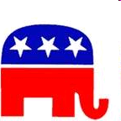


A symbol is…
an object that stands for itself and a greater idea.
We see symbols every day…

Slide 68







Slide 69
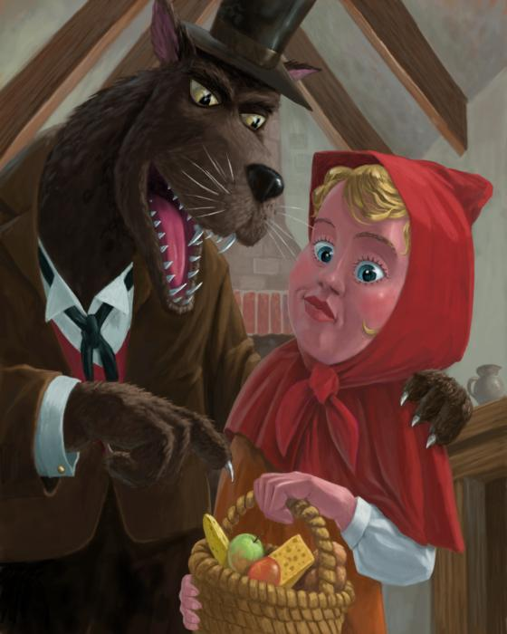
Symbolism in stories -
When the author uses an object to add deeper meaning to a story
Sometimes easy to find. Sometimes hard.

Slide 70
Symbolism in Literature
Symbolism is the practice or art of using an object or a word to represent an abstract idea. An action, person, place, word, or object can all have a symbolic meaning. When an author wants to suggest a certain mood or emotion, he can also use symbolism to hint at it, rather than just blatantly saying it.

Slide 71
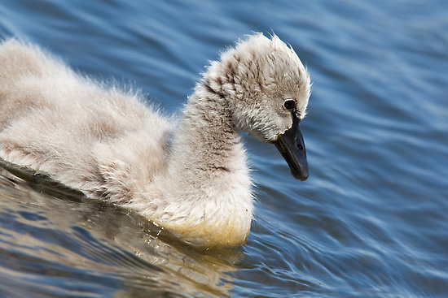
Symbolism is used to provide more meaning to the writing beyond what is actually being written.
The Ugly Duckling

Slide 72

Symbolism in Literature
Objects are often used to symbolize something else:
･A chain can symbolize the coming together of two things.

Slide 73
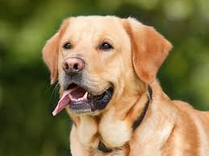
Take a moment to think about the abstract ideas the picture below symbolizes. Write 3 down

Slide 74
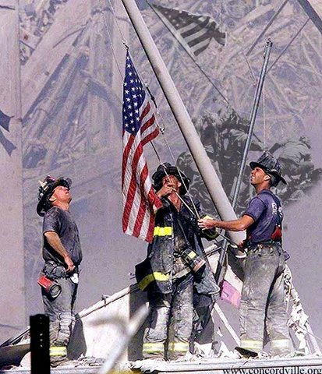
Objects as symbols
The American flag
  Real object
  Symbol for United States
  Represents freedom
  Represents a nation as a whole

Slide 75
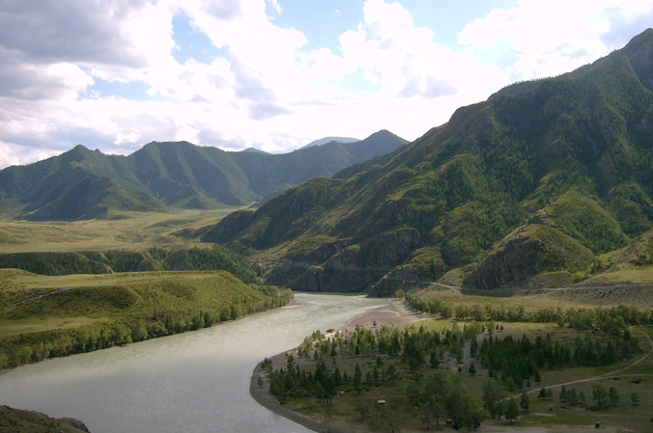
Symbolism is used to…
Provide meaning beyond the obvious:
  Emphasize key ideas or themes:
A river can represent the flow of life…
… or its depth may represent the unknown…
… the water might be purity…
… or there could be dangers beneath the surface.

Slide 76
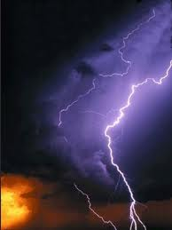
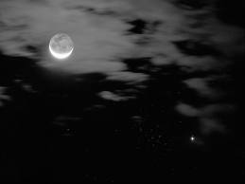

In literature, symbols are full of meaning and are used to develop atmosphere in the text.
Example: A storm occurring when there is a conflict or high emotions
Example: Transition from day
to night might = move from
goodness to evil
* Example: And dawn may show the end of conflict, the “start of a new day.”

Slide 77
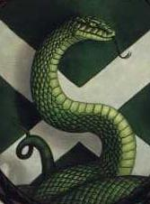
Examples from literature
Harry Potter (lots of symbolism)
A snake represents ___________!
It is no coincidence then that the symbol of Slytherin House is a serpent.

Slide 78
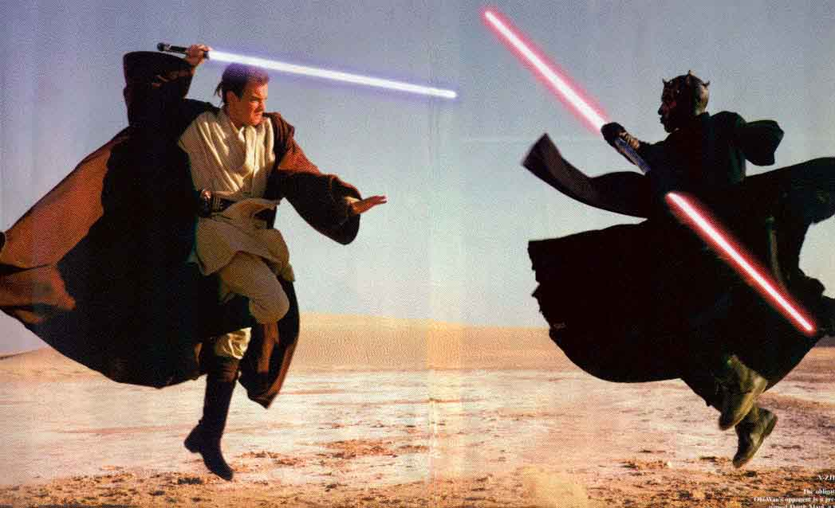
Examples from literature
Star Wars – Lightsabers
Good and Evil is represented by color; blue being the light side and red the dark side

Slide 79
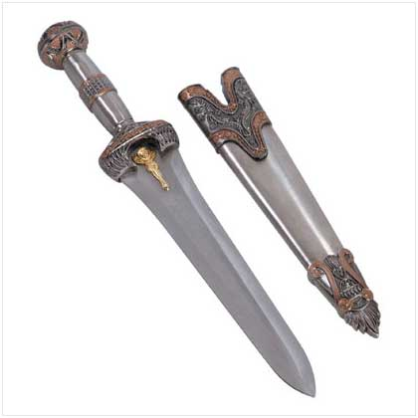
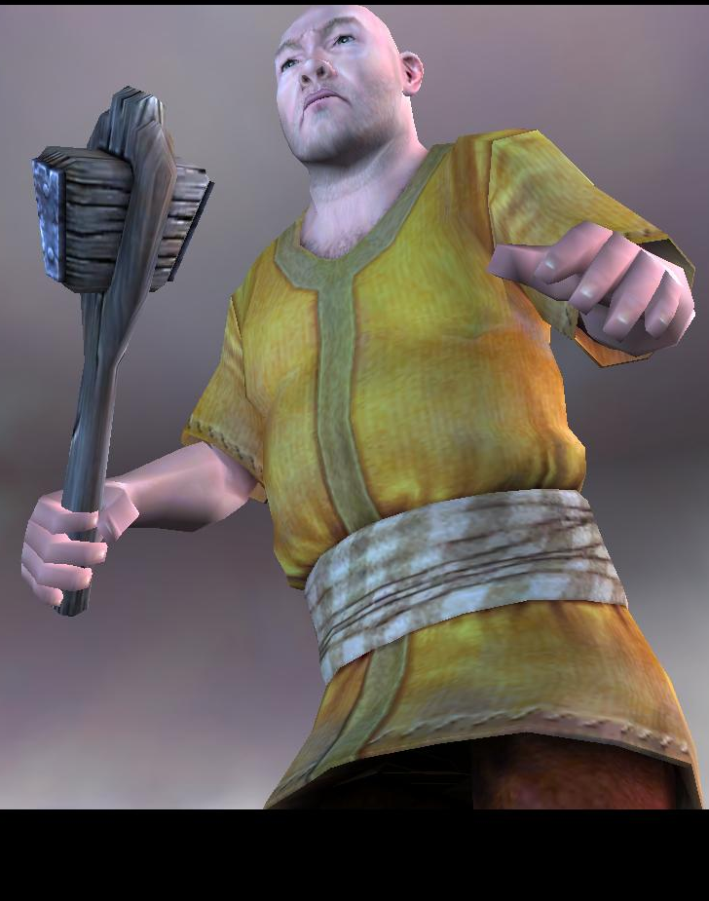
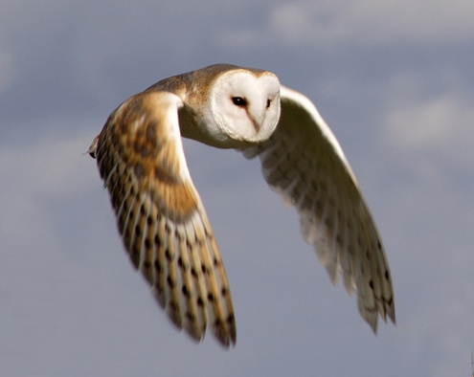
How can you spot a symbol?
There’s no one way, but some things to look for are:
  Colors or objects
  Unusual character names – “Rumblebuffin” – (giant in Chronicles of Narnia)
  Objects / creatures that have cultural meanings (lions = strength, owls = wisdom, etc.)

Slide 80
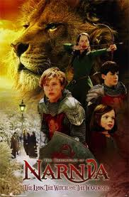
More examples in literature:
Chronicles of Narnia
  *Aslan - good; restores Narnia back to it’s original creation
  *White Witch - evil;
  tries to keep Narnia
  under her control

Slide 81
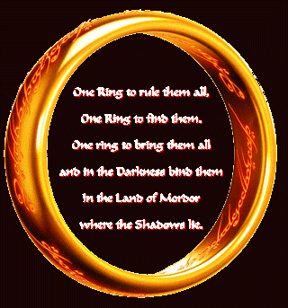
Even more examples in literature
Lord of the Rings
  Ring represents the power of good and evil

Slide 82
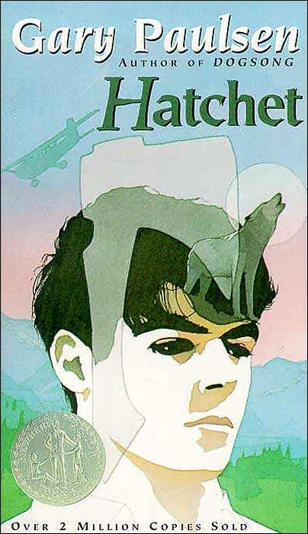
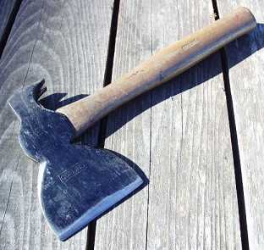
And more examples in literature
Hatchet
  The hatchet represents the object of survival

Slide 83
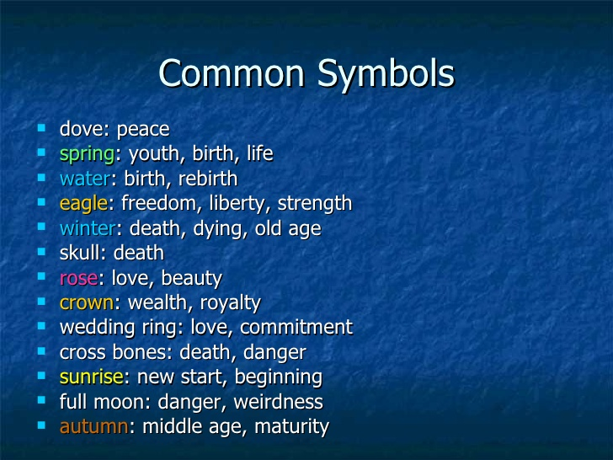
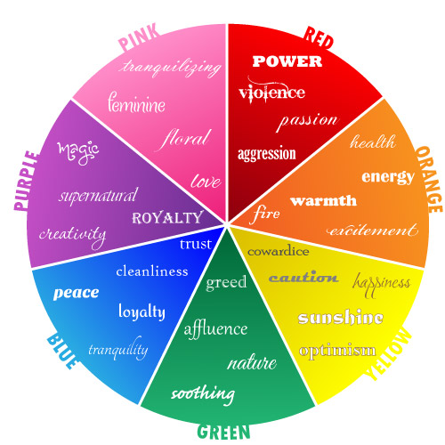
Symbolism
Colors and Objects
Write down 3 examples from common symbols and two examples from each color.

Slide 84
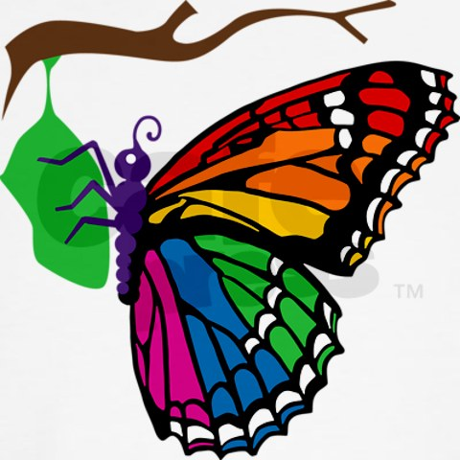
So, the next time you read a novel, watch out for what’s not written in the words.

