Slide 1
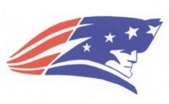
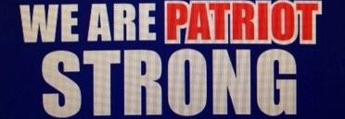
Week 11
Diction: Connotations, Irony, and Symbols

Slide 2

Monday November 2, 2020
Connotations, Symbols, and Irony check up Wednesday November 4
Learning Target(s)
Students will learn about symbolism and recognizing it in literature
Student will review connotations and irony.
Have out for your homework for checking along with your notebook open to bell ringers for last week. I will come by during reading time to check on all of it.
Activities:
Book Log 21p.5
Book log and Bell ringer Check
Continue Symbolism notes
Discus symbolism in “Eleven” by Sandra Cisneros
Review Connotations and Irony work
Second week of book projects is tomorrow. Get signed up if you have not.
Connotations, Symbols, and Irony check up Wednesday November 4

Slide 3
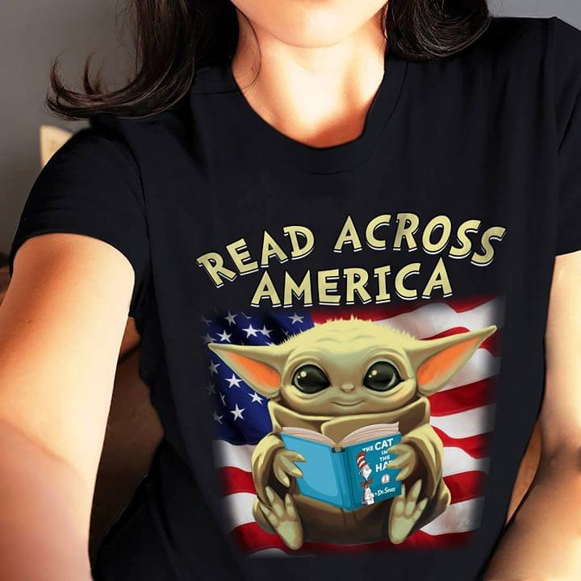
Reading Time
Don’t forget to log your progress in your book log section.
You may go to the library if you need to check out a book or return a book at this time.

Slide 4
Symbolism
Meanings beyond the obvious

Slide 5



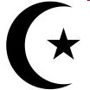



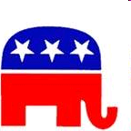


A symbol is…
an object that stands for itself and a greater idea.
We see symbols every day…

Slide 6







Slide 7
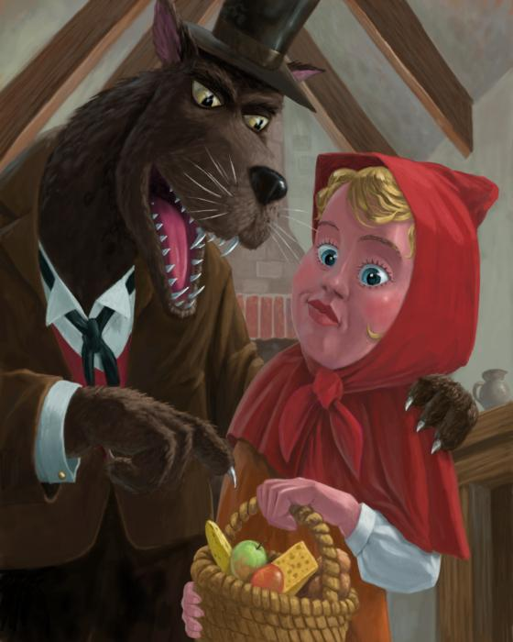
Symbolism in stories -
When the author uses an object to add deeper meaning to a story
Sometimes easy to find. Sometimes hard.

Slide 8
Symbolism in Literature
Symbolism is the practice or art of using an object or a word to represent an abstract idea. An action, person, place, word, or object can all have a symbolic meaning. When an author wants to suggest a certain mood or emotion, he can also use symbolism to hint at it, rather than just blatantly saying it.

Slide 9
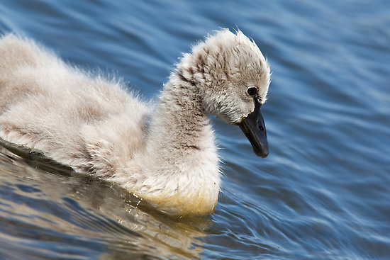
Symbolism is used to provide more meaning to the writing beyond what is actually being written.
The Ugly Duckling

Slide 10
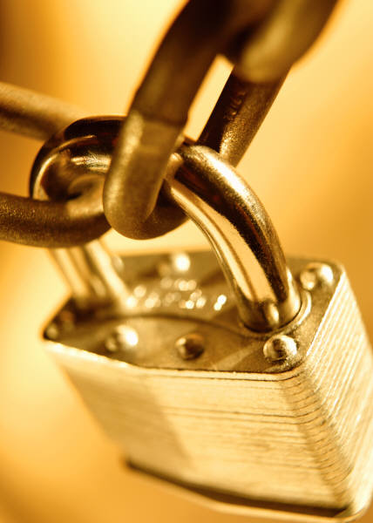
Symbolism in Literature
Objects are often used to symbolize something else:
･A chain can symbolize the coming together of two things.

Slide 11
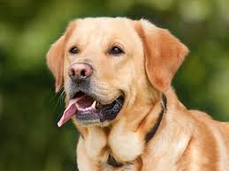
Take a moment to think about the abstract ideas the picture below symbolizes. Write 3 down

Slide 12
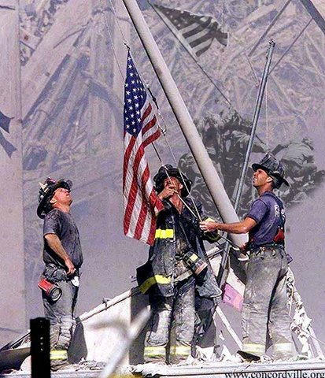
Objects as symbols
The American flag
  Real object
  Symbol for United States
  Represents freedom
  Represents a nation as a whole

Slide 13
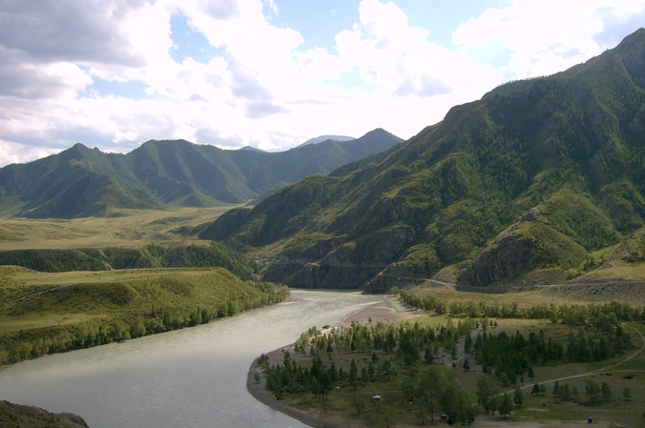
Symbolism is used to…
Provide meaning beyond the obvious:
  Emphasize key ideas or themes:
A river can represent the flow of life…
… or its depth may represent the unknown…
… the water might be purity…
… or there could be dangers beneath the surface.

Slide 14
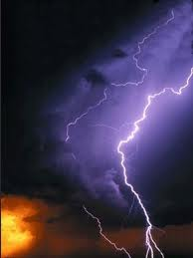
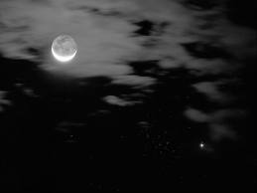

In literature, symbols are full of meaning and are used to develop atmosphere in the text.
Example: A storm occurring when there is a conflict or high emotions
Example: Transition from day
to night might = move from
goodness to evil
* Example: And dawn may show the end of conflict, the “start of a new day.”

Slide 15
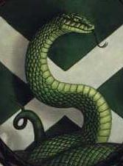
Examples from literature
Harry Potter (lots of symbolism)
A snake represents ___________!
It is no coincidence then that the symbol of Slytherin House is a serpent.

Slide 16
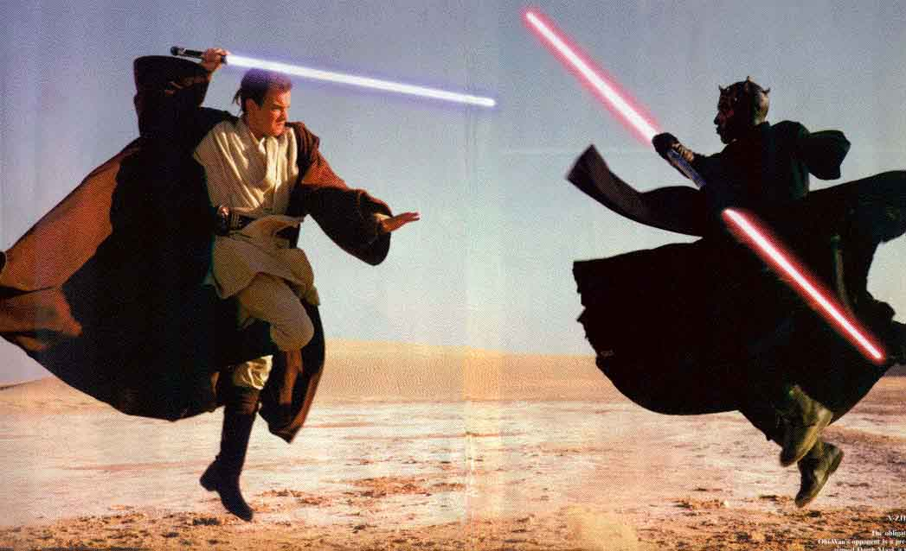
Examples from literature
Star Wars – Lightsabers
Good and Evil is represented by color; blue being the light side and red the dark side

Slide 17
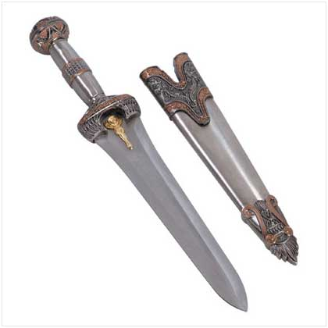
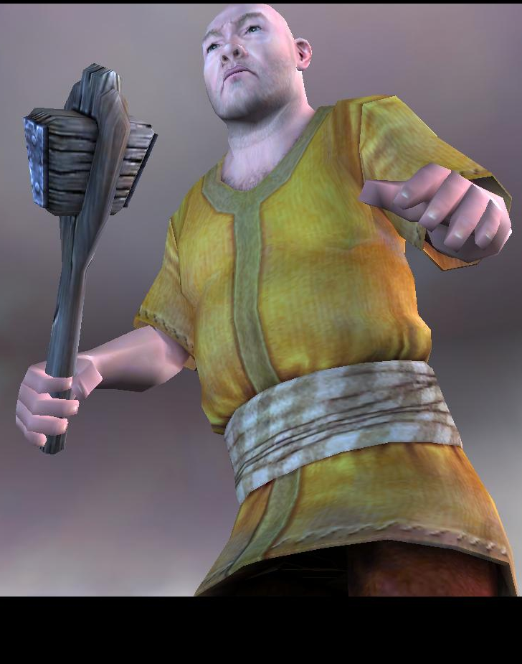
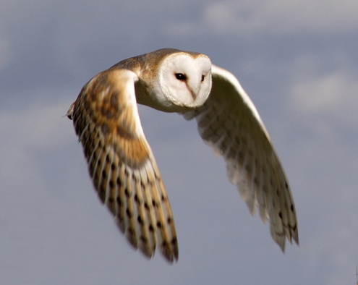
How can you spot a symbol?
There’s no one way, but some things to look for are:
  Colors or objects
  Unusual character names – “Rumblebuffin” – (giant in Chronicles of Narnia)
  Objects / creatures that have cultural meanings (lions = strength, owls = wisdom, etc.)

Slide 18
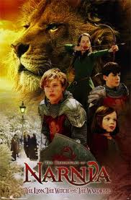
More examples in literature:
Chronicles of Narnia
  *Aslan - good; restores Narnia back to it’s original creation
  *White Witch - evil;
  tries to keep Narnia
  under her control

Slide 19
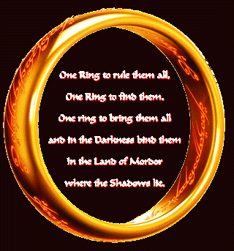
Even more examples in literature
Lord of the Rings
  Ring represents the power of good and evil

Slide 20
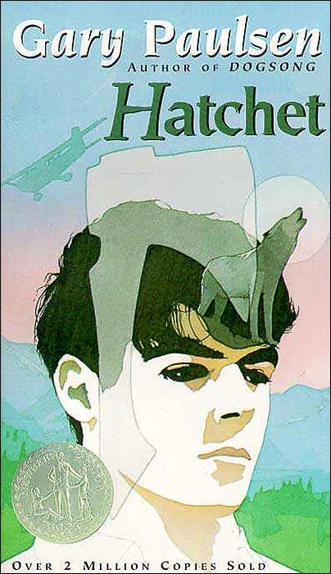
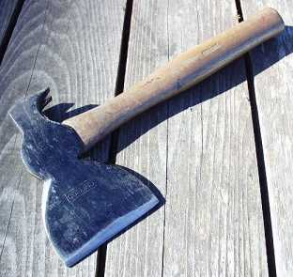
And more examples in literature
Hatchet
  The hatchet represents the object of survival

Slide 21
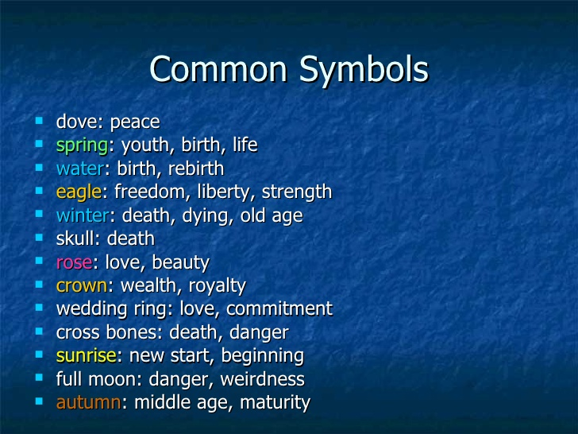
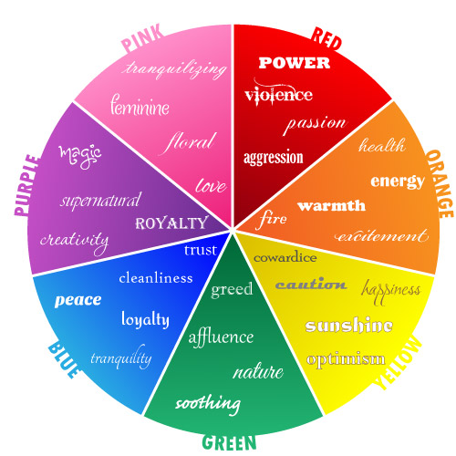
Symbolism
Colors and Objects
Write down 3 examples from common symbols and two examples from each color.

Slide 22
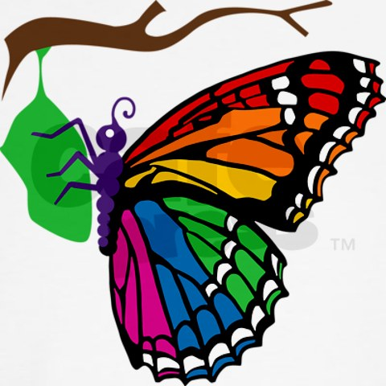
So, the next time you read a novel, watch out for what’s not written in the words.

Slide 23
Symbolism in “Eleven” by Sandra Cisneros
WE ARE….
Think of: Persons, places, things/objects, and specific words
What could these things represent other than themselves in the story “Eleven”?
Red Sweater
Ms. Price
11
10
5,
3
102
Wooden dolls
Birthdays
Cake
Onion
Patriot Strong!

Slide 24
Irony and Connotations H.W.
Connotations, Symbols, and Irony check up Wednesday November 4
WE ARE….
Check your work for correctness as we go over the answers.
Patriot Strong!
Connotations, Symbols, and Irony check up Wednesday November 4

Slide 25
Tuesday October 27, 2020
Connotations, Symbols, and Irony check up Wednesday November 4
Learning Target(s)
Students will annotating “Marigolds” looking for signposts.
Students will also annotate the passage for symbols, and connotative words that show the narrators voice and tone.
Go get your Springboard (S.B.) book off the shelf and open to page 16 after the bell ringer and reading time.
Activities:
Book project presentations
Bell Ringer 29 p.8
Book Log 22 p.7
Marigolds Signposts, symbols, and connotations Assign. p.10 Due Thursday 11/5
Connotations, Symbols, and Irony check up Wednesday November 4

Slide 26
Bell Ringer: Parts of a Sentence
Connotations, Symbols, and Irony check up Wednesday November 4
WE ARE….
Directions: Parts of speech: Directions: Label the parts of speech in the following sentences. Use the following symbols to identify the Parts of speech: Common noun= n, proper noun = N, verbs = v, Pronouns= Pro, Adjectives= Adj, Adverbs= Adv, Prepositions= prep, Coordinating Conjunctions= cc, Subordinate conjunctions=sc, Articles= art
1. Trina and Hareem went to a bar in Hollywood to celebrate their anniversary.
Directions: Label each part of the sentence using the following abbreviations: Subject= S for proper nouns and s for regular nouns, Predicate=p, and Object= O for proper nouns and o for regular nouns, and place parenthesis () around prepositional phrases.
2. Trina and Hareem went to a bar in Hollywood to celebrate their anniversary.
Patriot Strong!
Connotations, Symbols, and Irony check up Wednesday November 4

Slide 27
Bell Ringer answers
Connotations, Symbols, and Irony check up Wednesday November 4
WE ARE….
1. Trina and Hareem went to a bar in Hollywood to celebrate their anniversary.
2. Trina and Hareem went (to a bar) (in Hollywood) (to celebrate their anniversary).
N
N
v
prep
art
n
prep
N
prep
v
Pro
cc
n
S
S
p
o
O
p
o
Patriot Strong!
Connotations, Symbols, and Irony check up Wednesday November 4

Slide 28
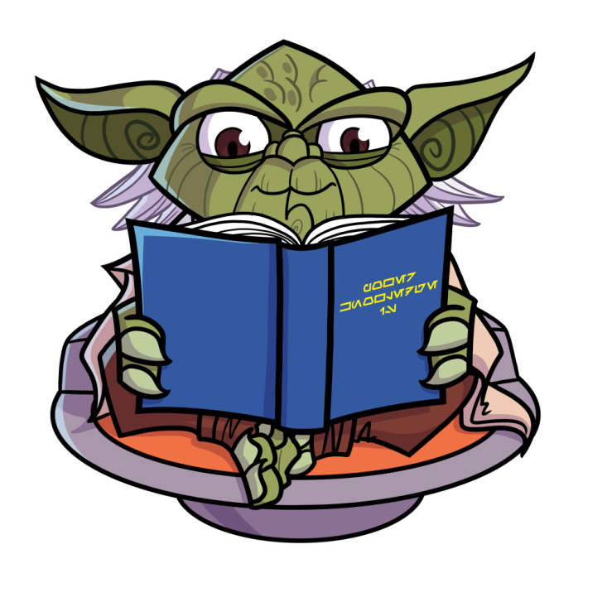
Reading Time
Don’t forget to log your progress in your book log section.
You may go to the library if you need to check out a book or return a book at this time.

Slide 29
“Marigolds”
Connotations, Symbols, and Irony check up Wednesday November 4
WE ARE….
As you read,
make note of signposts with your highlighters- notice and note (you will have 6 due on Thursday)
Circle persons, places, things/objects, special words that could be symbols
Underline words that you feel have a positive or negative connotation
On a separate paper, make a list of and explain at least 3 symbols you found and 7 connotative words that were used.
Patriot Strong!
Connotations, Symbols, and Irony check up Wednesday November 4

Slide 30
Wednesday November 4, 2020
Connotations, Symbols, and Irony check up Wednesday November 4
Learning Target(s)
Students will annotating “Marigolds” looking for signposts.
Students will also annotate the passage for symbols, and connotative words that show the narrators voice and tone.
Go get your Springboard (S.B.) book off the shelf and open to page 16 after the bell ringer and reading time.
Activities:
Bell Ringer 30 p.8
Book Log 23 p.7
Check up
Connotations, Irony, and Symbols Check up
Continue Marigolds Signposts, symbols, and connotations Assign. p.10 Due Thursday 11/5
Connotations, Symbols, and Irony check up Wednesday November 4

Slide 31
Bell Ringer: Parts of a Sentence
Connotations, Symbols, and Irony check up Wednesday November 4
WE ARE….
Directions: Parts of speech: Directions: Label the parts of speech in the following sentences. Use the following symbols to identify the Parts of speech: Common noun= n, proper noun = N, verbs = v, Pronouns= Pro, Adjectives= Adj, Adverbs= Adv, Prepositions= prep, Coordinating Conjunctions= cc, Subordinate conjunctions=sc, Articles= art
1. Wicked Regina cast a spell on the entire city, so the citizens decided to rebel.
Directions: Label each part of the sentence using the following abbreviations: Subject= S for proper nouns and s for regular nouns, Predicate=p, and Object= O for proper nouns and o for regular nouns.
2. Wicked Regina cast a spell on the entire city, so the citizens decided to rebel.
Patriot Strong!
Connotations, Symbols, and Irony check up Wednesday November 4

Slide 32
Bell Ringer Answers
WE ARE….
1. Wicked Regina cast a spell on the entire city, so the citizens decided to rebel.
2. Wicked Regina cast a spell (on the entire city), so the citizens decided (to rebel).
adj
N
v
prep
adj
n
art
v
prep
n
art
n
art
cc
n
S
p
o
o
s
p
o
Patriot Strong!

Slide 33
Reading Time
Don’t forget to log your progress in your book log section.
You may go to the library if you need to check out a book or return a book at this time.

Slide 34
Check up Time!
Connotations, Symbols, and Irony check up Wednesday November 4
WE ARE….
Put your name and class period on the answer document.
Answer by bubbling in your answer on the answer document.
When you are done, continue working on the Marigolds story work. Turn it in when you are finished.
As you read,
make note of signposts with your highlighters- notice and note (you will have 6 due on Thursday)
Circle persons, places, things/objects, special words that could be symbols
Underline words that you feel have a positive or negative connotation
On a separate paper, make a list of and explain at least 3 symbols you found and 7 connotative words that were used.
Patriot Strong!
Connotations, Symbols, and Irony check up Wednesday November 4

Slide 35
Thursday November 5, 2020
Connotations, Symbols, and Irony check up Wednesday November 4
Learning Target(s)
Students will annotating “Marigolds” looking for signposts.
Students will also annotate the passage for imagery and words that show the narrators voice.
Activities:
Book project presentations
Bell Ringer 31 p.8
Book Log 24 p.7
Marigolds Signposts, symbols, and connotations Assign. p.10 Due Thursday 11/5
Connotations, Symbols, and Irony check up Wednesday November 4

Slide 36
Bell Ringer: Parts of a sentence
Connotations, Symbols, and Irony check up Wednesday November 4
WE ARE….
Directions: Parts of speech: Directions: Label the parts of speech in the following sentences. Use the following symbols to identify the Parts of speech: Common noun= n, proper noun = N, verbs = v, Pronouns= Pro, Adjectives= Adj, Adverbs= Adv, Prepositions= prep, Coordinating Conjunctions= cc, Subordinate conjunctions=sc, Articles= art
1. Gold coins rained down to the earth like tears from the heavens.
Directions: Label each part of the sentence using the following abbreviations: Subject= S for proper nouns and s for regular nouns, Predicate=p, and Object= O for proper nouns and o for regular nouns.
2. Gold coins rained down to the earth like tears from the heavens.
Patriot Strong!
Connotations, Symbols, and Irony check up Wednesday November 4

Slide 37
Bell Ringer Answers
Connotations, Symbols, and Irony check up Wednesday November 4
WE ARE….
prep
Gold coins rained down to the earth like tears from the heavens.
2. Gold coins rained down (to the earth like tears) (from the heavens).
adj
n
v
art
n
adj
n
prep
art
n
s
p
o
o
o
Patriot Strong!
Connotations, Symbols, and Irony check up Wednesday November 4

Slide 38
“Marigolds”
Connotations, Symbols, and Irony check up Wednesday November 4
WE ARE….
As you read,
make note of signposts with your highlighters- notice and note (you will have 6 due on Thursday)
Circle persons, places, things/objects, special words that could be symbols
Underline words that you feel have a positive or negative connotation
On a separate paper, make a list of and explain at least 3 symbols you found and 7 connotative words that were used.
Patriot Strong!
Connotations, Symbols, and Irony check up Wednesday November 4

Slide 39
Reading Time
Don’t forget to log your progress in your book log section.
You may go to the library if you need to check out a book or return a book at this time.

Slide 40
Marigolds
Connotations, Symbols, and Irony check up Wednesday November 4
WE ARE….
As you read,
make note of signposts with your highlighters- notice and note (you will have 6 due today at the end of class
Circle persons, places, things/objects, special words that could be symbols
Underline words that you feel have a positive or negative connotation
On a separate paper, make a list of and explain at least 3 symbols you found and 7 connotative words that were used. Due to day at the end of class.
Patriot Strong!
Connotations, Symbols, and Irony check up Wednesday November 4

Slide 41
Friday November 6, 2020
Connotations, Symbols, and Irony check up Wednesday November 4
Learning Target(s)
Homecoming half day
Connotations, Symbols, and Irony check up Wednesday November 4

