Slide 1
Week 12
Narrative: The Short Story

Slide 2
Monday November 9, 2020
Learning Target(s)
Students will examine their returned work for writing errors to record
Students will complete Marigolds work.
Activities:
Return and look over work
Complete the chart on page 19
Finish “Marigolds” work

Slide 3
Reading Time
Don’t forget to log your progress in your book log section.
You may go to the library if you need to check out a book or return a book at this time.

Slide 4
Get Marigolds work done
WE ARE….
Turn in your “Marigolds” assignment in the basket before you leave today.
Patriot Strong!

Slide 5
Tuesday November 10, 2020
Learning Target(s)
Students will examine passages to determine if each is a story or not a story
Students will attempt to write 3 short one paragraph stories
Activities:
Story or no story activity
3 Short stories assign p. 11due Thursday at the start of class

Slide 6
Book Project Day
WE ARE….
Patriot Strong!

Slide 7
Story or no Story
WE ARE….
Green members, get a copy of the story not a story In Your groups, you will read 6 passages and determine if the passages are a story or not a story.
Discuss in your group what you think.
Yellow, will speak for the group
Blue will record your answers
You will have 8 minutes to read, discuss, and determine your thoughts about each.
Story Elements: characters, conflict, events, climax, change, resolution
Patriot Strong!

Slide 8
Passage 1
WE ARE….
My mom is a great cook. She can make anything: creamy pasta dishes, amazing hamburgers, delicious desserts. I think the way she got so good at cooking is by just trying a lot of new recipes. If she sees a cherry pie in a restaurant, she'll just go home, look up a recipe, and try it. She's always watching cooking shows, too, and then she tries to make the same stuff at home. That's how she became such an outstanding cook.
Patriot Strong!
Notes:
Not a story because it lacks conflict and change for the character.

Slide 9
Passage 2
WE ARE….
Yesterday I saw a shoebox on the sidewalk. I almost ignored it, but then I heard a squeak coming from inside. I opened it and found three tiny kittens! I knew I wouldn’t be able to keep them, but they needed a good home, so I brought them to my house. I took pictures of them and made fliers with our phone number, then hung the fliers all over my neighborhood. After a few hours, someone called and said they’d be happy to adopt the kittens.
Patriot Strong!
Notes:
Is a story because it has characters, events, conflict, a climax, and change.

Slide 10
Passage 3
WE ARE….
Jordan had always been afraid of spiders, until the day he and his friend Brian were hanging around in the back yard. They saw a spider in the grass, and Brian dared Jordan to let it crawl up his leg. At first, Jordan said no. Then Brian did it first to show Jordan that it wouldn’t hurt him. Still, he wasn’t convinced. Finally, when Brian said he would let Jordan use his skateboard for a week, Jordan did it, and it turned out it wasn’t that bad after all.
Patriot Strong!
Notes:
Is a story because it has characters, events, conflict, a climax, and change.

Slide 11
Passage 4
WE ARE….
Neka couldn’t find her glasses anywhere—she looked all over the house, in the car, even in the yard, but she couldn’t find them. Her mom was going to be so mad! She was always telling Neka not to leave her glasses lying around because they would be expensive to replace if they were lost or broken. After looking for hours, she told her mom. It turned out her mom had the glasses all along. After that, Neka never left them lying around again.
Patriot Strong!
Notes:
Is a story because it has characters, events, conflict, a climax, and change.

Slide 12
Passage 5
WE ARE….
Mario just got a new job as an assistant at a home improvement store. One of his main duties is to keep the shelves organized when they get messy and re-stock them when they start to empty out. He is also responsible for answering customers’ questions and helping them find things around the store. Every now and then, he gets to set up special displays of new or seasonal products. Mario has been pretty happy with the job so far.
Patriot Strong!
Notes:
This is not a story because it lacks a climax and change for the character.

Slide 13
Passage 6
WE ARE….
The storm last evening was incredible! Everything looked normal at first: The sky was a bright blue and there were fluffy white clouds floating around. But when you looked over to the west side of town, the sky was dark gray and so cloudy and thick, it was almost like a solid wall was coming toward us. In just a few minutes, that beautiful day had turned into a loud, rainy storm with thunder and lightning and wind. It was pretty amazing.
Patriot Strong!
Notes:
This is not a story because it lacks a change in the character or real conflict.

Slide 14
What makes a story?
WE ARE….
Every story has to have what?
Patriot Strong!

Slide 15
3 STORIES
Choose your three best stories from the topics below and write a quick summary of each one.
What is something important you learned in the past few years?
Describe a time when you felt nervous.
Have you ever had a nickname? What's the story behind it?
Describe a time when you got lost or lost something.
What is your best memory about a holiday?
Describe a time when you had to apologize.
What was a really good gift you gave someone?
Describe a time when you helped someone.
What was the worst vacation you ever had?
Describe a big mistake you made.
Describe an argument you had with a family member.
Describe a time when you wanted something but didn't get it.
Describe a time when you felt homesick.
What is something you have changed your mind about?
Describe a time when you said something you regretted.
1
2
3

Slide 16
3 STORIES
Choose your three best stories from the topics below and write a quick summary of each one.
Hmph! The pillow top engulfs my frame as I slam my body into it. Too soft to damage anything, too safe to make an impression. That about sums me up- always the safe route. The wall would hurt and everyone would emerge from their domiciles like cavemen wondering at the yelp and obscenities being spilled out like oil on their ocean of serenity. Would someone cry with me? Or, would it be like always- suffering alone in my loneliness? But, never am I alone really. I know she feels my pain. My wife knows the disappointment of rounding the mountain again and again held captive by our fears. Typical, I’ll just cry hear silently alone. Fear has won again.
What is something important you learned in the past few years?
Describe a time when you felt nervous.
Have you ever had a nickname? What's the story behind it?
Describe a time when you got lost or lost something.
What is your best memory about a holiday?
Describe a time when you had to apologize.
What was a really good gift you gave someone?
Describe a time when you helped someone.
What was the worst vacation you ever had?
Describe a big mistake you made.
Describe an argument you had with a family member.
Describe a time when you wanted something but didn't get it.
Describe a time when you felt homesick.
What is something you have changed your mind about?
Describe a time when you said something you regretted.
1
Midnight was just around the corner. Tradition was playing out in the Moore family household just as always. Music, games, food, and family swelled and retracted throughout the house all day. My eyes could hardly leave the presents under the Christmas tree. One in particular, a rectangular box that I knew to be mine, sat their as delectable as the Christmas ham we were still snacking on late into the evening. As I eyed the present, the moments paused to lecture me on the importance of Christmas, but I had no ears for it, so they seemed to pause all the more. I had waited for this gift for years with disappointment. The clock struck twelve and I went for the gift, but it didn’t have my name on it. I watched with a broken heart as my brother unwrapped my perfect gift while I was left holding a Yoda puppet.
2
Seeing Mary brought back a shame I haven’t felt in a long time. I stood thinking as she approached me about how her hand felt all those years ago smooth as silk and how she looked at me in away that no other had up to that point in my life. Yet, our days were few and adolescence had scarcely wrapped on our door. I saw the years in that look: middle school dances, high school prom, married after high school, babies, and oh, but no! Wait a minute! We’re to young for all of that! What if I mess it up somewhere down the line and my good friend is lost in the craziness of boyfriend and girlfriend stuff. I can’t risk it. Who’s that with her? Perhaps, I should ask her out and avoid the awkward question growing between us. Yes, that’s what I’ll do. She’ll never know that I knew she wanted to ask me out. This way I can just say I have a girlfriend and we can just go on being friends. Well, it’s funny how reasoning seems so sound at the time. But, time always tells the truth. I lost something valuable that day that I will never get back.
3

Slide 17
Wednesday November 11, 2020
Veteran’s day

Slide 18
Thursday November 12, 2020
Learning Target(s)
Students will listen to a short story and plot diagram the story
Students will decide on their story and attempt to plot diagram it.
Activities:
Listen to “Frog” and discuss the story arc (plot diagram) for the story
Decide on the writing of your narrative short story and plot diagram it assign. p. 12 needs to be done tomorrow at the start of class

Slide 19
Book Project Day
WE ARE….
Patriot Strong!

Slide 20
“Frog” by Jennifer Gonzalez
WE ARE….
Listen to the reading of “Frog”.
Follow along on the hand out.
See if you can plot diagram Frog.
Patriot Strong!

Slide 21
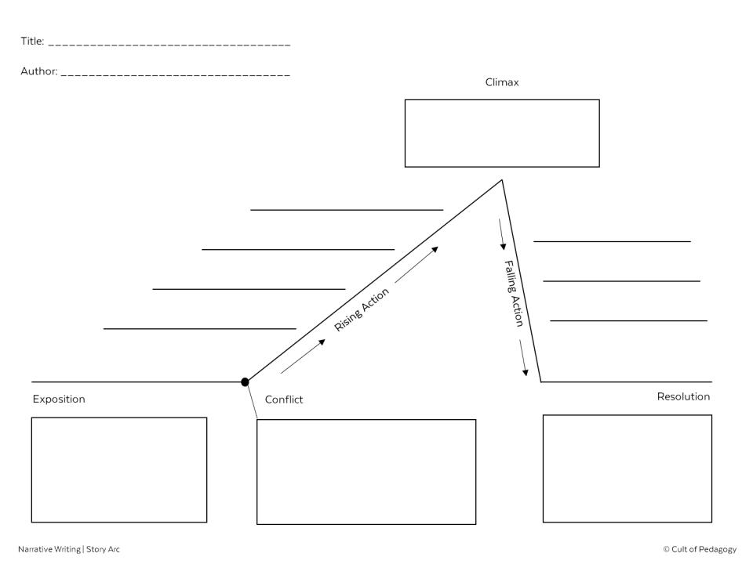
Frog
Jennifer Gonzalez
I chase the frog out of the house with a tennis racket
I spend the rest of the night cleaning up my mess
I try and fail to get it into a bag
I get into pajamas and watch t.v.
I try and fail to trap it in a trash can
My parents come home
I hide from it
Happy that things seem okay, my parents plan another outing
Parents never let me stay home alone, but one night the babysitter cancels and they have to. Everything stats off fine. I’m having a great time.
I see a frog in the hall. I am totally afraid of frogs, so I freak out
I consider asking to not be left alone, then realize the frog incident showed me I’m stronger than I thought.

Slide 22
Selecting Your story
WE ARE….
Use the idea from the yesterday’s exercise
You can use your heart map
Draw on a very specific memory of an event in your life, the life of someone else, or something similar to something you have seen or read before
The character(s) you use need to be your own- no borrowing from books or movies
Patriot Strong!

Slide 23
Story mapping
WE ARE….
Use the plot map graphic organizer given to you to create your own Story map.
It must be done by tomorrow.
Patriot Strong!

Slide 24
Friday November 13, 2020
Learning Target(s)
Students will Use their story arc to decide what parts will be emphasized with a scene and what should be summary
Activities:
Decide which parts of your story need to be summary and which should be a scene.
Finish your story arc

Slide 25
Pacing
MENU

Slide 26
event
event
event
event
event
event
Notes:
A good story doesn’t just describe one event after another, with each event taking up exactly the same amount of time.

Slide 27
event
event
event
event
event
event
Notes:
Instead, it takes some events and expands them to make them extra big and dramatic, and squeezes the less important parts so they’re really small.

Slide 28
seeing frog trying to get it out
getting it out
Parents leave.
eating, dancing, making a mess
cleaning up, PJs, TV
Parents come home.
exposition
Notes:
Here’s how it looks for the story “Frog”: (*) It starts with some exposition about why the character never gets to stay at home, then shows the (*) parents leaving. Next, (*) we see the character eating, dancing, and making a mess in the house—this part is a little longer, because she’s really enjoying her time alone. Next is the (*) biggest part, where she sees the frog, tries a few things to get it out, and finally gets it out. Because this part is the most dramatic, it takes up a big part of the story. Once that’s over, (*) she cleans up, gets into her pajamas, and watches TV. This part is not so dramatic, so it’s quicker. Finally, (*) her parents come home. At this point, the story is just about done, so this part doesn’t take up a lot of time, either.

Slide 29
seeing frog trying to get it out
getting it out
Parents leave.
eating, dancing, making a mess
cleaning up, PJs, TV
Parents come home.
exposition
SUMMARY
SCENE
SUMMARY
SCENE
SUMMARY
SCENE
Notes:
There’s another thing you should notice about the story: Each of these chunks is done in a different way. The exposition is written as (*) a summary, but the part where the parents decide to leave is done (*) as a full scene, with dialogue and more specific actions—it’s like actors have actually come on stage and are acting this part out. Then the part where the character is eating, dancing, and making a mess is done again as a (*) summary: We don’t see every moment of her crazy behavior, just a summary of it. Then comes the big (*) scene: the frog part. This part is done really slowly, so we feel every minute going by. Once that’s over, the character cleans up: This part is done (*) as a summary, too. Finally, when her parents come home, we get to see this again as a (*) scene.

Slide 30
seeing frog trying to get it out
getting it out
Parents leave.
eating, dancing, making a mess
cleaning up, PJs, TV
Parents come home.
exposition
SUMMARY
SCENE
SUMMARY
SCENE
SUMMARY
SCENE
Notes:
At three different times in the story, we also see a break in time: (*) After the parents leave, there’s a jump ahead in time, then another one (*) after she gets rid of the frog, and (*) another one between her settling back down and when her parents come home.
All of those breaks are there because readers don’t really want to see every minute. Some chunks of time just aren’t that interesting, so you can jump over them to get to the more interesting parts.

Slide 31
NOW: Try it with your story.
event
event
event
event
event
event
Notes:
Activity: Now, think about the story you are writing. Create a diagram like this one, where you plan out which parts are going to be big and which parts are going to be small. Think about which parts will be scenes and which parts you can just summarize, and where you might put time breaks.
Note to teacher: Although the example showed scenes and summaries alternating back and forth, they don’t necessarily have to be done that way. Also, the example had three time breaks, but your students’ stories may not need that many. The point is to show them that these are options that many writers use.

