Slide 1
Week 13

Slide 2
Monday November 16, 2020
Learning Target(s)
Students will participate in CPR to increase reading stamina.
Students will learn about modes of story telling.
Students will do 10 minute quick write of their story
Activities:
CPR- classes participating in reading
Check Story arcs, and book logs
Take notes on modes of story telling ref. 25

Slide 3
Reading Time
Don’t forget to log your progress in your book log section.
You may go to the library if you need to check out a book or return a book at this time.

Slide 4
Rough Draft
WE ARE….
Use your story arc to begin your first draft
Patriot Strong!

Slide 5
Modes of Storytelling

Slide 6
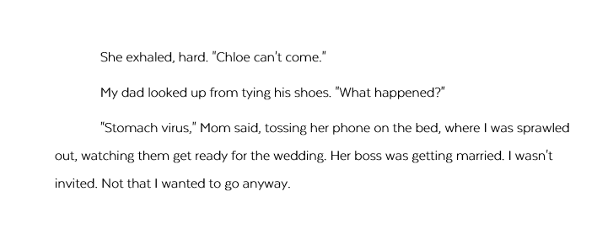
Notes:
Look at this excerpt from the story “Frog.” Turn to a partner and discuss your answers to these questions:
What is happening in this scene?
What plans do the parents have for the night? How do you know?
How does the narrator feel about the wedding? How do you know?
Picturing the scene in your mind, what does it look like? What furniture do you see? How are the people positioned in the room? How do you know that?

Slide 7
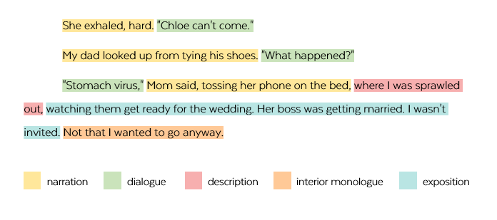
Notes:
Even though this reads like one continuous set of sentences, the author is actually doing a lot of different things all at once. In this lesson, we’re going to look at how writers use different techniques to create a story.

Slide 8
5 Modes for Telling Stories
narration
description
dialogue
interior monologue
exposition
Notes:
Most writers use five different methods, or “modes,” for telling stories. The modes are narration, description, dialogue, interior monologue, and exposition. Usually, they use all five of these in the same story, all mixed up together.

Slide 9
5 Modes for Telling Stories
narration
description
dialogue
interior monologue
exposition
The writer tells you something is happening; the “live action” parts.
Notes:
Narration is when the writer tells you something is happening. These are the “live action” parts of the story, where we can actually picture characters doing things.

Slide 10
5 Modes for Telling Stories
narration
description
dialogue
interior monologue
exposition
I laid the bag on its side in front of him, then grabbed a tennis racket and tried to gently nudge him to go inside. Instead, he hopped to the left and got even closer to me, causing me to drop the racket and run screaming back to my bedroom.
Notes:
Here’s an example from the story “Frog.”
(read aloud if desired)

Slide 11
5 Modes for Telling Stories
narration
description
dialogue
interior monologue
exposition
A detailed look at something in the story; appeals to at least one of the five senses.
Notes:
Description is a detailed look at something in the story. Description appeals to at least one of the five senses.

Slide 12
5 Modes for Telling Stories
narration
description
dialogue
interior monologue
exposition
In the dim hallway, his squatty little body was a silhouette in the light coming from the living room, like a buffalo wing someone had dropped on the floor.
Notes:
This example is a visual description of the frog.
(read aloud if desired)

Slide 13
5 Modes for Telling Stories
narration
description
dialogue
interior monologue
exposition
The characters speak out loud.
Notes:
Dialogue is where the characters speak out loud. Their dialogue is written in quotation marks.

Slide 14
5 Modes for Telling Stories
narration
description
dialogue
interior monologue
exposition
She exhaled, hard. "Chloe can't come."
My dad looked up from tying his shoes. "What happened?"
"Stomach virus," Mom said, tossing her phone on the bed.
Notes:
Here’s an example.
(Read aloud if desired.)

Slide 15
5 Modes for Telling Stories
narration
description
dialogue
interior monologue
exposition
We see a character’s thoughts.
Notes:
Interior monologue is where we see a character’s thoughts.

Slide 16
5 Modes for Telling Stories
narration
description
dialogue
interior monologue
exposition
Seriously, girl, I thought to myself. You're like a hundred times bigger than him. Just end this already.
Notes:
In this example, Bree is talking to herself about getting rid of the frog.

Slide 17
5 Modes for Telling Stories
narration
description
dialogue
interior monologue
exposition
We learn facts or background information about the characters, setting, and situation.
Notes:
Finally, with exposition, we learn facts or background information about the characters, setting, and situation.

Slide 18
5 Modes for Telling Stories
narration
description
dialogue
interior monologue
exposition
Chloe is a college student, the daughter of my parents' friends, and they say she just comes over to "hang out" with me.
Notes:
In this example, we learn who Chloe is. We also learn that Bree’s parents understand that she might feel embarrassed to have a babysitter, so in the past, they have used another term for babysitting.
(Read aloud if desired.)

Slide 19
Notes:
Most writers take all five modes and mix them up in their stories. This section of “Frog” contains all five modes. Take a few moments to see if you can identify them, then discuss your ideas with a partner.

Slide 20
Notes:
How did you do? When you are writing your own story, try to do the same: Use all five modes to tell your story, but weave them together to keep things interesting.
Note to Teacher: There may be some disagreement about some of these. “Watching them get ready for the wedding” could be considered narration, but because this was already in progress when the story started, it could also be considered exposition. Getting this “right” isn’t as important as understanding the purposes for all these different techniques.

Slide 21
STORY MODE SORT
Notes:
Activity: Now you will do an activity called a Story Mode Sort, where you will sort sentences from the story “Frog” by which storytelling mode they are using.
Note to teacher: If you are giving this lesson to a whole class, use the Group version of Story Mode Sort. For students who miss this “live” lesson, give them the PDF of the Modes of Storytelling lesson; that contains a worksheet that has them sort the same sentences, but without the paper strips.

Slide 22
Tuesday November 17, 2020
Learning Target(s)
Students will practice recognition of the mode of story telling
Students will learn about adding exposition and dialogue to your writing
Activities:
Notes on exposition ref p. 26 and Dialogue ref p. 27
Work on your Story Arc or Rough Draft

Slide 23
What story mode is it?
WE ARE….
Take a few minutes to decide on what story mode is presented on the handout you picked up.
Patriot Strong!

Slide 24
Exposition
MENU

Slide 25
narration
description
dialogue
interior monologue
exposition
exposition
MENU
Notes:
You have now seen the term exposition twice: (*) At the beginning of the story arc, and as (*) one of the five modes of storytelling. So which is it? It's both.
The part of a story arc called "exposition" is where the reader is figuring out who the characters are and what their situation is. But if you give too much information at once, without anything happening in the story, you'll bore your readers. One way to handle this is to give a small chunk of exposition at the beginning, then squeeze in more throughout the story. In this mini-lesson, we'll explore a few ways to add exposition to your story.

Slide 26
2 Rules of Exposition
Only give information that’s necessary to the story.
Keep the story moving.
Notes:
Before we do, we'll look at two exposition rules to follow:
(*) 1. Only give information that's necessary to the story. If your character's height does not affect the story, don't tell us how tall he is. If it really doesn't matter what town the story takes place in, leave that information out.
(*) 2. Keep the story moving. If you spend too much time in exposition, but nothing actually happens, your readers will get bored.

Slide 27
Ways to Add Exposition to a Story
expository paragraphs
between lines of narration or dialogue
inside dialogue
inside interior monologue
Notes:
Four strategies you can try for adding exposition to the story are (*) expository paragraphs, (*) between lines of narration or dialogue, (*) inside dialogue, or (*) inside interior monologue. Let’s look at examples of each one of these.

Slide 28
Ways to Add Exposition to a Story
expository paragraphs
between lines of narration or dialogue
inside dialogue
inside interior monologue
I have always wanted my parents to let me stay at home alone, but they almost never do. I'm thirteen. It's ridiculous. They'll go to the store for 30 minutes or maybe let me stay home while they have a dentist appointment or something, but otherwise, if they're going to be gone more than an hour, they have a babysitter come over.
Notes:
Expository paragraphs are whole paragraphs that just give us background information about the characters or their situation. (*) Here’s an example.
(Read aloud if desired.)

Slide 29
Ways to Add Exposition to a Story
expository paragraphs
between lines of narration or dialogue
inside dialogue
inside interior monologue
I turned it up loud—they were always telling me to turn it down—and danced around the kitchen.
“Wait for me,” he called. Since his injury, Mattias had trouble keeping up with me. “I have some news!”
Notes:
You can also squeeze a little bit of exposition in between other things, like lines of narration or dialogue. Here’s an example of putting exposition in the middle of some narration. (*) The sentence is about Bree dancing, but it’s interrupted to give us a bit of information about her parents’ usual rules. You could do the same thing with a line of dialogue, like in (*) this sentence, which is not from the story we read.

Slide 30
Ways to Add Exposition to a Story
expository paragraphs
between lines of narration or dialogue
inside dialogue
inside interior monologue
"...Do you think I'm going to open the door to some serial killer or burn the house down or something? I get good grades in school and I've never gotten in trouble, but apparently I can't be trusted…"
Notes:
Another way to add exposition is right inside a line of dialogue. In other words, have the character say something that provides information about them, like in (*) this example.
When you use this technique, it's important to make the dialogue sound natural. For example, (click to next slide)

Slide 31
Ways to Add Exposition to a Story
expository paragraphs
between lines of narration or dialogue
inside dialogue
inside interior monologue
“Why do you always ask Chloe, a college student, to babysit me?”
(No one talks like that!)
Notes:
…a character would never say, "Why do you always ask Chloe, a college student, to babysit me?" People don't really talk like that, so only add exposition when it would make sense in the conversation.

Slide 32
Ways to Add Exposition to a Story
expository paragraphs
between lines of narration or dialogue
inside dialogue
inside interior monologue
Ugh. Arthur? The last time I watched that show was six years ago!
Notes:
Finally, you can add exposition inside interior monologue, the character’s thoughts inside her head. (*) Here, Bree is reacting to her father’s suggestion that they watch the show “Arthur,” and in her thoughts, she adds that she hasn’t watched the show in six years. She doesn’t say it aloud, but she thinks it.

Slide 33
Dialogue
MENU

Slide 34
What time should we meet?
Let’s meet at five.
Notes:
Dialogue is what we call the things characters say out loud. Adding dialogue to your story can make it more interesting and dramatic.

Slide 35
Rules for Punctuating Dialogue
Put quotation marks around the part that is spoken.
Notes:
There are a couple of rules for punctuating dialogue that you need to know. The first one is (*) Put quotation marks around the part that is spoken.

Slide 36
What time should we meet?
Let’s meet at five.
“What time should we meet?” he asked.
“Let’s meet at five,” she said.
Notes:
So this conversation would look like this: (*) “What time should we meet?” he asked. (*) “Let’s meet at five,” she said. The quotation marks act just like the speech bubbles: They wrap around the spoken words to show that they are said out loud.

Slide 37
“What time should we meet?” he asked.
“Let’s meet at five,” she said.
quote
speaker tag
quote
speaker tag
Notes:
The part that is spoken is called the (*) quote, and the part that tells you who said it is called the (*) speaker tag.

Slide 38
Rules for Punctuating Dialogue
Put quotation marks around the part that is spoken.
The end punctuation of the quote stays inside the quotation marks.
Notes:
Rule #2 is: (*) The end punctuation of the quote stays inside the quotation marks.

Slide 39
“What time should we meet?” he asked.
Notes:
Notice that this question mark is inside the quotation marks.

Slide 40
“Let’s meet at five.”
“Let’s meet at five,” she said.
Notes:
This quote ends in a period, so that would go inside the quotation marks. But (*) if there’s a speaker tag after it, then that period changes to a comma. This is the only time you’d change it—question marks and exclamation points don’t change, just periods.

Slide 41
Rules for Punctuating Dialogue
Put quotation marks around the part that is spoken.
The end punctuation of the quote stays inside the quotation marks.
If the speaker tag comes before the quote, put a comma after it.
Notes:
Rule #3 is: (*) If the speaker tag comes before the quote, put a comma after it.

Slide 42
“Let’s meet at five,” she said.
She said, “Let’s meet at five.”
Notes:
So if this quote came after the speaker tag instead (*), that comma would go back to being a period, and you’d add a comma after the speaker tag.

Slide 43
Rules for Punctuating Dialogue
Put quotation marks around the part that is spoken.
The end punctuation of the quote stays inside the quotation marks.
If the speaker tag comes before the quote, put a comma after it.
Start a new line every time the speaker changes.
Notes:
Rule #4 is: (*) Start a new line every time the speaker changes.

Slide 44
“How many did you get?” Josie asked.
“I don’t know,” Ruby said. “Maybe twelve? I lost count, but it was a lot.”
“That’s great!” Josie said.
“Thanks!”
Notes:
This conversation happens between Josie and Ruby. Every time the speaker changes, a new line starts. Because readers know this, you can sometimes skip the speaker tag completely—we know the last line was said by Ruby because it’s her turn, even though there’s no speaker tag on it.

Slide 45
When to Use Dialogue
seeing frog trying to get it out
getting it out
Parents leave.
eating, dancing, making a mess
cleaning up, PJs, TV
Parents come home.
exposition
SUMMARY
SCENE
SUMMARY
SCENE
SUMMARY
SCENE
DIALOGUE
DIALOGUE
Notes:
Now, let’s talk about WHEN to use dialogue in your story. In a previous lesson, (*) we looked at how some parts of your story should be scenes and some parts should be summaries. The scenes will be the more dramatic and interesting parts of the story, and usually, scenes contain dialogue. In “Frog,” only (*) two scenes contain dialogue: the conversations with Bree’s parents at the beginning and the end of the story.

Slide 46
When to Use Dialogue
You don’t have to include everything that everyone says.
Notes:
What's important to know about dialogue is that you don't have to include everything that everyone says. Instead of writing out an entire conversation in dialogue, you can just summarize most of it and only show the most dramatic parts.

Slide 47
"Hi," Tina said.
"Hi," Brian said.
"What are you doing?" Tina asked.
"Not much," Brian said.
"Oh," Tina said.
Notes:
Suppose you were going to write about a girl named Tina who saw her friend Brian cheat on a test, and she wants to tell him that it upset her, since she studied really hard for it. Their lockers are right next to each other, and she sees him after school. Their conversation might start out (*) like this. (Read conversation out loud.)
This is boring. Nothing important is happening right now, so instead of including all of this back and forth in your story, skip it!

Slide 48
After school, Tina was at her locker and Brian showed up. After exchanging small talk for a minute, Tina finally came out with it.
"I saw you in math," she said.
"What do you mean?" Brian said.
"With that cheat sheet in your lap," she said. "I saw it."
Notes:
Instead, you could write a quick summary of what's going on, then get right to the interesting part of the conversation, which happens a few minutes into it (*).
(Read conversation out loud.)
Now we have some serious tension--this is the kind of dialogue you want to show. Remember this when you're adding dialogue to your story: Cut out all the boring stuff and only put into dialogue the parts that are actually going to be interesting.

Slide 49
Other Ways to Keep Dialogue Interesting
vary speaker tags
Notes:
Lastly, let’s talk about a few more things you can do to keep your dialogue interesting. The first is to (*) vary your speaker tags. In other words, don’t use the same kinds of speaker tags over and over again.

Slide 50
“Said” is dead?
Notes:
You may have been told to avoid using the word "said" at all costs. This is because your teachers want you to use more interesting words. That makes sense, but it's really easy to overdo it and still end up with some pretty uninteresting dialogue. Let’s look again at that boring conversation from before:

Slide 51
"Hi," Tina said.
"Hi," Brian said.
"What are you doing?" Tina asked.
"Not much," Brian said.
"Oh," Tina said.
Notes:
Now, let’s replace the word “said” with other words…

Slide 52
"Hi," Tina exclaimed.
"Hi," Brian replied.
"What are you doing?" Tina demanded.
"Not much," Brian declared.
"Oh," Tina mumbled.
Notes:
It's STILL a boring conversation, but now it's just dressed up with fancy speaker tags. In fact, the constant switching up of verbs in these speaker tags is kind of distracting. The whole conversation should be replaced with something more interesting.

Slide 53
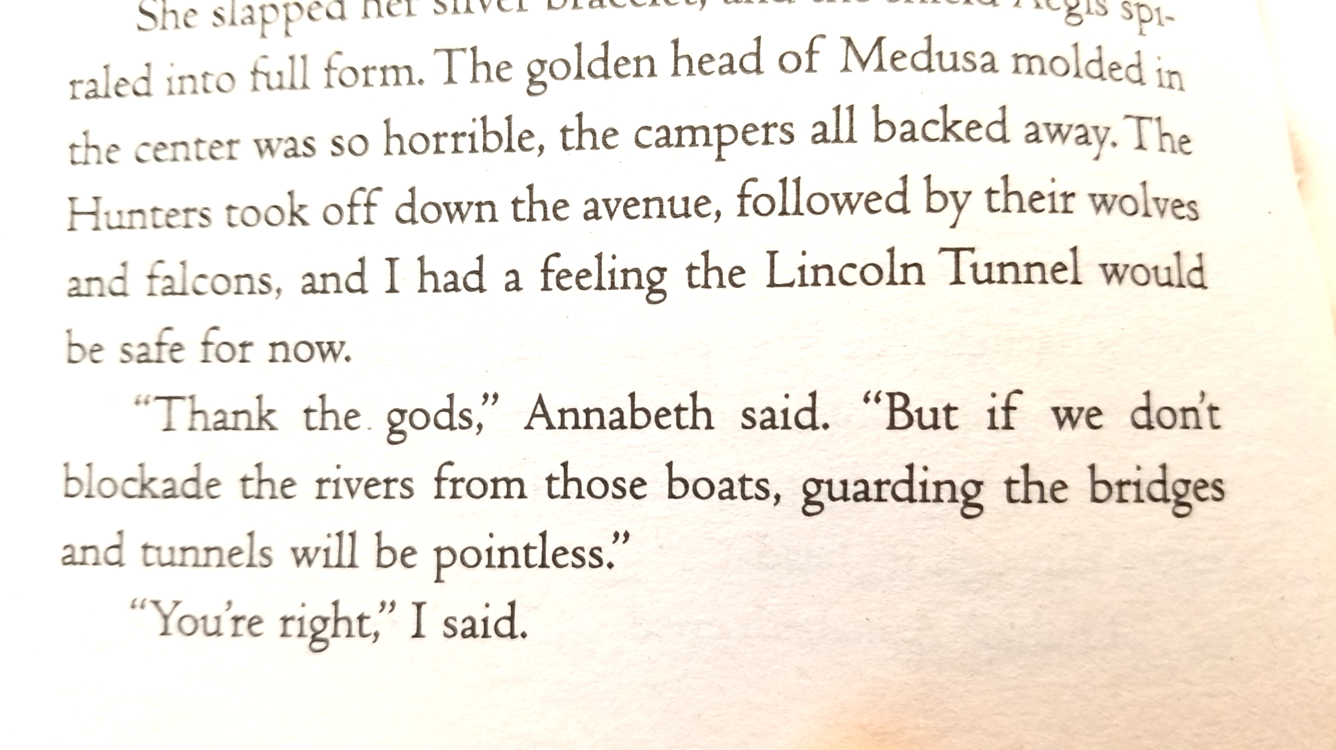
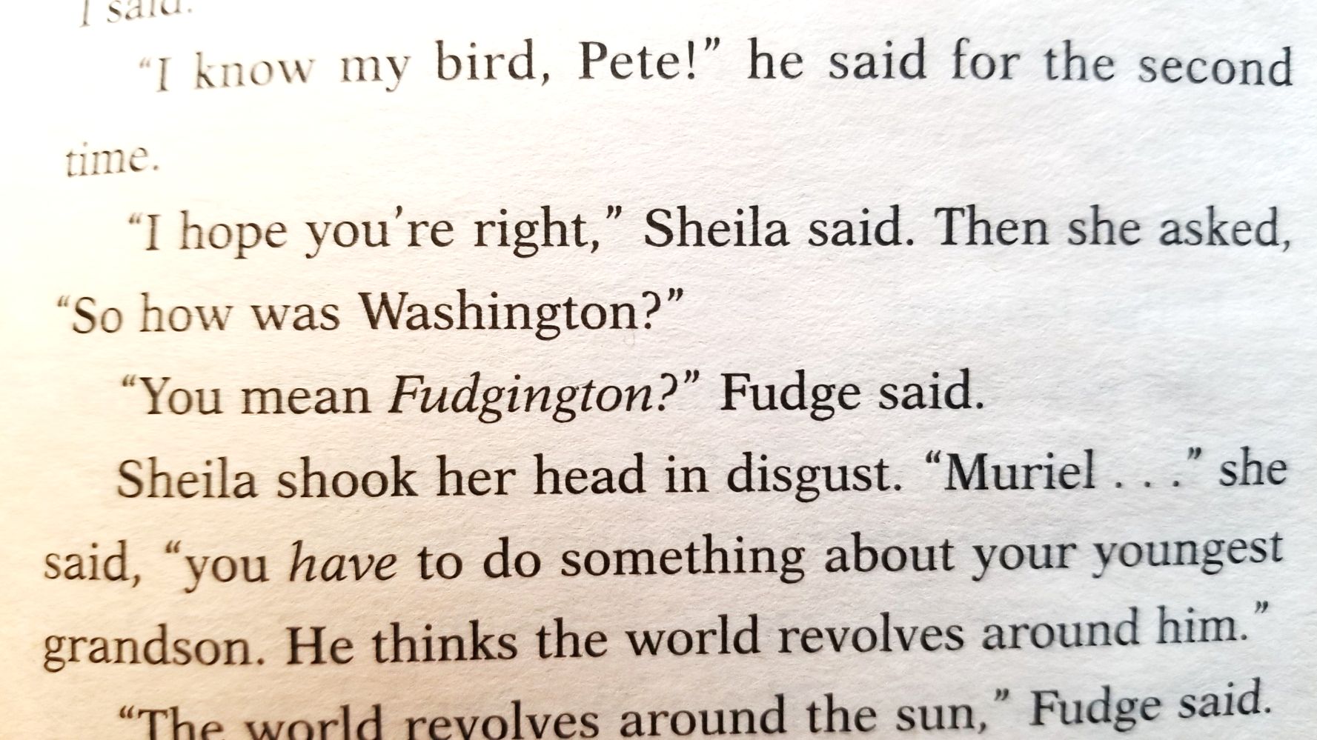
Double Fudge,
Judy Blume
The Last Olympian, Rick Riordan
Notes:
If you look at most published novels, you might be surprised by how often the author actually uses the word "said." Or when they do replace it, it's often with something pretty simple, like "answered.“ Instead of replacing the word "said," most authors vary their speaker tags in other ways:

Slide 54
Quote first | “Let’s meet at five,” she said.
Speaker tag first | She said, “Let’s meet at five.”
Physical gesture | My dad looked up from tying his shoes. "What happened?"
Interior monologue | I couldn’t believe it. “Are you kidding?”
No speaker tag | “Are you ready?” he asked. “Nope!”
Notes:
We’ve already looked at how you can put the speaker tag before or after the quote, but you can do a lot of other things, too. You can (*) use physical gestures instead of a speaker tag, like in this sentence: My dad looked up from tying his shoes. “What happened?”
You can (*) use interior monologue in place of a speaker tag, like this: I couldn’t believe it. “Are you kidding?” Or you can sometimes (*) skip the speaker tag completely, like in this last sentence, if it’s obvious who is talking.

Slide 55
Other Ways to Keep Dialogue Interesting
vary speaker tags
paraphrase
Notes:
Another thing you can try is to (*) paraphrase a character’s speech instead of quoting them directly.

Slide 56
“Why do we have to do drills again?” I whined.
Without looking up from his clipboard, Coach recited through his usual reasons: practice makes perfect, muscle memory, and so on.
“But we do it every day,” I said. “Can’t we ever take a break?”
Notes:
Read this conversation. (pause)
We don’t see the coach’s direct quote. Instead, the author paraphrases what he said. Maybe this is because his speech would be too long, or maybe it’s a way to show us that the protagonist tunes it out. Either way, it’s a different way to show the conversation instead of including every bit of dialogue.

Slide 57
Other Ways to Keep Dialogue Interesting
vary speaker tags
paraphrase
create pauses
Notes:
The third technique you can try is to (*) create pauses in your dialogue with other storytelling modes.

Slide 58
"I saw you in math," she said.
"What do you mean?" Brian said.
"With that cheat sheet in your lap," she said. "I saw it."
Notes:
Let’s look at this conversation again. We can create more tension if we add other stuff between the lines of dialogue, like this. (click to next slide)

Slide 59
"I saw you in math," she said.
At first it looked like he hadn’t heard her. He just moved his books around, rearranging them, even though they were perfectly organized already. Finally, without looking at her, he said, "What do you mean?"
"With that cheat sheet in your lap," she said. "I saw it."
Notes:
This description of Brian nervously messing around with his books takes a while to read. In that time, no one is talking, so it’s building up more of the suspense and creating an uncomfortable pause.
Here’s another example:

Slide 60
"Seriously, though," I said, sitting up. "I don't know what you guys think is gonna happen.”
Notes:
The speaker tag has been placed between two quotes, along with a little bit of narration. That brief pause is about the same amount of time that Bree would have paused between the first sentence and the second one. Since she would naturally pause there anyway, you can place the speaker tag (and maybe something else) right there to create that pause.

Slide 61
NOW:
Add dialogue to the most dramatic parts of your story.
Remove boring dialogue.
Use some new techniques to make your dialogue interesting.
Notes:
Activity: Now, look at the draft you’re working on for your story. Try doing these things: Add dialogue to the most dramatic parts of your story, remove boring dialogue, and use some new techniques to make your dialogue more interesting.

Slide 62
Improving your Writing
WE ARE….
Using the notes you just took and your pacing guide, find places where you can add more exposition to your writing. Indicate the place where you plan to add more exposition by putting the type of exposition you want to add to that spot.
Ex.
“Look L.W. we’ve been at this for almost a year. I’ve recited it in seclusion. I’ve recited it to you. I know it so well I have to be sure not to say it out of force of habit. Besides we aren’t in friendly territory, even the trees might have ears.”
Between lines exposition about what is bothering L.W.
Patriot Strong!

Slide 63
Wednesday November 18, 2020
Learning Target(s)
Students will lean about adding description to their writing
Activities:
Notes on adding description to writing ref. p. 28
Continue improving the rough draft

Slide 64
Description
MENU

Slide 65
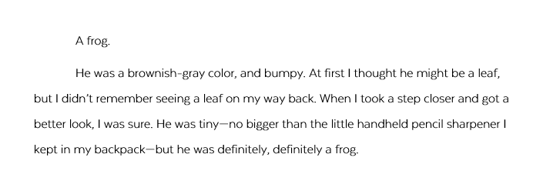
Notes:
Description is where we are getting a detailed look at something in the story. When you add description, you help your reader feel like they are really experiencing the events in your story, and this makes them care more about what happens.

Slide 66
WHAT to Describe
RELEVANT details: things that really matter in the story.
IRRELEVANT
RELEVANT
Notes:
Just like with exposition and dialogue, your descriptions should be focused only on (*) relevant details—things that really matter in the story. In “Frog,” the (*) clothes Bree is wearing don’t have any impact on the story, so the story doesn’t include a description of her clothes. Instead, the detailed description is given to the (*) frog himself.

Slide 67
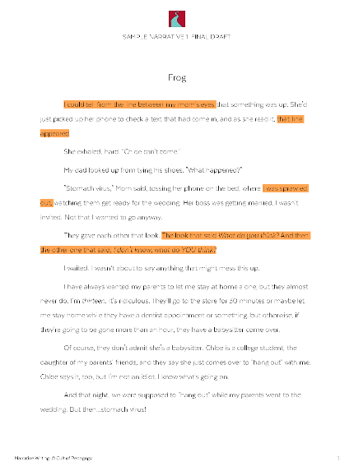
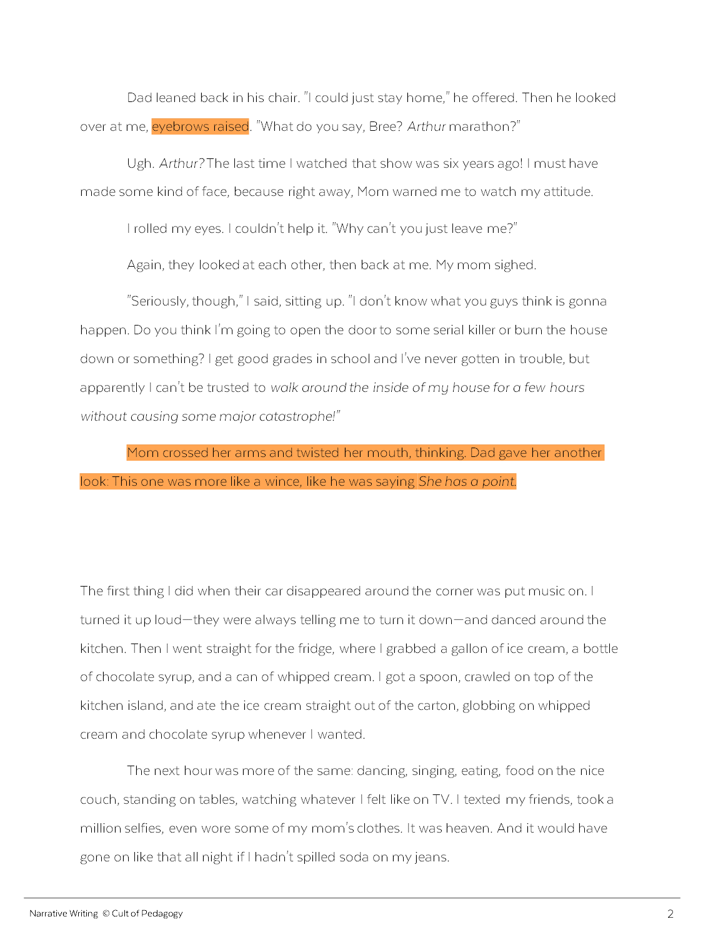
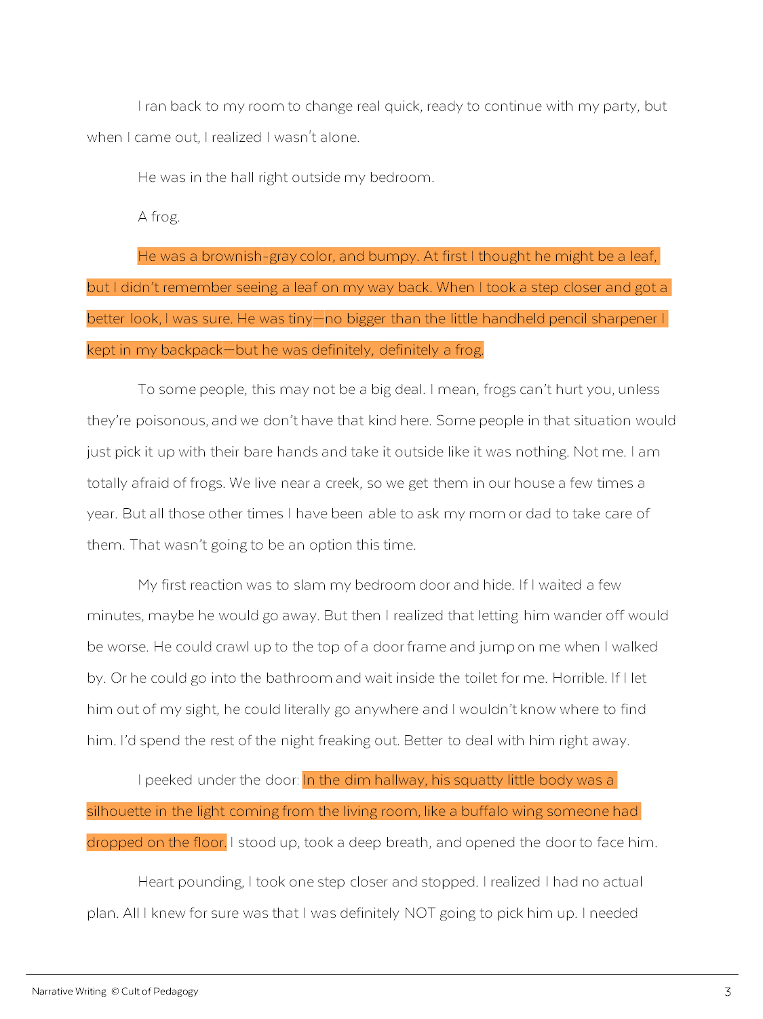
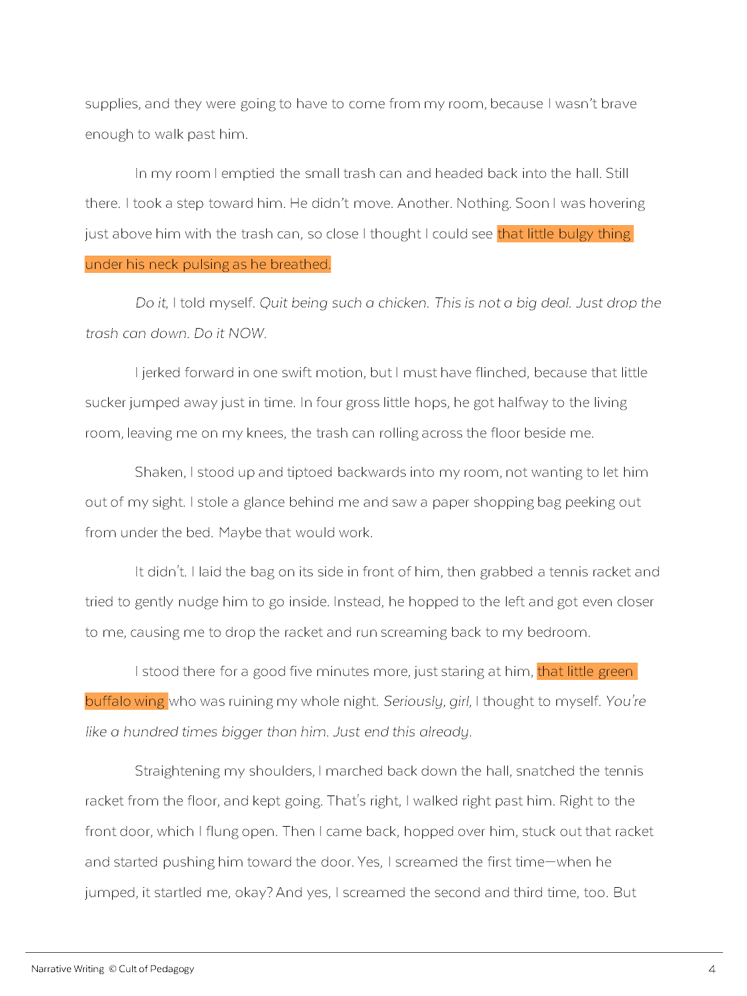
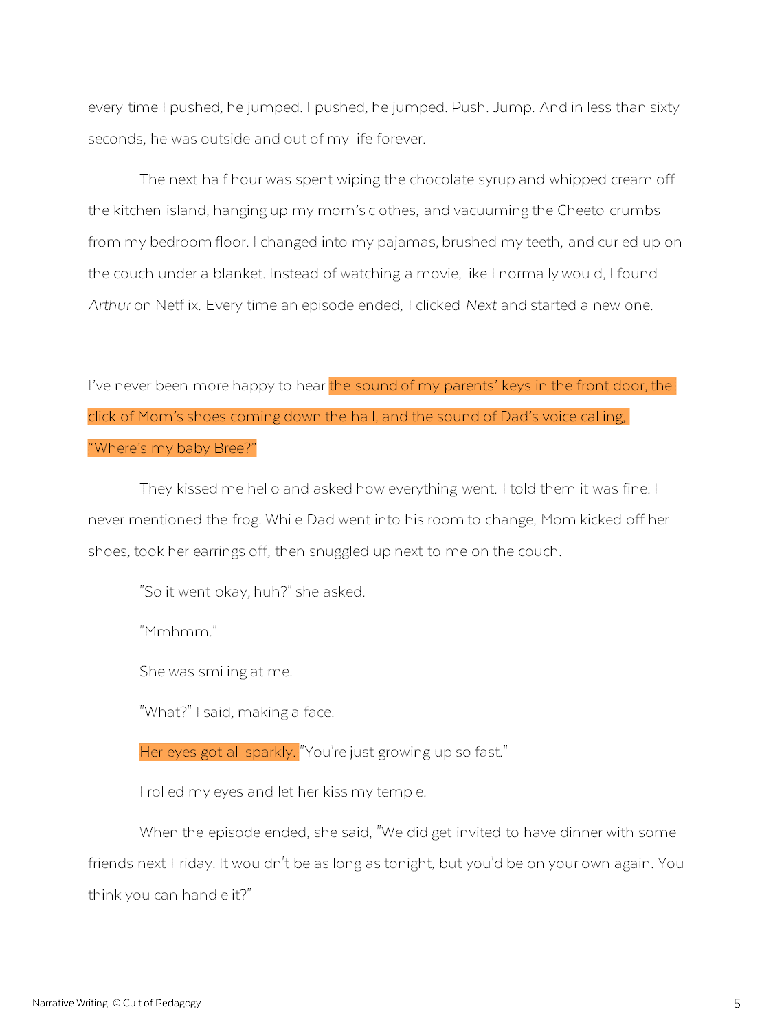
WHEN to Describe
Add description in parts of the story when a character would notice that thing.
Notes:
As the author, you get to decide when to describe things in your story. Just like with exposition, description can work best if you (*) spread it around your story, rather than dumping it all out in one place. A good guideline to follow is to (*) add description right at the times when a character would be noticing, experiencing, or thinking about that thing. In “Frog,” we don’t see the description of the frog (*) until the frog actually shows up in the story.

Slide 68
HOW to Describe
sensory details
sight, sound, smell, taste, and touch
Notes:
You can use a variety of techniques to describe things. One way is to use sensory details: (*) Use sight, sound, smell, taste, and touch to describe something.

Slide 69
sight
He was a brownish-gray color, and bumpy…no bigger than the little handheld pencil sharpener I kept in my backpack.
taste + touch
The bread was still hot from the oven. The salty taste of butter flooded my mouth as I sunk my teeth in.
sound + touch
Every now and then the boom-boom of a passing car stereo would make the glasses in our kitchen cabinets rattle.
smell
Hours after she hugged me, the smell of cigarette smoke and perfume stuck to my clothes.
Notes:
Here are some examples. (Go through these one at a time.)

Slide 70
HOW to Describe
sensory details
sight, sound, smell, taste, and touch
You don’t need to use ALL senses ALL the time!
Notes:
One tip for using sensory details is that (*) you don’t need to use all of the senses all the time. Just choose the senses that fit the situation.

Slide 71
HOW to Describe
sensory details
similes and metaphors
compare two things that are not usually connected
Notes:
Another way to describe what something is like is with similes and metaphors, which (*) compare two things that are not usually connected.

Slide 72
simile
…his squatty little body was a silhouette in the light coming from the living room, like a buffalo wing someone had dropped on the floor.
uses like or as
metaphor
I stood there for a good five minutes more, just staring at him, that little green buffalo wing who was ruining my whole night.
doesn’t use like or as
Notes:
A simile uses like or as to compare the two things. (*) Here’s an example: “his squatty little body was a silhouette in the light coming from the living room, like a buffalo wing someone had dropped on the floor.”
A metaphor is a lot like a simile, but it doesn’t use like or as: (*) “I stood there for a good five minutes more, just staring at him, that little green buffalo wing who was ruining my whole night.”

Slide 73
HOW to Describe
sensory details
similes and metaphors
personification
use human characteristics to describe a non-living thing
The waves reached out and pulled us in.
Notes:
Another option is to use personification, where you (*) use human-like characteristics to describe a non-living thing.
For example, if you wanted to make the ocean seem powerful and scary, you might write, (*) “The waves reached out and pulled us in.”

Slide 74
HOW to Describe
sensory details
similes and metaphors
personification
interpretation
how a character understands or interprets something
They gave each other that look. The look that said What do you think? And then the other one that said, I don't know, what do YOU think?
Notes:
Finally, you can use interpretation, which is (*) how a character understands or interprets something.
For example, when Bree’s parents look at each other in “Frog,” instead of trying to describe their actual facial expressions, the story just gives us a (*) description of how Bree interprets their expressions—the meaning behind them.

Slide 75
Showing vs. Telling
“Show, don’t tell.”
Telling: She was angry.
Showing: She slammed the door so hard it shook the whole house.
Notes:
A common piece of writing advice is (*) “Show, don’t tell.” Most of the time, this is good advice, because a good story lets the reader experience things instead of just being told about them. For example, instead of writing, (*) “She was angry,” it’s more interesting to write (*) “She slammed the door so hard it shook the whole house.” In the second sentence, the writer is showing us how angry she is, instead of just telling us she was angry.

Slide 76
Showing vs. Telling
“Show AND tell.”
Notes:
But there are times when it makes more sense to show AND tell, because combining both helps readers get a better idea of the meaning you’re trying to convey. Take a look at one of the examples from earlier:

Slide 77
showing only:
Every now and then the boom-boom of a passing car stereo would make the glasses in our kitchen cabinets rattle.
Notes:
This sentence is only showing. But if we add just a little bit of telling to this description, it can change its whole meaning.
(click to next slide)

Slide 78
showing and telling:
Every now and then the boom-boom of a passing car stereo would make the glasses in our kitchen cabinets rattle, and every time I prayed it would stop at our house—then I would know my brother was finally home.
Notes:
(read the revised sentence)
Now we understand that the sound of the passing car has a deeper, positive meaning for the speaker.
Now look how different this same detail feels if we change the end of the sentence: (click to next slide)

Slide 79
showing and telling:
Every now and then the boom-boom of a passing car stereo would make the glasses in our kitchen cabinets rattle, and every time I held my breath, praying it would pass by.
Notes:
(read the revised sentence)
With this different ending, the passing car suddenly becomes more frightening.

Slide 80
NOW:
Find places in your story to add description: Use sensory details, a metaphor, a simile, some personification, or an interpretation.
Put most of the description in places where the characters would notice those things.
Remove description that isn’t relevant to the story.
Find places that need more showing or more telling and decide what works best.
Notes:
Activity: Now, look at the draft you’re working on for your story. Try doing these things: (read bullets as you click through them)

Slide 81
Thursday November 19, 2020
Learning Target(s)
Students will learn how to add interior monologues and transitions to their story
Activities:
Interior monologue notes ref p. 29 and transition notes ref p. 30
Continue improving the rough draft

Slide 82
Interior Monologue
MENU

Slide 83
What time should we meet?
She’s pretty cute.
Let’s meet at five.
Notes:
As we go through our lives, we think lots of things that we never say out loud (*). The great thing about stories is that many of them let us get inside a character’s head and hear what they are thinking.

Slide 84
“What time should we meet?” he asked, thinking, She’s pretty cute.
“Let’s meet at five,” she said.
interior monologue
Notes:
Interior monologue is the storytelling mode that shows us what a character is thinking.

Slide 85
“What time should we meet?” he asked, thinking, She’s pretty cute.
interior monologue
= inside
Notes:
The word “interior” means “inside,” meaning the thoughts happen inside the character’s head, and
(click to next slide)

Slide 86
“What time should we meet?” he asked, thinking, She’s pretty cute.
interior monologue
= conversation between one person and him- or herself
monologue = 1
dialogue = 2 or more
Notes:
The word “monologue” means a conversation between one person and him- or herself.
(*) The prefix “mono” means one, and the prefix (*) “dia” means two, so dialogue is a conversation between two or more people, and monologue is a conversation with just one person alone.

Slide 87
Why Use Interior Monologue?
To provide information
Ugh. Arthur? The last time I watched that show was six years ago!
Notes:
Why would a writer use interior monologue? There are a few reasons. One is (*) to provide information that doesn’t naturally fit into the story. In (*) this example, we learn that Bree hasn’t watched “Arthur” in six years. It just happens to be something she thinks, so we get to see inside her head AND learn something about her at the same time.

Slide 88
Why Use Interior Monologue?
To provide information
To add tension
Do it, I told myself. Quit being such a chicken. This is not a big deal. Just drop the trash can down. Do it NOW.
Notes:
Another reason is to add tension. (*) This section of interior monologue makes us wait longer to see what Bree will do about the frog. Because she’s kind of yelling at herself here, it builds the emotion in the story as we wait to see if she’ll follow her own commands.

Slide 89
Why Use Interior Monologue?
To provide information
To add tension
To help us understand characters
If I waited a few minutes, maybe he would go away. But then I realized that letting him wander off would be worse. He could crawl up to the top of a door frame and jump on me when I walked by. Or he could go into the bathroom and wait inside the toilet for me. Horrible.
Notes:
Finally, interior monologue can help us understand characters in a story. (*) This passage lets us see the way Bree thinks and helps us better understand how her fear feels to her.

Slide 90
How to Format Interior Monologue
indirect
If I waited a few minutes, maybe he would go away. But then I realized that letting him wander off would be worse. He could crawl up to the top of a door frame and jump on me when I walked by. Or he could go into the bathroom and wait inside the toilet for me. Horrible.
Not the exact words “spoken” inside the character’s head.
Notes:
So how do you format interior monologue? There are two different kinds, and you can treat them differently. The first kind is (*) indirect, which is not the exact words that are “spoken” inside the character’s head. These are more like a summary or a paraphrasing of their thoughts, like (*) this example. For these, you don’t really need to do anything special; you can just write them like regular sentences.

Slide 91
How to Format Interior Monologue
direct
Do it, I told myself. Quit being such a chicken. This is not a big deal. Just drop the trash can down. Do it NOW.
The exact words “spoken” inside the character’s head.
Not a “rule”
“Speaker tag” not required, but helpful
Notes:
Direct interior monologue is where we see the actual words that are being “spoken” inside the character’s head. For these, (*) some writers choose to put those words in italics. Keep in mind that (*) this is not a strict rule: Some writers use italics, and some don’t. Also, (*) using a “speaker tag” to let the reader know that this is the character “talking” inside his or her head is not required, but sometimes it can be helpful so that the reader isn’t confused.

Slide 92
Point of View
Name | IM? | Definition | Example
1st person | Yes | Uses “I” voice, sees story through one character’s eyes. | I like going to the park.
3rd person omniscient | Yes | Uses “he/she” voice, sees story through many characters’ eyes. | She liked going to the park, but he didn’t.
3rd person limited | Yes | Uses “he/she” voice, sees story through ONE characters’ eyes. | She liked going to the park, but she didn’t think he liked it.
3rd person objective | No | Uses “he/she” voice, sees story through no characters’ eyes. | They went to the park.
IM = interior monologue
Notes:
Not all types of stories can have interior monologue. If a story is told from a certain point of view, we won’t see inside any of the characters’ heads. This chart shows which points of view allow for interior monologue (IM). (review each item)
(Note to teacher: If your students are all writing personal narratives, then they would all be in first person, so you could skip this slide altogether. If some or all students are writing short stories, then this slide would be important to go over.)

Slide 93
NOW:
Find places in your story to add interior monologue: Look for places where the reader might wonder what the character is thinking, and add some in.
Notes:
Activity: Now, find places in your story to add interior monologue. Look for places where the reader might wonder what the character is thinking, and add some in.

Slide 94
Transitions

Slide 95
?
MENU
Notes:
In your story, (*) you are taking readers on a journey. To make that journey enjoyable, you need to make sure your reader is never confused or lost while they read.

Slide 96
transitions
words and phrases that show the relationships between ideas, sentences, and paragraphs
first, second, third
meanwhile, later
Notes:
One of the best ways to guide your reader through your writing is to use effective transitions, (*) words and phrases that show the relationships between ideas, sentences, and paragraphs. Transitions act as little signposts in a piece of writing to help the reader along. Some examples of transition words are (*) first, second, and third, or (*) meanwhile and later.

Slide 97
The first thing I did when their car disappeared around the corner was put music on. I turned it up loud—they were always telling me to turn it down—and danced around the kitchen. Then I went straight for the fridge, where I grabbed a gallon of ice cream, a bottle of chocolate syrup, and a can of whipped cream. I got a spoon, crawled on top of the kitchen island, and ate the ice cream straight out of the carton, globbing on whipped cream and chocolate syrup whenever I wanted.
The next hour was more of the same: dancing, singing, eating, food on the nice couch, standing on tables, watching whatever I felt like on TV. It was heaven. And it would have gone on like that all night if I hadn't spilled soda on my jeans.
I ran back to my room to change real quick, ready to continue with my party, but when I came out, I realized I wasn't alone.
Notes:
This passage from “Frog” has all of the transition words and phrases highlighted. Some of these are pretty long, (*) like these two. Both of these contain lots of words that aren’t transition words, but as a group, they behave like transitions, connecting the different parts of the story. Sometimes people talk about a story “flowing” well: Those stories probably have a lot of good transitions in them. Take a look at this passage without the transitions:
(click to next slide)

Slide 98
I put music on. I turned it up loud—they were always telling me to turn it down. I danced around the kitchen. I went straight for the fridge. I grabbed a gallon of ice cream, a bottle of chocolate syrup, and a can of whipped cream. I got a spoon. I crawled on top of the kitchen island. I ate the ice cream straight out of the carton, globbing on whipped cream and chocolate syrup whenever I wanted.
I did more of the same: dancing, singing, eating, food on the nice couch, standing on tables, watching whatever I felt like on TV. It was heaven. I spilled soda on my jeans.
I ran back to my room to change real quick, ready to continue with my party. I realized I wasn't alone.
Notes:
(Give students time to read this silently, or read it aloud to them, emphasizing the choppiness.)
In this version, the same events are happening, but the story is much choppier, and we don’t see how the events are connected to each other.

Slide 99
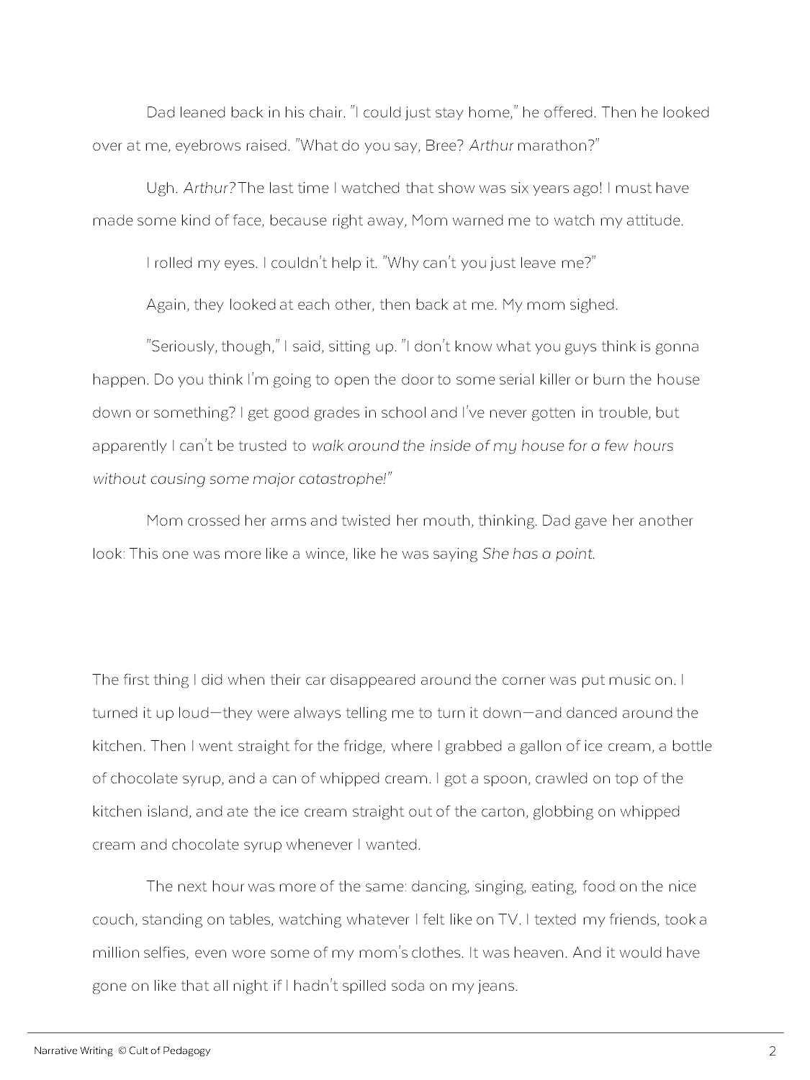
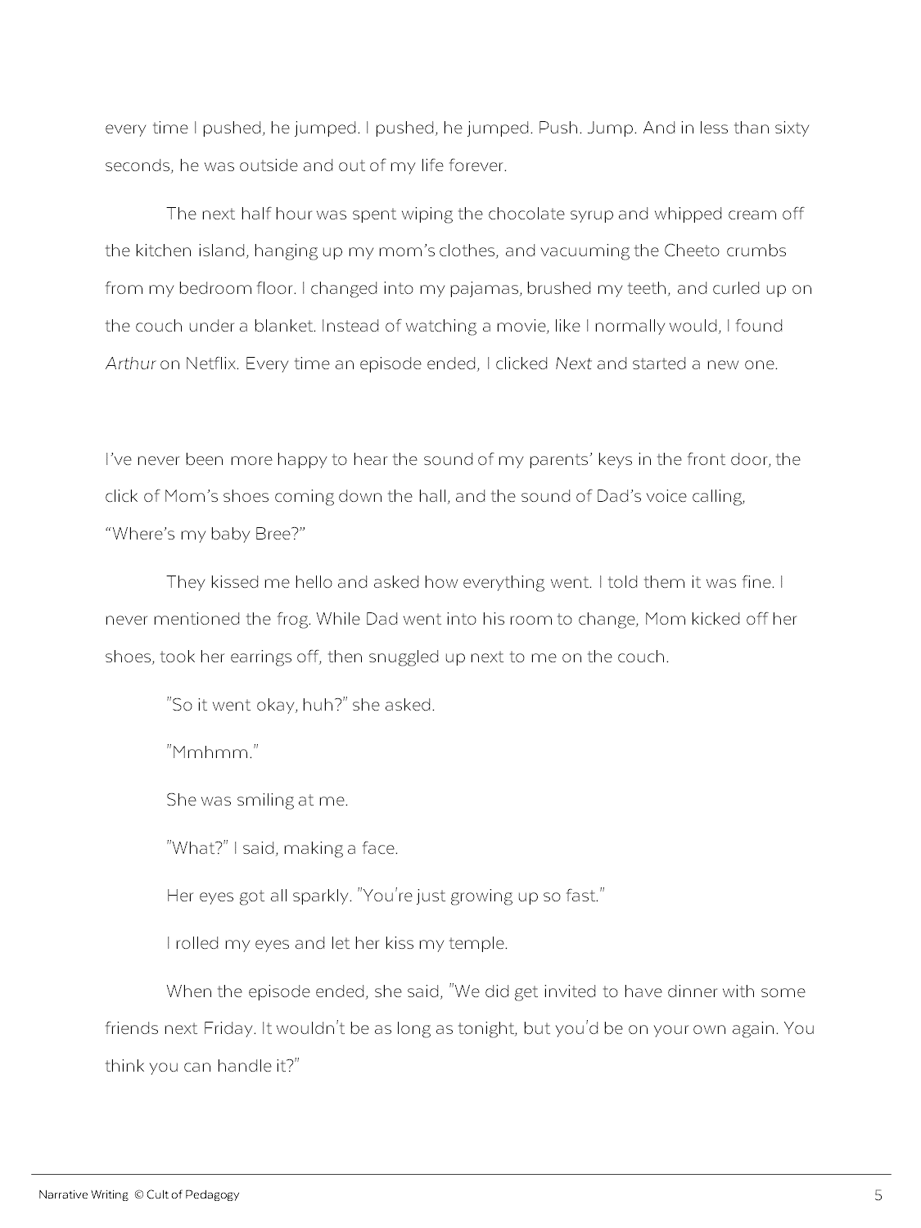
Notes:
Another way you can create transitions in narrative writing is to use space. In (*) two places in the story “Frog,” you’ll see extra space between paragraphs. This is one way to show that a chunk of time has passed. Usually this is done because nothing really interesting happens in that span of time, so the author just makes a jump. Try not to do this too often, though: If your story is full of big spaces like this, it will be hard for your reader to really dig into your story.

Slide 100
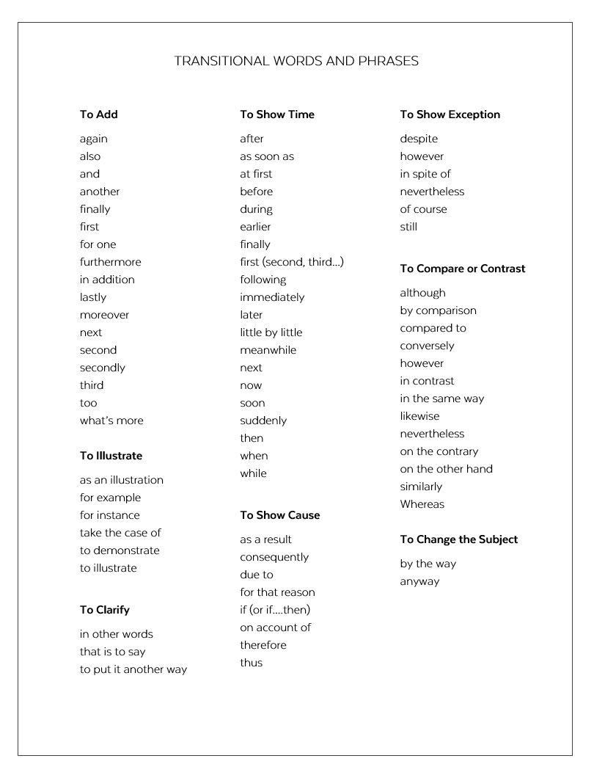
NOW:
Find places in your story to add transitions. Look for places that feel choppy or where the reader might need help understanding how things are connected. Use this list to find possible words.
Notes:
Activity: Now, find places in your story to add transitions. Look for places that feel choppy or where the reader might need help understanding how things are connected. Use (*) this list to find possible words. (Note to teacher: This list is available in the PDF version of this mini-lesson.)

Slide 101
Friday November 20, 2020
Learning Target(s)
Students will learn about improving the flow of writing
Students will learn about creating good openings and endings to stories.
Activities:
Notes on transitions ref p. 31, openings ref p. 32, and endings ref. p.33
Continue improving the rough draft

Slide 102
The Ending
MENU

Slide 103
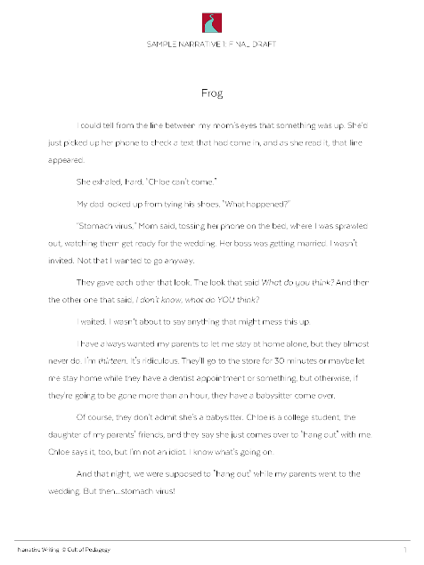
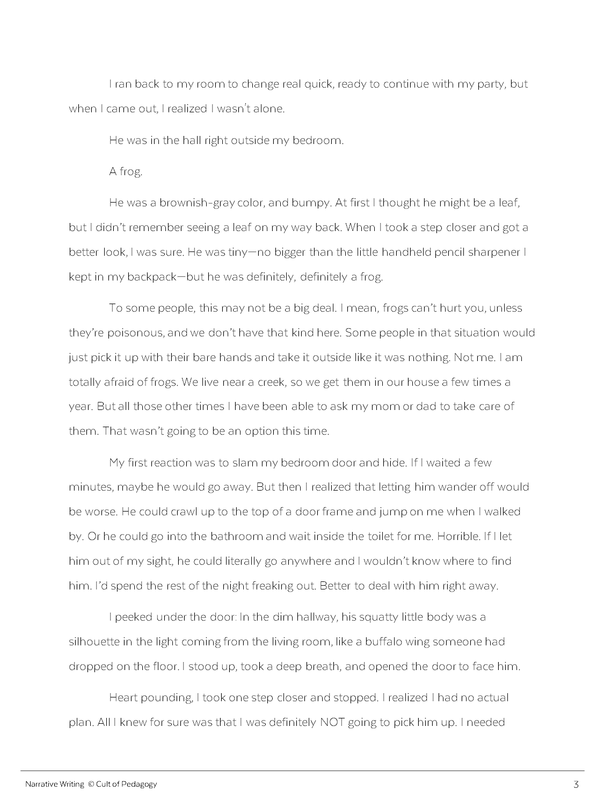
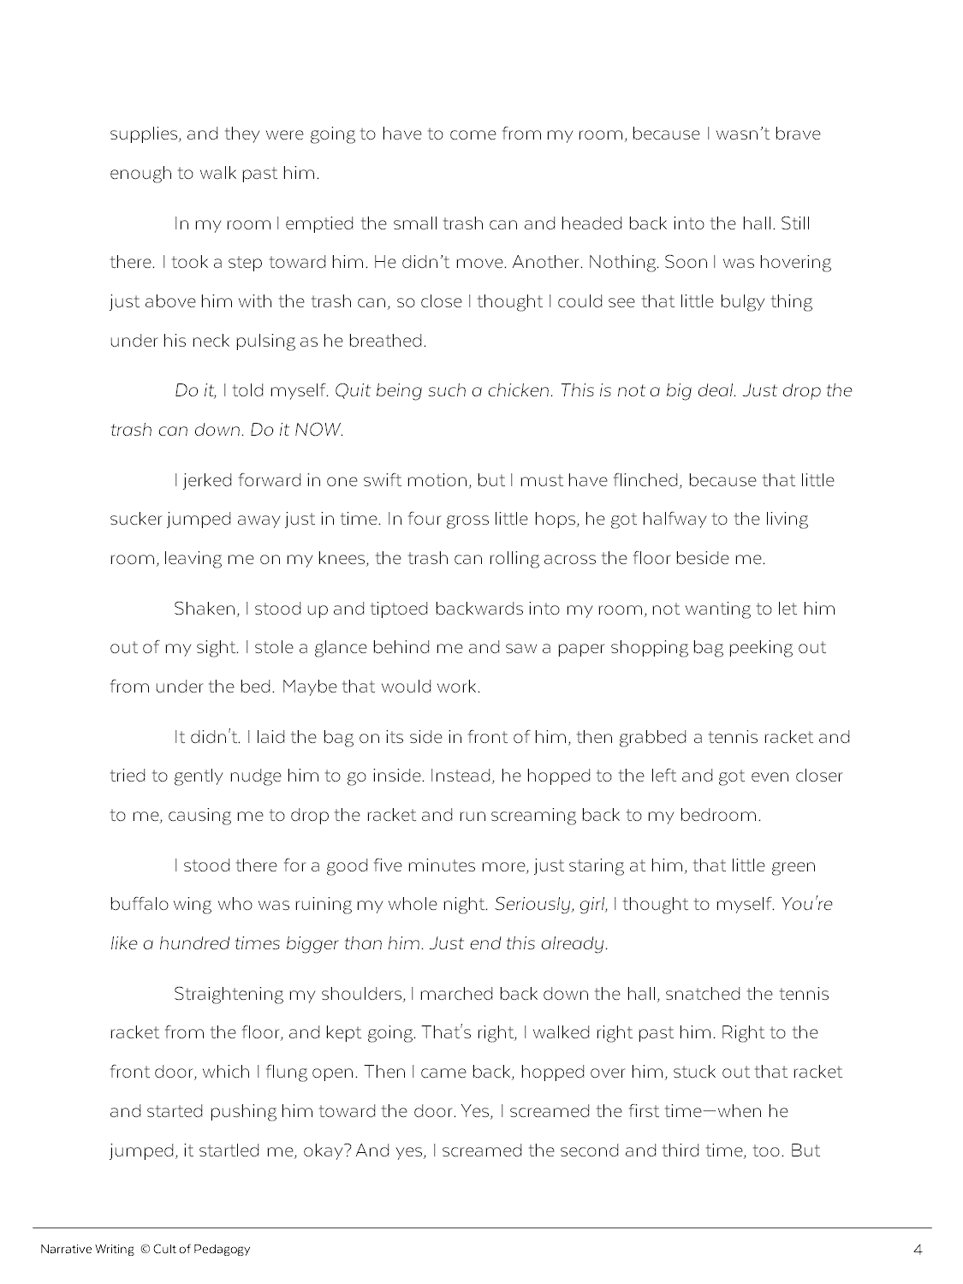
?
Notes:
Your story is written, but you’re not sure how to end it. If you want your readers to feel satisfied after reading your story, a well-written ending is essential. Let’s start by taking a look at three questions you need to check off to make sure you have a satisfying ending.

Slide 104
Checklist for a Good Ending
1. Is the main conflict resolved?
Notes:
The first question is Is the main conflict resolved?
By the end of your story, your conflict should be resolved in some way. Even if it’s not a happy ending, the most pressing conflict should be over for the most part.
In “Frog,” the conflict (*) is that the frog is in the house and Bree wants him gone. By the end of the story, (*) she has gotten the frog out. That conflict has been resolved.

Slide 105
Checklist for a Good Ending
1. Is the main conflict resolved?
2. Are the other loose ends tied up?
Notes:
The second question is, Are the other loose ends tied up?
Other things might happen in your story that need to be wrapped up by the time you’re done. In “Frog,” (*) Bree makes a mess in several rooms of her house, so it’s important to mention that she cleaned this up. If she didn’t clean it up, that would be okay, too, but the story should then include the parents’ reaction when they saw the mess. We can’t just have her mess up the house and then drop that detail completely before the story is over. (*) The same should be true of your story: Make sure your reader isn’t going to have any unanswered questions by the time the story is over.

Slide 106
Checklist for a Good Ending
1. Is the main conflict resolved?
2. Are the other loose ends tied up?
3. Do we get a glimpse of how things will be different now?
Notes:
The final question is Do we get a glimpse of how things will be different now?
In a good story, something should change by the end; make sure your readers can tell what that is. The story “Frog,” was about more than just a frog: (*) Bree wanted her independence. By the end of the story, she has gotten it, but she realizes that it comes with bigger responsibilities than she’d expected. We needed that last scene to see that Bree has grown to appreciate her parents more, but she also realizes that she’s strong enough to handle tough situations.

Slide 107
5 Types of Story Endings
Summary
Description
Gesture
Dialogue
Interior Monologue
Notes:
So how do you actually write the ending? We’ll look at five different types: (*) summary, (*) description, (*) gesture, (*) dialogue, and (*) interior monologue.

Slide 108
5 Types of Story Endings
After that night, my parents felt more comfortable leaving me at home for longer periods of time. And even though my battle with the frog made me appreciate it more when they were around, I knew that even when things got a little scary and I could act like a big fool, in the end I could take care of things myself.
Summary
Notes:
The first type is a summary, where you’d just summarize the situation or what the character has learned. This is not the most creative or moving type of ending, but it gets the job done. (*) Here is a different way “Frog” could have ended if it used a summary ending.

Slide 109
5 Types of Story Endings
While Dad went into his room to change, Mom kicked off her shoes, took her earrings off, then snuggled up next to me on the couch. I pulled my blanket over her knees and leaned into her, inhaling her perfume. My father joined us a few minutes later and curled up on the other side, the three of us like a sandwich.
Summary
Description
Notes:
If you end with a description of something—an object, a person, a crowd—you can create a mood or suggest the character’s state of mind without having to explain it. Suppose that instead of showing that Bree was feeling confident by the end of “Frog,” we want to show that she really didn’t want to be left alone anymore. (*) We could have ended that story with a description of her parents sitting beside her. (pause to read)
Although Bree’s description doesn’t come right out and say it, it shows us how happy and safe she’s feeling to have her parents back home. If we end the story there, the reader is left with a strong sense that Bree is mostly relieved to have her parents home and isn’t thinking much about having time to herself anymore.

Slide 110
5 Types of Story Endings
For a second, I pictured myself on the floor of the hall, the trash can on its side, that little buffalo wing torturing me for half the night. Then I glanced past her and saw the tennis racket leaning in the corner.
I looked back at her. “That sounds great.”
I snuggled deeper into the blanket, lifted the remote, and clicked Next.
Summary
Description
Gesture
Notes:
Another way to finish a story is to have your main character do some sort of gesture or action that shows something has changed. (*) This is how “Frog” ends. When Bree lifts the remote and puts on another episode of Arthur, it’s a way of showing that she’s comfortable with her decision.

Slide 111
5 Types of Story Endings
For a second, I pictured myself on the floor of the hall, the trash can on its side, that little buffalo wing torturing me for half the night. Then I glanced past her and saw the tennis racket leaning in the corner.
I looked back at her. “That sounds great.”
Summary
Description
Gesture
Dialogue
Notes:
You could also end your story with dialogue: a direct quote from one of the characters. In that same example from before, if we just took off the last line, we could end the story with the quote instead.

Slide 112
5 Types of Story Endings
For a second, I pictured myself on the floor of the hall, the trash can on its side, that little buffalo wing torturing me for half the night. Then I glanced past her and saw the tennis racket leaning in the corner.
I would be just fine.
Summary
Description
Gesture
Dialogue
Interior Monologue
Notes:
Finally, a story could be ended with a few lines of interior monologue, where we hear a character’s closing thoughts. If we wanted to do this with the original ending, we could remove the last two lines and instead, add a line of interior monologue.

Slide 113
Finding more ideas…
other stories
inside your story
Notes:
Keep in mind that there are lots of other ways to end stories. To give yourself a better variety of choices, look at (*) other short stories and novels and explore the different ways they end. Also, (*) look through the story you already have: You might find that there’s already a line or section that would make a great ending instead.

Slide 114
NOW:
Read your story or have someone else read it and go through the Checklist for a Good Ending to make sure your ending meets all of those items.
Try some of the five ending styles with your own story until you find one that you like best. If you want more ideas, look at other stories and see how the authors chose to end them.
Your ending might already be somewhere else in your story; you might just need to move it to the end.
Notes:
(read the slide)
Note to teacher: It might be helpful to give students a copy of the PDF version of this mini-lesson so they can reference the checklist and the five styles as they work.

Slide 115
The Opening
MENU

Slide 116
?
Notes:
Some writers wait until they have most of their story written before deciding how they want to start it. You might already have a good opening for your story, but just in case, now would be a good time to reconsider it before you decide your story is finished.

Slide 117
4 Types of Story Openings
Scene
Statement
Summary
Description
Notes:
In this lesson, we will look at four types of story openings: (*) scene, (*) statement, (*) summary, and (*) description.

Slide 118
4 Types of Story Openings
Frog
I could tell from the line between my mom's eyes that something was up. She'd just picked up her phone to check a text that had come in, and as she read it, that line appeared.
She exhaled, hard. "Chloe can't come."
Scene
Notes:
The first type is a scene. This is how the final version of the story “Frog” begins: right in the middle of a scene between Bree and her parents.

Slide 119
4 Types of Story Openings
Frog
I am totally afraid of frogs. I know it’s silly, because they can’t hurt you unless they’re poisonous, and we don’t even have that kind of frog near us. I know some people who just pick them up with their bare hands like it’s nothing. Not me. We live near a creek, so we get them in our house a few times a year, and when we do, I always just ask my mom or dad to take care of them.
That wasn’t going to be an option this time.
Scene
Statement
Notes:
Another way the story “Frog” could have opened is with a statement like this.

Slide 120
4 Types of Story Openings
Frog
I have always wanted my parents to let me stay at home alone, but they almost never do. I'm thirteen. It's ridiculous. They'll go to the store for 30 minutes or maybe let me stay home while they have a dentist appointment or something, but otherwise, if they’re going to be gone more than an hour, they have a babysitter come over.
But one night, the babysitter got a stomach virus, and that changed everything.
Scene
Statement
Summary
Notes:
“Frog” could have started with the summary of Bree’s history of not getting to stay home alone.

Slide 121
4 Types of Story Openings
Frog
At first I thought it was a leaf: the brownish-green, bumpy thing that was lying in the hall when I came out of my room. But I didn’t remember seeing a leaf earlier. When I took a step closer and got a better look, I was sure. He was tiny—no bigger than the little handheld pencil sharpener I kept in my backpack—and there was no doubt about it. He was definitely, definitely a frog.
Scene
Statement
Summary
Description
Notes:
Finally, a different opening for “Frog” would be the description of the frog. It would start by zooming right in on the frog itself, then it would have to back up and explain the events that led up to Bree noticing it in the first place.

Slide 122
Finding more ideas…
other stories
inside your story
Notes:
Keep in mind that there are lots of other ways to start stories. To give yourself a better variety of choices, look at (*) other short stories and novels and explore the different ways they start. Also, (*) look through the story you already have: You might find that there’s a section in the middle that you want to move to the beginning.

Slide 123
NOW:
Try some of these opening styles with your own story until you find one that you like best.
If you want more ideas, look at other stories and see how the authors chose to start them.
Your opening lines might already be somewhere else in your story; you might just need to move them to the top.
Notes:
Now, go to your story and try some of these opening styles until you find one that you like best. (read the rest of the slide)

Slide 124
Get to improving your writing.
WE ARE….
Patriot Strong!

