Slide 1
Week 14

Slide 2
Monday November 30, 2020
Learning Target(s)
Students will participate in CPR
Students will learn about creating a title and improving sentence variety
Students will create a narrative story
Activities:
Reading Log
Title notes ref p. 34
Sentence Variety notes ref p. 35
Bracket your Story showing where each part of your story arc (5 stages of plot)begins and ends

Slide 3
Reading Time
Don’t forget to log your progress in your book log section.
You may go to the library if you need to check out a book or return a book at this time.

Slide 4
The Title
MENU

Slide 5
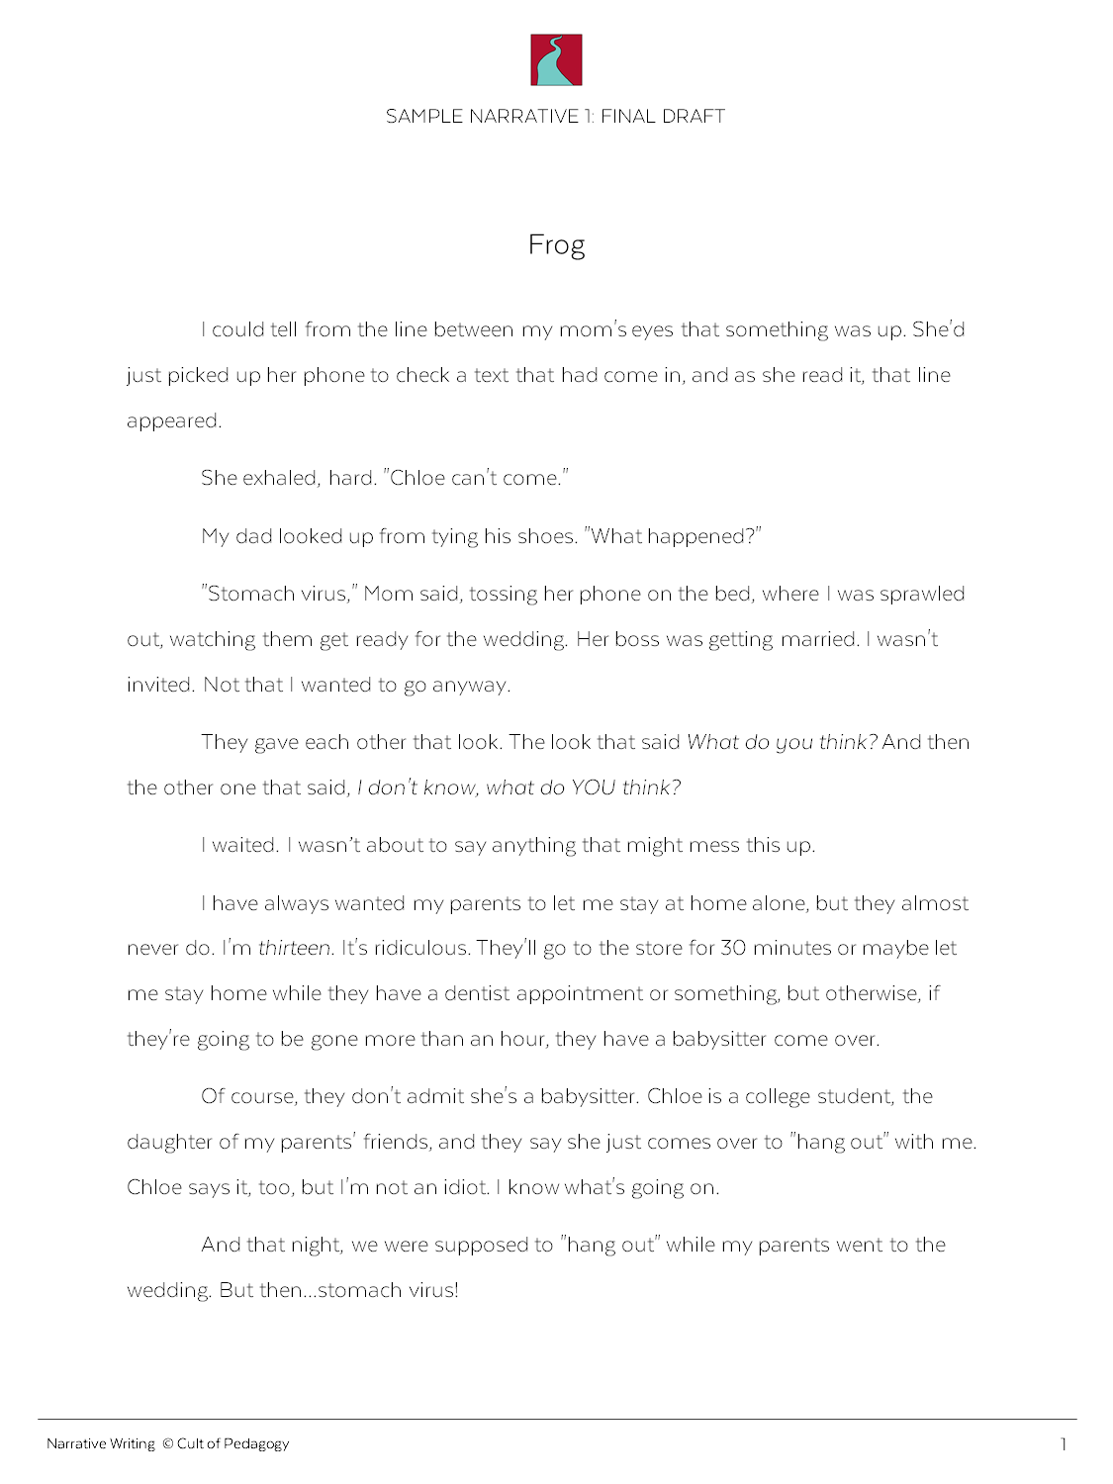
Notes:
Before you finalize your story, you need to decide on the title. You may already have a title that works, but consider whether another one might be better.

Slide 6
other stories
Notes:
One great way to get inspiration for your title is to look at titles from other stories and novels.

Slide 7
Story Titles
Hoot
Wonder
Monster
The Bet
Fish Cheeks
Everyday Use
Everything, Everything
Short
Notes:
Story titles come in all different kinds of lengths.
(*) Some titles, like these, are very short.

Slide 8
Story Titles
A Monster Calls
I Go Along
The Maze Runner
Superman and Me
The Yellow Wallpaper
I Am Number Four
The Things They Carried
Short
Medium
Notes:
Some, like these, are medium-length.

Slide 9
Story Titles
A Clean, Well-Lighted Place
One of Us Is Lying
A Very Old Man with Enormous Wings
A Heartbreaking Work of Staggering Genius
The Curious Incident of the Dog in the Nighttime
Short
Medium
Long
Notes:
And others are longer.

Slide 10
Your Title: What Gets Capitalized?
first and last word of the title
short verbs like be, am, is, and was
all words that are four letters long or longer
Notes:
When you’re writing a title, some words get capitalized, and others don’t. Here’s what to capitalize:
(click one at a time through each and read)

Slide 11
What Does NOT Get Capitalized?
articles (a, an, the)
conjunctions (and, but, for, nor, or, so, yet)
prepositions that are 3 or fewer letters (at, by, for, in, of, off, on, to)
(unless these words are the first or last word of the title)
Notes:
Here’s what doesn’t get capitalized:
(click one at a time through each and read).

Slide 12
The Yellow Wallpaper
Notes:
For example, all three words in “The Yellow Wallpaper” get capitalized, even the word “The” because it’s at the beginning of the title.

Slide 13
Superman and Me
Notes:
In “Superman and Me,” the “and” is not capitalized, because it is a small article and it isn’t the first or last word.

Slide 14
The Curious Incident of the Dog in the Nighttime
Notes:
The same rule applies to this title, where all words are capitalized except for “of,” “in,” and “the.”

Slide 15
I Am Number Four
Notes:
But the word “am” is capitalized in “I Am Number Four,” even though it is short, because it is a verb.

Slide 16
Check Your Understanding
diary of a wimpy kid
Notes:
Now let’s see if you understand the rules. How would you capitalize this title?
(answer on next slide)
Note to teacher: Students do not need to write down their answers; they can just do this in their heads.

Slide 17
Diary of a Wimpy Kid

Slide 18
Check Your Understanding
the lion, the witch, and the wardrobe
Notes:
Here’s another: How would you capitalize this title?
(answer on next slide)

Slide 19
The Lion, the Witch, and the Wardrobe

Slide 20
Check Your Understanding
frog and toad are friends
Notes:
Last one: How would you capitalize this title?
(answer on next slide)

Slide 21
Frog and Toad Are Friends
Notes:
In this case, the word “are” is capitalized, because it is a verb.

Slide 22
NOW:
Brainstorm a list of 10 possible titles for your own story until you find one that you like best.
Experiment with long and short titles to see what you come up with.
Use titles of other stories for inspiration.
Notes:
(read slide to students)

Slide 23
Sentence Variety
MENU
Notes:
One way to make your writing more interesting is to improve your sentence variety. When a writer uses a lot of the same types of sentences, it can make the writing kind of lifeless.

Slide 24
I emptied the small trash can in my room. I headed back out into the hall. I saw that the frog was still there. I took a step toward him, but he didn’t move. I hovered just above him with the trash can. I could see that little bulgy thing under his neck. It pulsed as he breathed.
Notes:
Look at this paragraph, which is from an early draft of “Frog.” (pause to read it out loud)
It clearly describes the action that is happening, but so many of the sentences are the same: They start the same, they are about the same length, and they have a similar style. Now let’s look at the same paragraph with better sentence variety…
(click to next slide)

Slide 25
In my room I emptied the small trash can and headed back into the hall. Still there. I took a step toward him. He didn’t move. Another. Nothing. Soon I was hovering just above him with the trash can, so close I thought I could see that little bulgy thing under his neck pulsing as he breathed.
Notes:
The second version has a much better mix of sentences. To improve sentence variety in your story, work on varying your sentence lengths, sentence beginnings, and sentence styles.

Slide 26
How to Improve Sentence Variety
Vary sentence length.
I emptied the small trash can in my room (9). I headed back out into the hall (7). I saw that the frog was still there (8). I took a step toward him, but he didn’t move (10). I hovered just above him with the trash can (9). I could see that little bulgy thing under his neck (10). It pulsed as he breathed (5).
Notes:
The first way to improve sentence variety is to vary sentence length.
When most of your sentences are about the same length, your writing can feel choppy and robotic. So look for places where you can add some very short sentences, and other places where you can combine sentences to make them longer. (*) In the first paragraph we just looked at, most of the sentences are close in length.

Slide 27
How to Improve Sentence Variety
Vary sentence length.
In my room, I emptied the small trash can and headed back into the hall (15). Still there (2). I took a step toward him (6). He didn’t move (3). Another (1). Nothing (1). Soon I was hovering just above him with the trash can, so close I thought I could see that little bulgy thing under his neck pulsing as he breathed (29).
Notes:
In the revised paragraph, the sentence lengths have a much wider variety.

Slide 28
How to Improve Sentence Variety
Vary sentence length.
I spent the next half hour wiping the chocolate syrup and whipped cream off the kitchen island, hanging up my mom’s clothes, and vacuuming the Cheeto crumbs from my bedroom floor. I changed into my pajamas, brushed my teeth, and curled up on the couch under a blanket. I found Arthur on Netflix instead of watching a movie, like I normally would.
Vary sentence beginnings.
Notes:
Another strategy is to vary sentence beginnings. If a lot of your sentences start the same way, (*) like in this paragraph, it can make your writing feel repetitive.

Slide 29
How to Improve Sentence Variety
Vary sentence length.
The next half hour was spent wiping the chocolate syrup and whipped cream off the kitchen island, hanging up my mom’s clothes, and vacuuming the Cheeto crumbs from my bedroom floor. I changed into my pajamas, brushed my teeth, and curled up on the couch under a blanket. Instead of watching a movie, like I normally would, I found Arthur on Netflix.
Vary sentence beginnings.
Notes:
In this revised paragraph, two sentences have been rewritten so that they start differently. This adds more interest and variety to the writing.

Slide 30
How to Improve Sentence Variety
Vary sentence length.
My parents don't admit she's a babysitter. Chloe is a college student. She is the daughter of my parents' friends. My parents say she comes over to "hang out" with me. Chloe says the same thing. I'm not an idiot. I know what's going on.
Vary sentence beginnings.
Vary sentence styles.
Notes:
The last way to improve your sentence variety is by varying sentence styles. This paragraph (*) contains several sentences that use the same style, with a simple subject, followed by a verb, and then a little more information. If we revise it, changing some of the sentences to give them a different style, it makes the paragraph more interesting. (click to next slide)

Slide 31
How to Improve Sentence Variety
Vary sentence length.
Of course, they don't admit she's a babysitter. Chloe is a college student, the daughter of my parents' friends, and they say she just comes over to "hang out" with me. Chloe says it, too, but I'm not an idiot. I know what's going on.
Vary sentence beginnings.
Vary sentence styles.
Notes:
This paragraph has better variety.

Slide 32
other stories
Notes:
One of the best ways to discover new ways to write sentences is by studying published stories to see what other writers do, then imitating their sentence styles in your own writing.

Slide 33
Heart pounding, I took one step closer and stopped.
phrase describing the subject,
action
and
action
Panting heavily, the dog charged toward the pool and jumped in.
Their costumes twinkling, the dancers burst onto the stage and dazzled the crowd.
Notes:
For example, this sentence appears in “Frog.” It is made up of a (*) phrase describing the subject, followed by a comma, then (*) an action and (*) another action. Other sentences that imitate this same style are (*) “Panting heavily, the dog charged toward the pool and jumped in,” and (*) “Their costumes twinkling, the dancers burst onto the stage and dazzled the crowd.”

Slide 34
He was tiny—no bigger than the little handheld pencil sharpener I kept in my backpack—but he was definitely, definitely a frog.
Straightening my shoulders, I marched back down the hall, snatched the tennis racket from the floor, and kept going.
Notes:
Here are two other sentences whose styles you can try. Look at your story draft and find places where you can imitate these sentence styles in your own story.

Slide 35
NOW:
Go through a chunk of your story and count the number of words in each sentence. If the total number in most sentences is close, revise for better variety.
Read your story out loud and look for places where you are starting lots of sentences the same way. Revise them so they have different beginnings.
Look through published stories for sentence styles you can imitate in your own writing, and add some of these styles to your story.
Notes:
(Read slide.)

Slide 36
Tuesday December 1, 2020
Learning Target(s)
Students will learn about word choice and peer review
Students will continue writing a narrative story
Activities:
Word choice notes ref. p. 36
Peer review notes ref. p. 37

Slide 37
Word Choice
MENU

Slide 38
I walked into the room and saw some food.
I crept into the kitchen and spotted a chocolate cake on the counter.
I rushed into the classroom and found seven grilled-cheese sandwiches waiting on my desk.
Notes:
Look at this sentence: “I walked into the room and saw some food.” It’s a pretty plain sentence, using vague words like “room” and “food,” so we don’t get a very vivid picture of what’s happening.
Now if we replace some of those words with more precise ones, we might end up with a sentence like this (*): “I crept into the kitchen and spotted a chocolate cake on the counter.” Now we see things much more clearly, and the sentence just got a lot more interesting.
If we change the words again, we get a completely different idea (*): “I rushed into the classroom and found seven grilled-cheese sandwiches waiting on my desk.”
Choosing the right words is one of the best ways to make your writing a lot more interesting.

Slide 39
Guidelines for Powerful Word Choice
Choose precise nouns and vivid verbs.
I have a pet.
I have a dog.
I have a Chihuahua.
I went to school.
I hurried to school.
Notes:
These guidelines will help you make more powerful word choices. The first is to (*) choose precise nouns and verbs. Nouns can be very general or very precise. For example, saying (*) “I have a pet” is vague, (*) “I have a dog” is more precise, and (*) “I have a Chihuahua” is even more precise, and more interesting.
The same is true for verbs: (*) “I went to school” is pretty drab, but (*) “I hurried to school” gives us a more vivid picture of what is happening.
If you find that your writing is a bit boring, look for ways to make your nouns more specific and your verbs more vivid.

Slide 40
Guidelines for Powerful Word Choice
Choose precise nouns and vivid verbs.
Use fewer adjectives and adverbs.
Notes:
The next guideline is to use fewer adjectives and adverbs.
(click to next slide)

Slide 41
Guidelines for Powerful Word Choice
kitten
peered
Choose precise nouns and vivid verbs.
The small, timid, orange cat looked out from behind the couch.
Use fewer adjectives and adverbs.
The orange kitten peered out from behind the couch.
describes a noun
Notes:
An adjective describes a noun. (*) This sentence, “The small, timid, orange cat looked out from behind the couch,” uses three adjectives: small, timid, and orange. Listing adjectives like this is an easy way to give details, but it can interrupt the rhythm of the story, and there are better ways to do it.
Since most cats are around the same size, (*) “small” can be left out, or we could describe the cat as a (*) kitten instead, if it’s very small.
(*) “Timid” can be shown with a better verb. Instead of (*) “looked,” we could say “peered.”
If we want to keep “orange” just to add some interest, that’s okay, but if it doesn’t have any impact on the story, that could be left out, too.
(*) Now we have a tighter sentence with fewer adjectives and stronger nouns and verbs.

Slide 42
Guidelines for Powerful Word Choice
Choose precise nouns and vivid verbs.
She walked slowly across the field.
She limped across the field.
She shuffled across the field.
She tiptoed across the field.
Use fewer adjectives and adverbs.
describes a verb
Notes:
An adverb describes a verb. In this sentence, the adverb “slowly” is describing the verb “walked.” This is an okay way to give your reader more detail about how she walked, but it would be even better if you could use a precise verb and get rid of the adverb completely. Each of these three examples uses a different verb, and each one means something slightly different: (click through and read each one).

Slide 43
Guidelines for Powerful Word Choice
Choose precise nouns and vivid verbs.
I jumped forward in one swift motion, but I must have flinched, because that little sucker jumped away just in time. In four gross little jumps, he got halfway to the living room…,
Use fewer adjectives and adverbs.
Try not to repeat.
Notes:
The third guideline is try not to repeat. In (*) this passage, the word “jump” is used three times very close together. This starts to feel repetitive. Sometimes the only way to even notice this problem is by reading your work out loud—then you can “hear” the repetition and find places where you need more variety.
Now, if we replace two of those “jump” words with other words… (click to next slide)

Slide 44
Guidelines for Powerful Word Choice
Choose precise nouns and vivid verbs.
I jerked forward in one swift motion, but I must have flinched, because that little sucker jumped away just in time. In four gross little hops, he got halfway to the living room…,
Use fewer adjectives and adverbs.
Try not to repeat.
Notes:
…we get a richer, more interesting sentence.
So keep this in mind when you’re writing. It’s fine to use the same word many times in a story—and with small words like “the” or “and,” it’s not a problem at all—but with bigger words that come close together, it’s better to give your readers some variety.

Slide 45
Guidelines for Powerful Word Choice
Choose precise nouns and vivid verbs.
Disconcerted, she felt her countenance flush a deep crimson.
Use fewer adjectives and adverbs.
Embarrassed, she felt her face flush a deep red.
Try not to repeat.
Write mostly like people talk.
Notes:
Finally, remember to write mostly like people talk. In your search for more interesting words, it’s easy to go overboard and end up with a sentence like this: (*) “Disconcerted, her countenance flushed a deep crimson.” Most people don’t really talk like that, and if you use too many fancy words, your readers will have a hard time getting into your story. (*) This sentence still keeps things interesting, but it uses mostly words readers will be familiar with.

Slide 46
NOW:
Read your story out loud. Do this slowly, so you really hear it.
Find places where you can use more specific nouns and verbs. If you are using a lot of adjectives and adverbs, try to cut some of these out and replace them with good nouns and verbs instead.
Look for places where you are repeating the same word and try to replace some of these with different ones.
Notes:
(Read slide.)

Slide 47
Revision & Peer Review
MENU

Slide 48
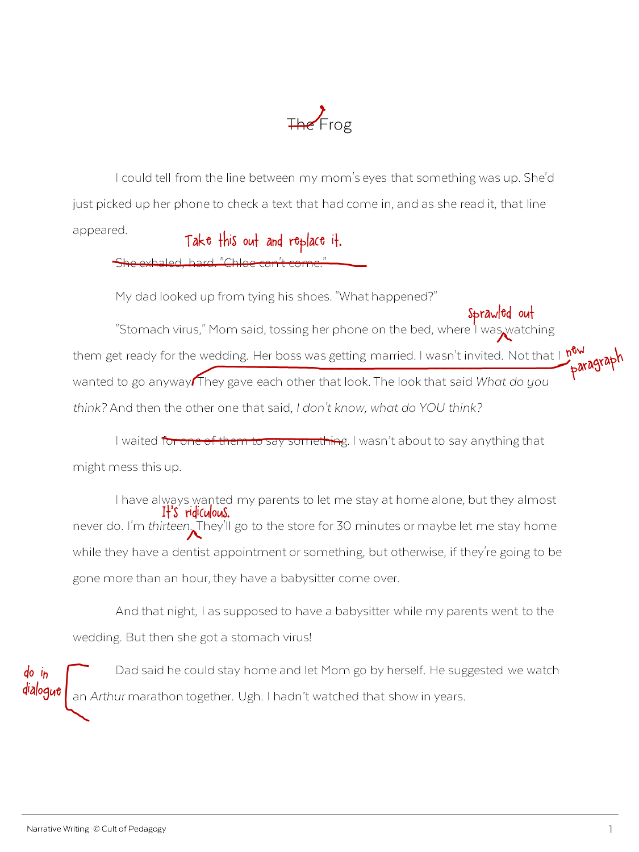
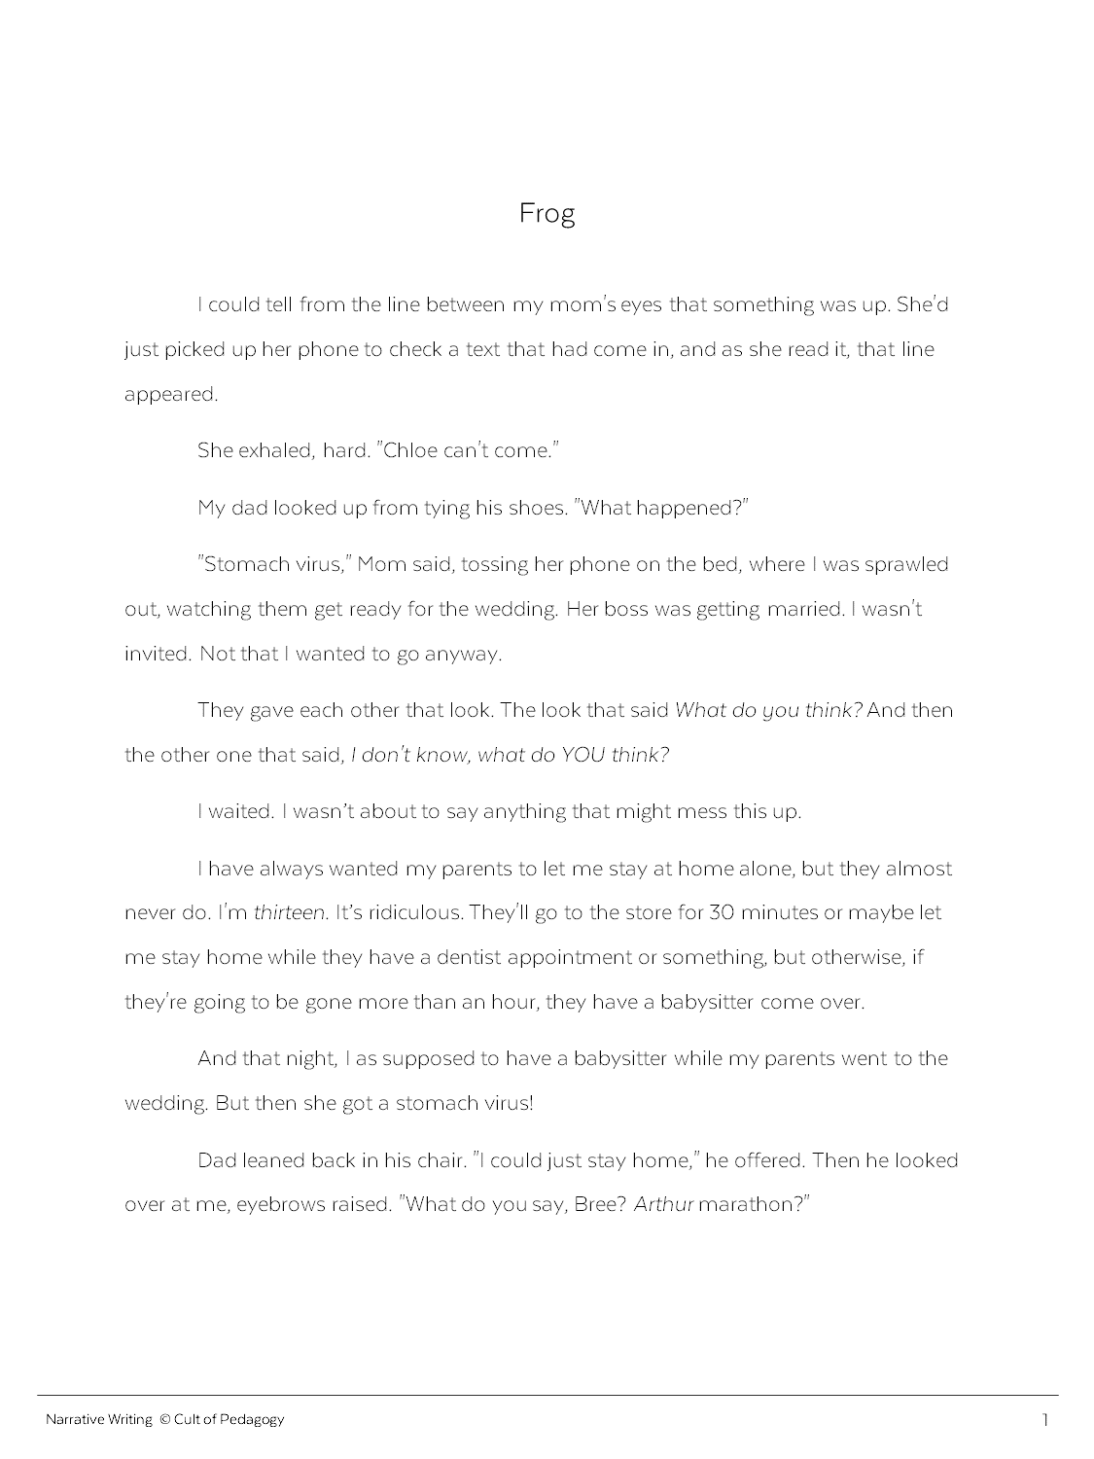
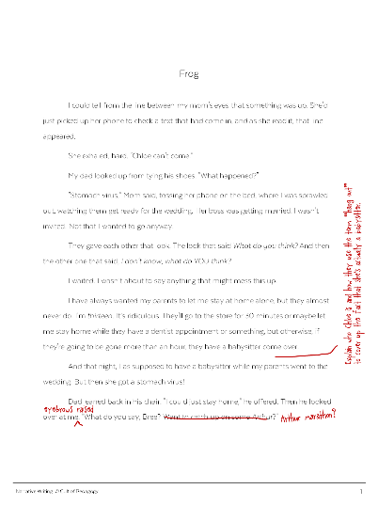
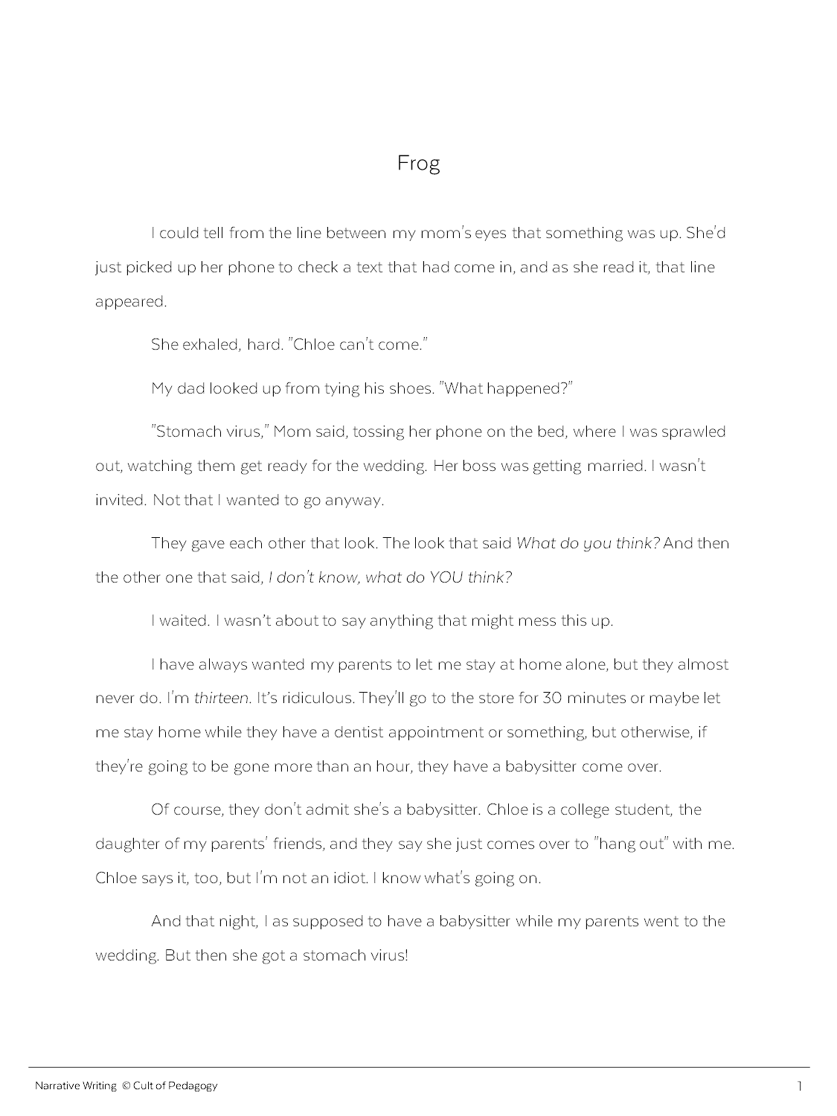
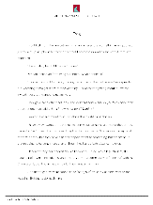
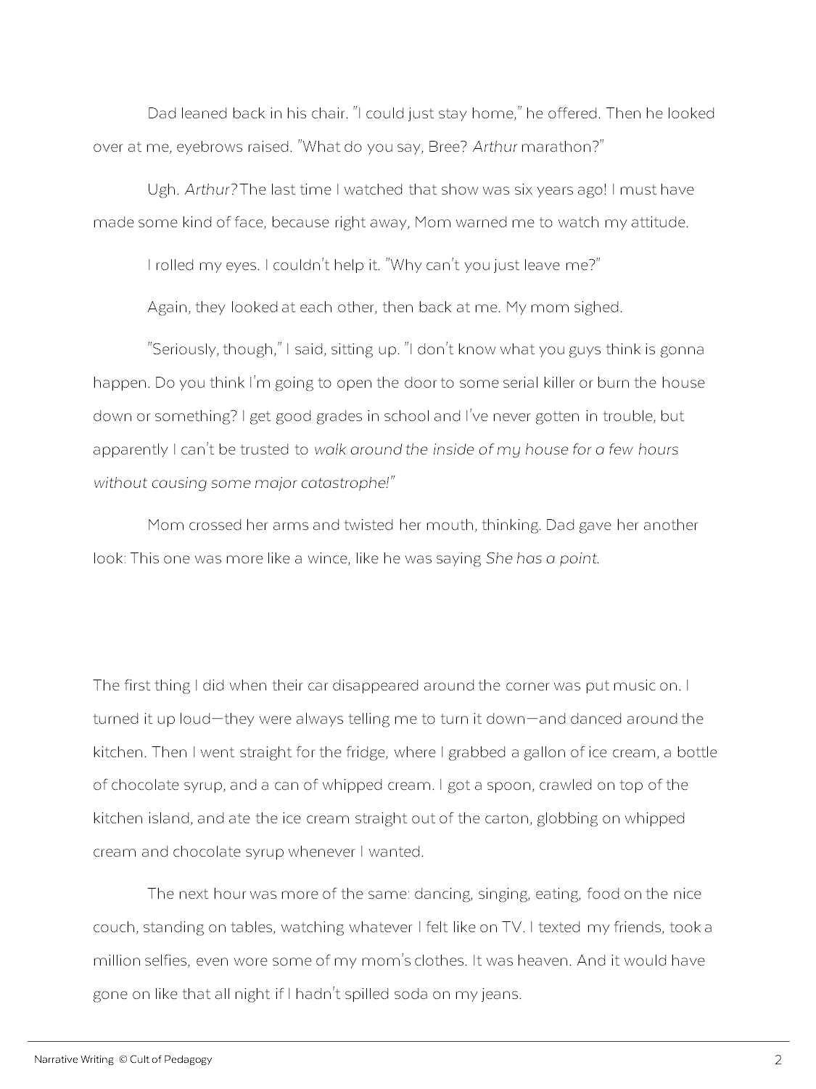
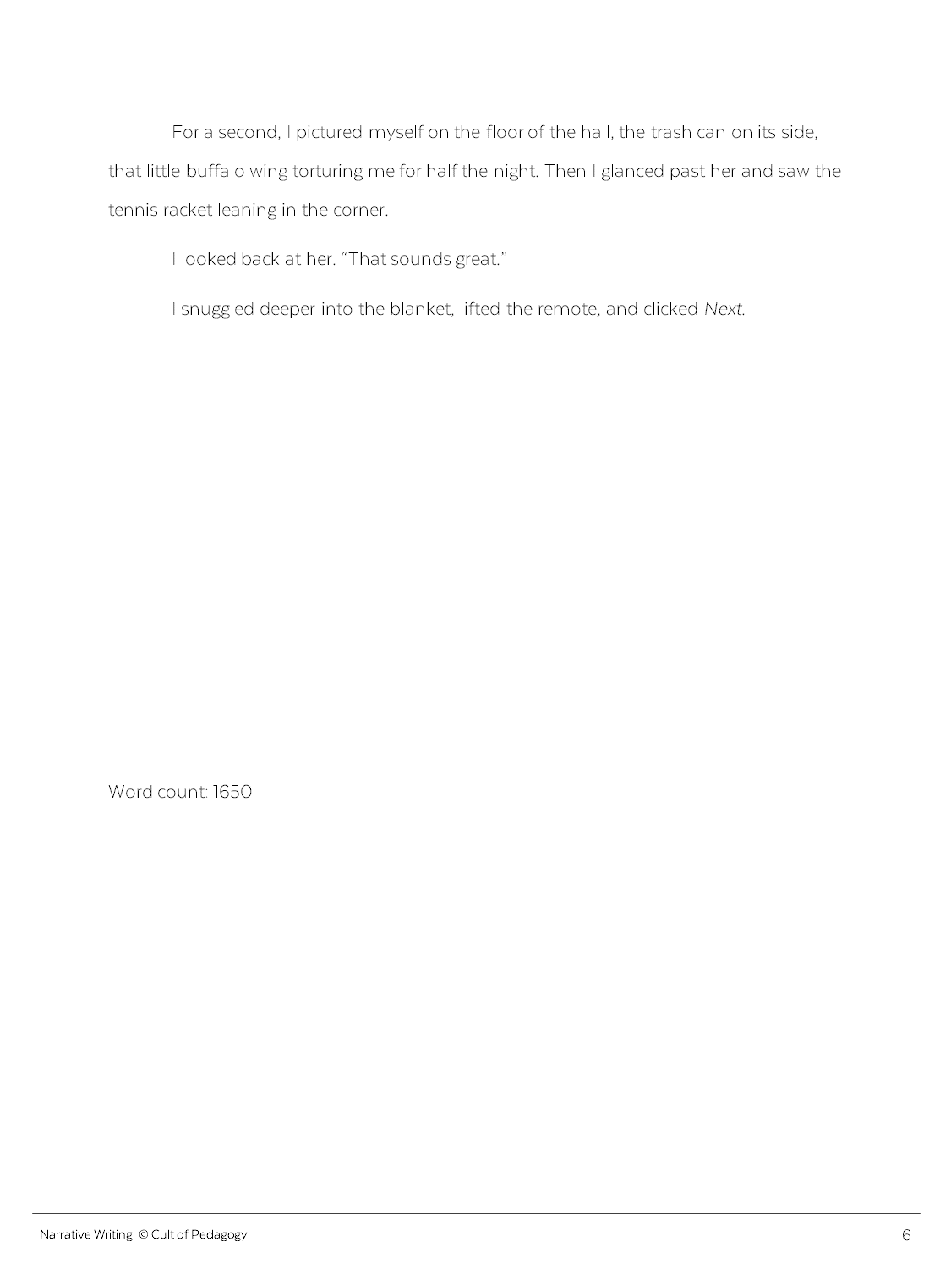
DONE!
Notes:
At some point, you’ll start to feel like your story is finished. (*) But all stories can be improved, and some of the best ones out there get revised many times before they are ever published. To improve your story, you need to revise it. In this lesson, we’ll look at two different strategies for revision: one you do on your own, and one you do with a classmate.

Slide 49
Self-Review
Print it out.
Read it out loud.
Review the rubric.
Repeat.
Notes:
The first strategy is self-review. You can do a lot on your own to review and revise your own writing. Here are some tips to make the most of that:
(*) Print it out. If you can, print out your story when you think it’s done. Looking at it on paper will always help you see things you don’t see on a screen.
(*) Read it out loud. This is one of the BEST things you can do to improve your writing. Slowly and carefully, actually read your story out loud—you will notice things that you just don’t notice otherwise. When you come to places that sound wrong or need changing, just mark these places so you can change them later.
(*) Review the rubric. Go over the rubric that your teacher will use to grade your story, and look for evidence that you’ve done what’s required. If you haven’t, then you need to make some changes to your story.
(*) Repeat. Once you’ve revised your story, go back to the beginning of this list and do it again. You’ll be amazed at how many new things you find that you want to change the second time around.

Slide 50
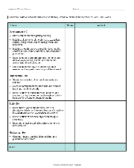
Peer Review
After reading your story, a peer could:
Summarize it
Use the rubric to “score” it
Point out three places that are working, and three places that need improvement
Notes:
The second strategy is peer review. This is where another classmate reads your story and gives you feedback. After reading your story, a peer could:
Summarize it. Having someone else tell you what your story is about is a good way to see if you wrote the story you wanted to write.
Use the rubric to “score” it. This will help you see if you are missing any requirements.
Point out three places that are working, and three places that need improvement. This helps you see what you’re doing right and where you need improvement.
A peer could do all three of these things at once, of course.

Slide 51
Guidelines for Giving Helpful Feedback
Early rounds are not for editing.
Notes:
When you are giving feedback to your peers, follow these guidelines for giving helpful feedback.
(*) First: Early rounds are not for editing. When you and your classmates are revising stories, you should be adding details, reorganizing things, and developing the story. This is not the time to go through and fix spelling or punctuation errors.

Slide 52
I empteid the small trash can in my room. I headed back out in to the hall. I saw that the frog was still there. I took a step toward him, but he didnt move. I hovered just above him him with the trash can. I could see that little bulgy thing under his neck. it pulsed as he breathed.
Notes:
Here’s an example: This paragraph needs more sentence variety. It also has a few errors. If you spent all your time marking up the errors, it would take everyone’s attention away from the words themselves. This writer first needs to improve her sentence variety, and after that—after she has chosen and arranged all the words in the best way possible—THEN she can make sure they’re all spelled right.
If you only focus on things like spelling and punctuation in the early rounds of peer review, the story will just be correct, but it might not be any good. So for now, ignore spelling, grammar, and punctuation, unless it actually gets in the way of understanding the story.

Slide 53
Guidelines for Giving Helpful Feedback
Early rounds are not for editing.
Start with praise.
Notes:
The next guideline is to start with praise. Before you give someone feedback about what is NOT working with their story, point out a few things that ARE working.

Slide 54
Guidelines for Giving Helpful Feedback
Early rounds are not for editing.
Start with praise.
Be specific.
Notes:
Also, be specific with all of your feedback. It’s much more helpful to point out one sentence that is especially good than to just say “Good story.”

Slide 55
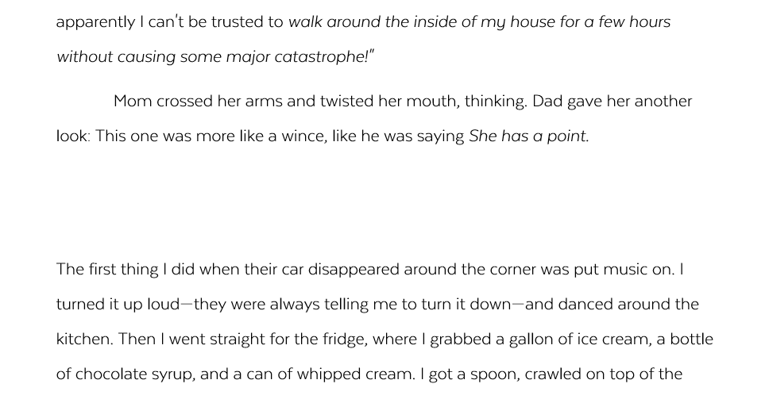
I like how you jumped to the next scene and let the reader figure out what happened.
Notes:
In this example, the reviewer is describing what they like about one particular part of the story, where the writer didn’t tell everything that happened at the end of a scene, but left a space instead, and let the reader figure out what happened. When you notice the writer doing something interesting, try to find the words to explain why you like it, and tell them that.

Slide 56
I emptied the small trash can in my room. I headed back out into the hall. I saw that the frog was still there. I took a step toward him, but he didn’t move. I hovered just above him with the trash can. I could see that little bulgy thing under his neck. It pulsed as he breathed.
Choppy sentences.
Good action here. Needs more sentence variety.
Notes:
This advice is the same for criticism. The sentences in this paragraph are all about the same length, and they all start in a similar way. Instead of just saying something like (*) “choppy sentences,” it’s more helpful to try and find something positive to say first, then give specific feedback about the problem that needs to be fixed. (*) The paragraph does contain some good action, so this reviewer says that first, then adds that it needs more sentence variety.

Slide 57
Guidelines for Giving Helpful Feedback
Early rounds are not for editing.
Start with praise.
Be specific.
Offer suggestions with criticism.
Notes:
Another guideline is to offer suggestions with your criticism. Whenever you can, try to give the writer some kind of advice about what they should do to fix a problem, rather than just pointing out the problem.

Slide 58
I emptied the small trash can in my room. I headed back out into the hall. I saw that the frog was still there. I took a step toward him, but he didn’t move. I hovered just above him with the trash can. I could see that little bulgy thing under his neck. It pulsed as he breathed.
Good action here. Needs more sentence variety—
try starting them in different ways.
Notes:
So back to this same example, after pointing out that the paragraph needs more sentence variety, you could (*) add the suggestion to try starting the sentences in different ways.

Slide 59
"Hi," Tina said.
"Hi," Brian said.
"What are you doing?" Tina asked.
"Not much," Brian said.
"Oh," Tina said.
Use better dialogue.
This section could be skipped, since nothing really important happens.
What was the most interesting part of the conversation? You could start the dialogue there.
Notes:
So what if you don’t have anything positive to say? You don’t have to always find something to praise, but remember the other tips. In (*) this example, this writer just needs to know that this dialogue is not really working at all. Instead of saying something like (*) “Use better dialogue,” the reviewer could suggest that (*) this section could be taken out, since nothing really important happens. Then, they could add a suggestion to improve it even more: (*) “What was the most interesting part of the conversation? You could start the dialogue there.” This feedback really helps the writer get better.

Slide 60
Guidelines for Giving Helpful Feedback
Early rounds are not for editing.
Start with praise.
Be specific.
Offer suggestions with criticism.
Describe your feelings as a reader.
Notes:
The last tip is to describe your feelings as a reader. (click to next slide)

Slide 61
“I got confused here.”
“This part made me laugh.”
Notes:
Using comments like, “I got confused here,” or “This part made me laugh,” remind the writer that they are writing for an actual audience, and the choices they make will change how the readers experience their story.

Slide 62
Confusing!
I got confused here.
Notes:
And especially if you’re giving criticism, saying something like (*) “I got confused here” is easier for the writer to accept than if you’d just written “confusing.”

Slide 63
NOW:
Do a self-review of your story by reading it out loud. Remember to go slow and mark places you’d like to change.
Have at least one peer read your story and give you feedback. When you are giving feedback, remember the guidelines from this lesson: don’t focus on editing, start with praise, be specific, offer suggestions, and describe your feelings as a reader.
Notes:
(Read slide.)

Slide 64
Wednesday December 2, 2020
Learning Target(s)
Students will type their rough draft
Students will print out their rough draft and share it with a classmate for peer review
Activities: Get the computer that corresponds with your current seat number and log in
Type your rough draft
Review your work
Peer review another persons story

Slide 65
Typing Time!
WE ARE….
Review your paper according to the notes you have received and any adjustments I have told you to make.
Login to Teams and look for the Embedded Assessment 1 assignment.
Put your heading on your paper just as you would if it were a regular assignment in class
Center the title of your story
Type your paper as expressed on the assignment documents I gave to you when we started this project.
Patriot Strong!

Slide 66
Thursday December 3, 2020
Learning Target(s)
Students will type their rough draft
Students will print out their rough draft and share it with a classmate for peer review
Activities: Get the computer that corresponds with your current seat number and log in
Type your rough draft
Review your work
Peer review another persons story

Slide 67
Typing time and Peer review
WE ARE….
Typing Time!
Peer Review- You may only review one person’s story.
Review your paper according to the notes you have received and any adjustments I have told you to make.
Login to Teams and look for the Embedded Assessment 1 assignment.
Put your heading on your paper just as you would if it were a regular assignment in class
Center the title of your story
Type your paper as expressed on the assignment documents I gave to you when we started this project.
Print out your finished rough draft when you are done.
Do the self review from your notes.
Follow the example given to you in your notes for peer review.
Use the sticky notes, space between lines, and/or the margins of the paper to add helpful commentary.
Be kind but truthful
Be specific
Be helpful by expressing how the writing appeals to you and by using an I statement and give a way to fix it.
Grade the paper according to the rubric
Sign the paper to show that you reviewed it
Return the paper to the owner
Make needed corrections and turn in your paper.
Patriot Strong!

Slide 68
Friday December 4, 2020
Learning Target(s)
Students will type their rough draft
Students will print out their rough draft and share it with a classmate for peer review
Students will make last adjustments to their story and click turn in
Activities: Get the computer that corresponds with your current seat number and log in
Type your rough draft
Review your work
Peer review another persons story
Turn in revised Final Draft

Slide 69
Typing time and Peer review
WE ARE….
Typing Time!
Peer Review- You may only review one person’s story.
Review your paper according to the notes you have received and any adjustments I have told you to make.
Login to Teams and look for the Embedded Assessment 1 assignment.
Put your heading on your paper just as you would if it were a regular assignment in class
Center the title of your story
Type your paper as expressed on the assignment documents I gave to you when we started this project.
Print out your finished rough draft when you are done.
Do the self review from your notes.
Follow the example given to you in your notes for peer review.
Use the sticky notes, space between lines, and/or the margins of the paper to add helpful commentary.
Be kind but truthful
Be specific
Be helpful by expressing how the writing appeals to you and by using an I statement and give a way to fix it.
Grade the paper according to the rubric
Sign the paper to show that you reviewed it
Return the paper to the owner
Make needed corrections and turn in your paper.
.
Patriot Strong!

Slide 70
Reviewing before turning it in
Self review
Peer review
Print it out
Read it out loud
Review it using the rubric
Repeat 2 -3
Summarize the story to the author
Use the rubric to grade it
Point out 3 highlights and 3 lowlights
Use the sticky notes, space between lines, and/or the margins of the paper to add helpful commentary.
Be kind but truthful
Be specific
Be helpful by expressing how the writing appeals to you and by using an I statement and give a way to fix it.

