Slide 1
Week
Nuts and Bolts Continue

Slide 2
Monday August 14, 2023
Learning Target(s)
Students will learn about and discuss expectations for each aspect of the class.
Activities:
• Get your school supplies
• Get your paperwork completed and turned in
• Get to know the classroom expectations and procedures
• Paperwork due Friday

Slide 3
English I Class Expectations: 3 Bs
Yeah… This again.

Slide 4
Things to consider…
WE Have….
What do you need to feel or be safe?
What do you need to feel or be respected?
What do you need to feel or be responsible?
How does those things look, feel, and sound at school?
Panther Pride!

Slide 5
Class Mantra
Teacher- I am the safe keeper. My job is to keep it safe.
Students: My job is to help keep it that way

Slide 6
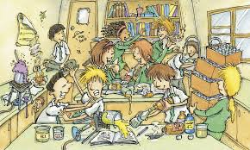
B: Safe
Physical Safety
Keep hands and feet to self
Four on the floor- Keep all points of the chair legs on the floor and keep your feet on the floor
Don’t throw things
Emotional/Mental Safety
Use kind/safe words
Use kind/neutral facial and other expressions
Conversate about school appropriate subjects or in nonaggressive, non-mocking or shaming manner
Academically
Do authentic Work
Give your best

Slide 7
Be: Respectful
Physical Respect
Ask for permission to enter other’s space or touch them or their things
Keep hands and feet to yourself and don’t throw things
Emotional/Mental Respect
Use helpful comments ( try not to embarrass or speak poorly of others)
Conversate about school appropriate subjects or in nonaggressive and non-mocking or shaming manner
Academic Respect
Do your own work to the best of your ability
Try your best

Slide 8
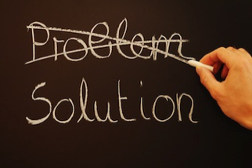
B: Responsible
Physical Responsibility
Own what you do to or around others. (You control you and no one else. No one makes you do anything.)
Emotional/Mental Responsibility
Own what you say and the gestures you make to or around others
Academic Responsibility
Be on time ( to school, class, and with your work)
Know what you are supposed to be doing and learn how to do it.
Try your best

Slide 9
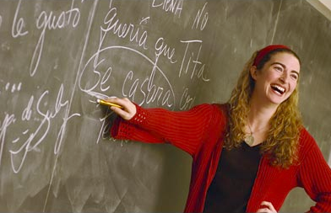
Positive Indicators
The teacher is able to teach the entire lesson for the day
The class (individuals) contribute positively to the lesson
The class (individuals) make adequate progress on the lesson as expected by the teacher and should be expected of one’s self.
The class (individuals) stay in a positive or neutral mood throughout the day/class.

Slide 10
Tuesday August 15, 2023
Learning Target(s)
Students will participate in a syllabus scavenger hunt
Students will create a Student Identification card
Activities:
Continue Norms and Expectations
Continued Activities
Get your school supplies
Get your paperwork completed and turned in

Slide 11
Class Mantra
Teacher- I am the safe keeper. My job is to keep it safe.
Students: My job is to help keep it that way

Slide 12
How will we be successful ?
WE Have….
Panther Pride!

Slide 13
Let’s Be CHAMPS
C
Conversation- What is the level of talking allowed?
H
Help- How do I get help?
A
Activity- What are we doing and what can we do?
M
Movement- Am I aloud to get up for any reason?
P
Participation-What level of participation is expected from me?
S
Success- If we have clear understanding and practice of the things above, we will have success.

Slide 14
Direct Teach and Presentations
C
Talking or noise at level i 0 unless called on
H
Raise your hand and wait to be called on if you to comment or ask questions
A
Taking notes, Listening, Answering questions
M
Everyone is to stay in their assigned seat or area for duration of the lesson. CC
P
Head up and eyes on the speaker
Open to correct page or has correct items ready
follow along
ask relevant questions, and make relevant comments
S
Success

Slide 15
Group Work
C
Talking and noise at level 2.
H
Raise your hand
Approach the teacher
Call the teacher
A
Work with your group
Attend to your assigned task(s)
M
Gathering materials
Restroom or water needs
That which is need for the task
Approach teacher
CC
P
Completed or earnestly attempted the work
Interact with your group members positively by helping with the task
S
Success

Slide 16
Individual Work
C
Talking or noise at level 0
H
Raise your hand
Call the teacher
Approach the teacher
A
Working in assigned area
M
Restroom or water
Approach Teacher
CC
P
Reading
Writing
Annotating
Questioning
S
Success

Slide 17
Assessment and Quiz Time
C
Talking and Noise at Level 0
H
Raise your hand
A
Attend to the assigned work
M
Restroom or Water
CC
P
Reading
Writing
S
Success

Slide 18
Entering Class
C
Talking and noise at level 2
H
Approach or call the teacher
A
Prepping for class
M
Putting belongings in designated space
Going to seat
P
Put away belongings
Take out what is needed
Sit in your assigned seat
Attempt the bell ringer
S
Success

Slide 19
Partner Work
C
Talking and noise at level 1
H
Raise hand
Approach teacher
Call teacher
A
Assigned task
M
Approach teacher
Restroom or water
CC
P
Completed or earnestly attempted the work
Interact with your partner positively by helping with the task(s)
S
Success

Slide 20
Chill Chamber
C
Talking and noice at level 0
H
Raise hand
Approach teacher
A
Pick a calming chill activity and set the 5-minute timer
M
Approach teacher
Move to the Chill Chamber
P
Quiet
Timer is set
Return to assigned area and start work
S
Success

Slide 21
Would you Rather
“Aw.. Heck naw!”

Slide 22
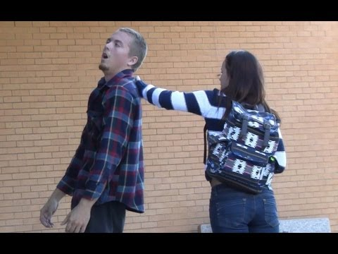
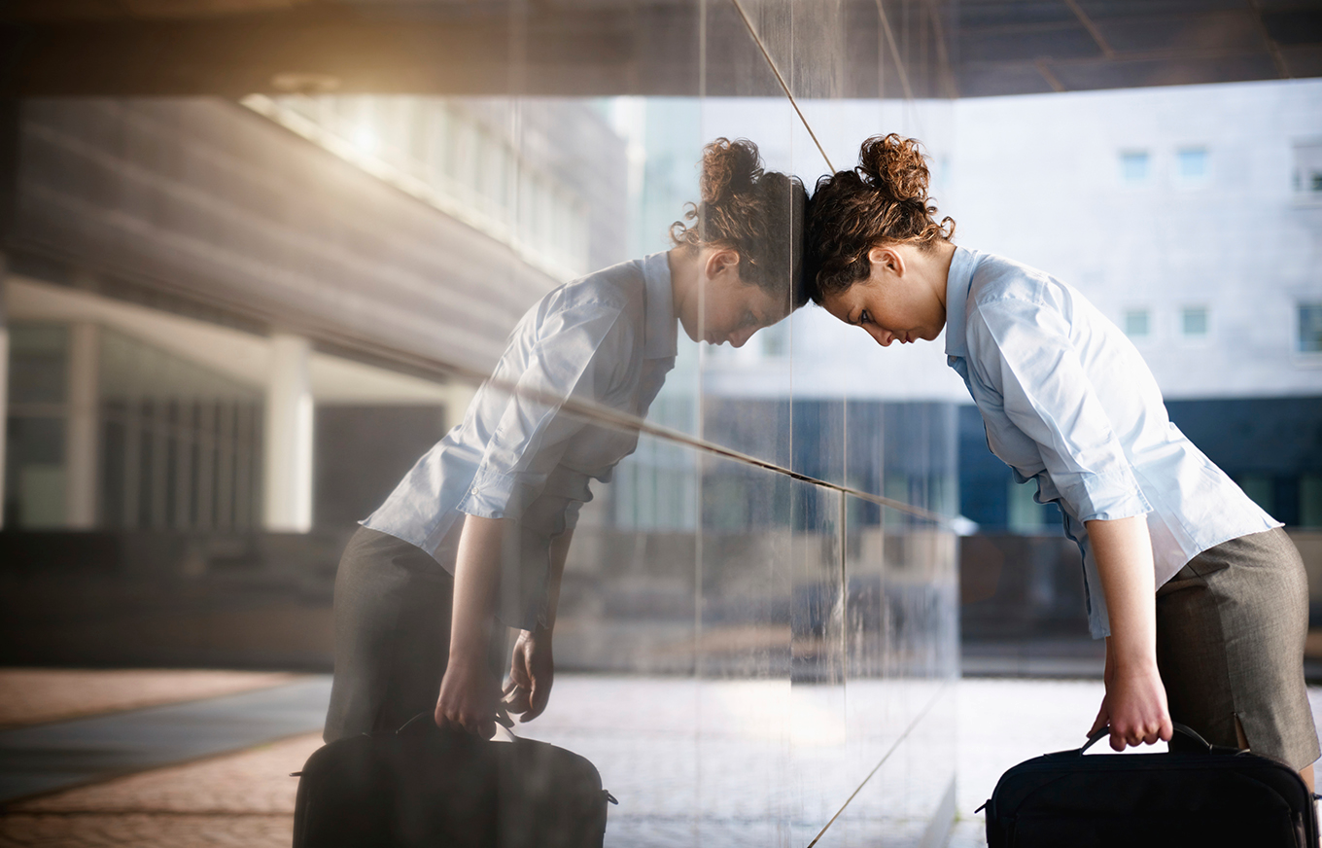
Would You Rather
Please scratch my back!
I did take a bath!
Be itchy every day for all of your life
Or
Be sticky everyday for all of your life

Slide 23
Would you rather
“What?”
“Jerk!”
Never to be able to tell the truth
Or
Never be able to tell a lie

Slide 24
Would you Rather
“Stank Breath”
“Toxic Waste”
Smell like rotten eggs when you talk
or
Have a green cloud appear when you fart

Slide 25
Would you rather
“Life is good! “
“Life is Good!”
Live in a tightly controlled society that is perfectly safe
Or
Live in open a free society that has lots of danger

Slide 26
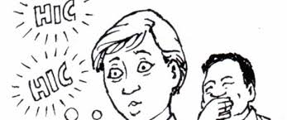
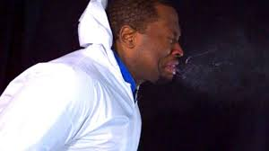
Would you Rather
“Can you get a word out?”
“Say it don’t Spray it!”
Have the hiccups all day every day for the rest of your life
or
Have to sneeze all day everyday for the rest of your life

Slide 27
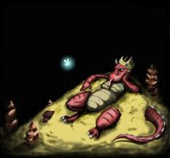
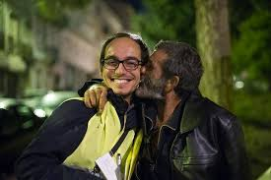
Would you rather
Mind on my Money; Money on my mind
Everybody Loves Raymond
Live like a King but have no friends or family
Or
live like a homeless person and have many friends and family

Slide 28
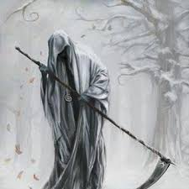
Would you Rather
Today is the Day!
Oh the pain!
or
Know when you are going to die
Know how you are going to die
Fait Can Not Be Challenged

Slide 29
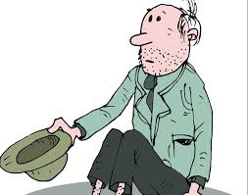
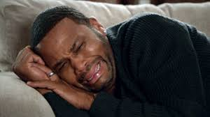
Would You Rather
Denied!!!!
or
Memories… why!?
lose all of your memory and Knowledge of Family and Friends
Lose all the Memory and Knowledge of the world

Slide 30
Would you Rather
“Well, Well. well”
“Only one!”
Have 7 wishes granted by the devil
Or
Have one wish Granted by God

Slide 31
Wednesday
Learning Target(s)
Students will review code of conduct before quizzing after 6th period today.
Students will explore their learning style and personality type
Activities:
Code of Conduct review
Scavenger Hunt (Group Grade)
Continued Activities
Get your school supplies
Get your paperwork completed and turned in
Friday

Slide 32
Class Mantra
Teacher- I am the safe keeper. My job is to keep it safe.
Students: My job is to help keep it that way

Slide 33
Syllabus Scavenger Hunt
WE Have….
Directions: Using your syllabus, answer the following questions on a sheet of paper. The first group to complete this correctly will get a treat.
How many points are taken away for each day late?
What is my email address?
What is the name of the program that allows student, teacher, and parent contact?
How do you earn extra credit?
What percentage grade are bell ringers?
How many colors of utensils should you have?
What are two themes we will cover this year?
What percentage of your grade are book projects?
How many days late can you be with work?
How do you get to redo or make up a test or quiz?
Panther Pride!

Slide 34
Thursday
Learning Target(s)
Students will prep their notebooks for use.
Activities:
Prep Binders for the year
Complete the learning style survey
Complete the color personality survey
Materials needed:
Binder
Dividers
Pen or Pencil
Syllabus
Paper

Slide 35
Class Mantra
Teacher- I am the safe keeper. My job is to keep it safe.
Students: My job is to help keep it that way

Slide 36
Binder Set up
WE Have….
Calendar
Reference
Assignments
Bell Ringers
Book Logs
Panther Pride!

Slide 37
Building your Calendar
WE Have….
Create the following calendar on a sheet of lined paper.
In the empty space at the top write Activities Calendar p. 1
Starting with the first line draw a line down the middle of the page vertically.
Count down from the first line ten to eleven lines and draw a line horizontally across the page.
Count ten to eleven lines down and draw another line horizontally across the page.
Starting with the upper left corner square begin labeling each square moving down for the days of the week
Example on next slide. Copy it word for word.
Panther Pride!

Slide 40
Reference pages
WE Have….
Page 1: Your syllabus is your first reference page. Place it behind the reference tab.
Page 2: Heading page- Create your heading the way I will display it on the next slide. That will be page 2
Page 3: Learning Style Survey
Page 4: Exploring your Color Survey
Panther Pride!

Slide 42
Learning Styles Survey
WE Have….
You will take a survey that helps you to understand what type of learner you are and how to best study.
One person from each table will come get a copy of the survey for each person at your table.
Take out a sheet of paper and number from one to fourteen. (You do not need to skip lines)
You will answer the questions with a K, V, or A. Choose the one that best fits you if you had no other way you could have it done.
Total up your K, V, and A answers to see which one you have the most of.
Then come to the front with your survey to turn in the survey and get the explanation page.
Write down 3-5 strategies on your answer page for your learning style
Put that answer page in your reference section behind your heading.
Panther Pride!

Slide 43
Friday
Learning Target(s)
Students will complete a writing in which they tell the teacher about themselves.
Activities:
Complete the learning style survey Due 8/18
Complete the color personality survey Due 8/18
About Me Due 8/18
Materials needed
Binder
Paper
Pencil or pen
Reminders
1st period: Turn in all paperwork.
All periods: Check the hanging folder by the front door if you missed Wednesday or Thursday.

Slide 44
Class Mantra
Teacher- I am the safe keeper. My job is to keep it safe.
Students: My job is to help keep it that way

Slide 45
Exploring your Colors
WE Have….
One person will come get an Exploring your colors page from the front for each person in your group as well as an answer document.
Wait for further instructions once you receive your documents. I will explain and help you through the first task.
Once you are finished You will bring your Exploring colors survey to the front and get the explanation page.
Write the information of the color you scored highest in on the back of your answer document. Then, place your answer document in the reference section behind the Learning styles survey.
When that is done. Come to the front to get the About Me student survey. Complete it and turn it in to the hanging basket for your class.
Panther Pride!

Slide 46
Number | A | B | C | D
1 | 1 | 3 | 4 | 2
2 | 1 | 2 | 3 | 4
3 | 2 | 3 | 4 | 2
4 | 2 | 1 | 3 | 4
5 | 1 | 3 | 4 | 2
6
7
8
9
10
11
Totals
Use your totals to fill in the blanks below
________ a Orange
_________ b Blue
_________ C Green
_________ D Gold

